Slide 1

Introduction to Operating Systems
Unit I

Slide 2
OBJECTIVES
Understand the structure and functions of operating systems
Learn about processes and process scheduling in detail.
Understand the basics of process synchronization techniques
Learn about different memory management techniques
Understand various input, output and file management functions of operating system

Slide 3
Course Outcomes Upon successful completion of this course, students are expected to have the ability to:
• Describe and explain the fundamental components of a computer operating system.
• Define, restate, discuss, and explain the policies for scheduling, deadlocks, memory management, synchronization, system calls, and file systems
• Describe and extrapolate the interactions among the various components of computing systems. [ABET (a), (i), (j), (k)] Assessment: Students will take midterm exams, final exams, and homework.
• Design and construct the following OS components: System calls, Schedulers, Memory management systems, Virtual Memory and Paging systems
• Illustrate, construct, compose and design solutions via C/C++ programs

Slide 4
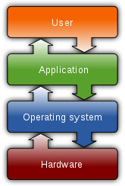
What is an Operating System?
Operating system (OS) is system software that manages computer hardware, software resources, and provides common service for computer programs.
Acts as an intermediary between a user and the computer hardware.
Operating system goals:
  Execute user programs and make solving user problems easier.
  Make the computer system convenient to use.
  Use the computer hardware in an efficient manner.

Slide 5
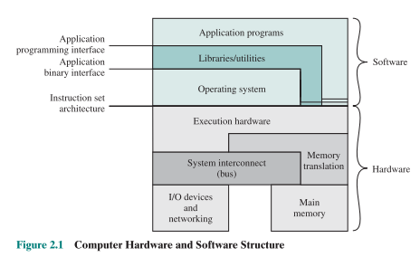
Objectives of Operating System
Convenience: An OS makes a computer more convenient to use.
Efficiency: An OS allows the computer system resources to be used in an efficient manner.
Ability to Evolve: An OS should be constructed in such a way as to permit the effective development, testing and introduction of new system functions at the same time without interfering with service.

Slide 6
A more common deﬁnition, and the one that we usually follow, is that the operating system is the one program running at all times on the computer—usually called the kernel.
Along with the kernel, there are two other types of programs:
systems programs, which are associated with the operating system but are not part of the kernel,
application programs, which include all programs not associated with the operation of the system.

Slide 7
Functions of Operating System
To make the computer system convenient to use in an efficient manner.
To provide users a convenient interface to use the computer system by hiding the details of the hardware resources from the users.
To act as an intermediary between the hardware and its users, making it easier for the users to access and use other resources.

Slide 8
Functions of Operating System
To manage the resources of a computer system and provide efficient and fair sharing of resources among users and programs.
To keep track of who is using which resource, granting resource requests, and mediating conflicting requests from different programs and users.

Slide 9
Characteristics of Operating System
Processor Management − Allocates the processor (CPU) to a process and deallocates the processor when it is no longer required.
Memory Management − Keeps track of the primary memory, i.e. what part of it is in use by whom, what part is not in use, etc. and allocates the memory when a process or program requests it.
Device Management − Keeps track of all the devices. This is also called I/O controller that decides which process gets the device, when, and for how much time.

Slide 10
Characteristics of Operating System
Security − Prevents unauthorized access to programs and data by means of passwords and other similar techniques.
Job Accounting − Keeps track of time and resources used by various jobs and/or users.
Control Over System Performance − Records delays between the request for a service and from the system.

Slide 11
Characteristics of Operating System
Interaction with the Operators − Interaction may take place via the console of the computer in the form of instructions. The Operating System acknowledges the same, does the corresponding action, and informs the operation by a display screen.
Error-detecting Aids − Production of dumps, traces, error messages, and other debugging and error-detecting methods.
Coordination Between Other Software and Users − Coordination and assignment of compilers, interpreters, assemblers, and other software to the various users of the computer systems.

Slide 12
Operating-System Services
operating system services are provided for the convenience of the programmer, to make the programming task easier.
User interface-
  command-line interface
  batch interface
  graphical user interface (GUI)

Slide 13
Program execution. The system must be able to load a program into memory and to run that program. The program must be able to end its execution, either normally or abnormally (indicating error).
I/O operations : A running program may require I/O, which may involve a ﬁle or an I/O device. For speciﬁc devices, special functions may be desired (such as recording to a CD or DVD drive or blanking a display screen). For efﬁciency and protection, users usually cannot control I/O devices directly. Therefore, the operating system must provide a means to do I/O.
File-system manipulation : programs need to read and write ﬁles and directories. They also need to create and delete them by name, search for a given ﬁle, and list ﬁle information. Finally, some operating systems include permissions management to allow or deny access to ﬁles or directories based on ﬁle ownership. Many operating systems provide a variety of ﬁle systems, sometimes to allow personal choice and sometimes to provide speciﬁc features or performance characteristics.

Slide 14
Communications : one process needs to exchange information with another process. Communications may be implemented via shared memory or message passing.
Error detection : For each type of error, the operating system should take the appropriate action to ensure correct and consistent computing. Sometimes, it has no choice but to halt the system. At other times, it might terminate an error-causing process or return an error code to a process for the process to detect and possibly correct.
For ensuring the efficient operation of the system itself.
Resource allocation : in determining how best to use the CPU, operating systems have CPU-scheduling routines that take into account the speed of the CPU, the jobs that must be executed, the number of registers available, and other factors. There may also be routines to allocate printers, USB storage drives, and other peripheral devices.

Slide 15
Accounting : We want to keep track of which users use how much and what kinds of computer resources. Usage statistics may be a valuable tool for researchers who wish to reconﬁgure the system to improve computing services.
Protection and security :
  requiring each user to authenticate himself or herself to the system
  defending external I/O devices - invalid access attempts and to recording all such connections for detection of break-ins

Slide 16
Objectives
Explain the steps taken by a processor to execute an instruction.
Understand the concept of interrupts and how and why a processor uses interrupts.

Slide 17
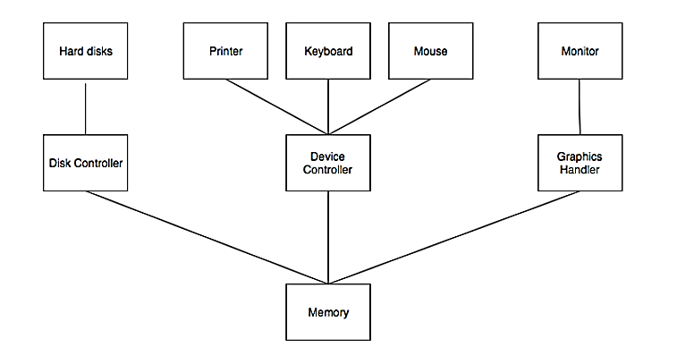
Computer System Organization
Computer system is a combination of many parts such as peripheral devices, secondary memory, CPU etc.

Slide 18
Computer System Organization
There are multiple device controllers, each is in charge of a particular device such as keyboard, mouse, printer etc.
There is buffer available for each of the devices. The input and output data can be stored in these buffers.
The data is moved from memory to the respective device buffers by the CPU for I/O operations and then this data is moved back from the buffers to memory.
The device controllers use an interrupt to inform the CPU that I/O operation is completed.

Slide 19
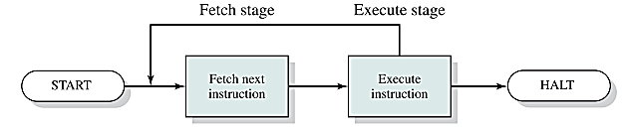
Instruction Execution
A program to be executed by a processor consists of a set of instructions stored in memory.
Instruction processing consists of two steps:
  The processor reads ( fetches ) instructions from memory one at a time and
  executes each instruction.
The processing required for a single instruction is called an instruction cycle.

Slide 20
The processor fetches an instruction from memory. Typically, the program counter (PC) holds the address of the next instruction to be fetched.
Unless instructed otherwise, the processor always increments the PC after each instruction fetch so that it will fetch the next instruction in sequence
This sequence may be altered, as explained subsequently.
The fetched instruction is loaded into the instruction register (IR).
The instruction contains bits that specify the action the processor is to take. The processor interprets the instruction and performs the required action (Processor-memory, Processor-I/O, Data processing, Control).

Slide 21
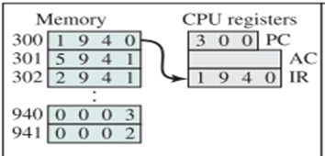
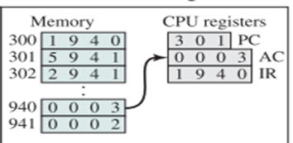
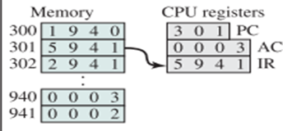
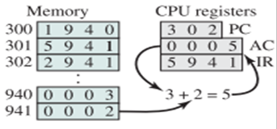
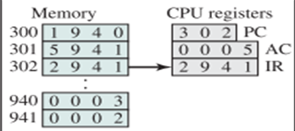
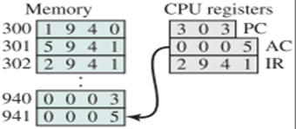

Slide 22
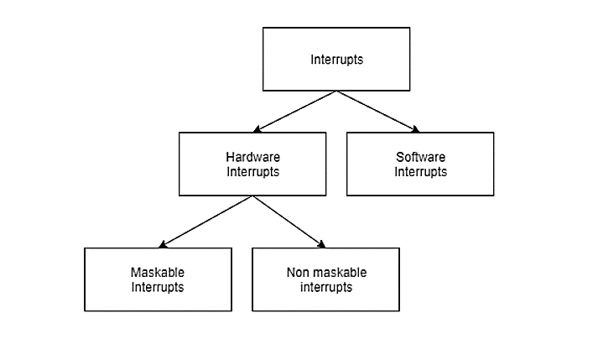
Computer System Organization
An interrupt can be generated by a device or a program to inform the operating system to halt its current activities and focus on something else.
Types of Interrupt

Slide 23
Interrupt
Provide a mechanism by which other modules (I/O, memory) may interrupt the normal sequencing of the processor.
Interrupts are provided primarily as a way to improve processor utilization
What if the processor is transferring data to a printer using the instruction cycle scheme ?

Slide 24
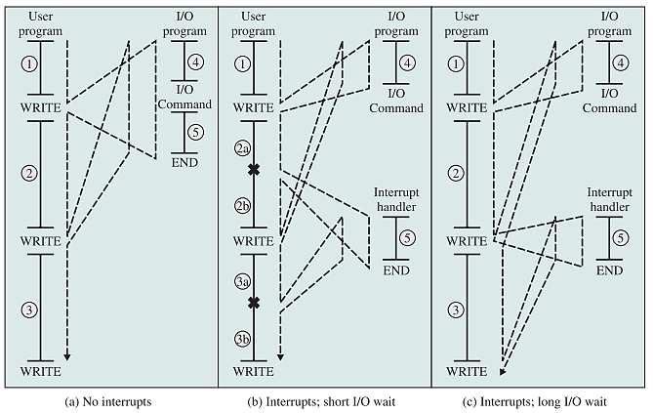
The dashed line represents the path of execution followed by the processor;

Slide 25
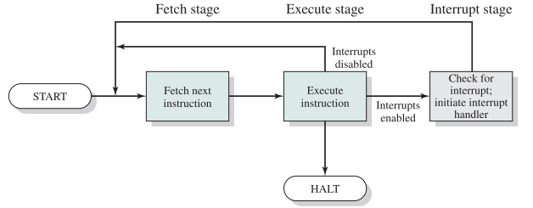
Interrupts and the Instruction Cycle
To accommodate interrupts, an interrupt stage is added to the instruction cycle

Slide 26
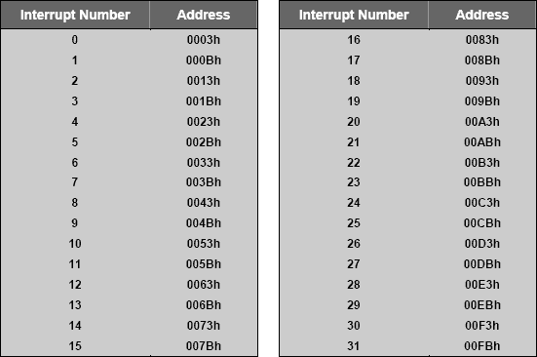
Interrupts
Interrupt transfers control to the interrupt service routine
  Interrupt Service Routine: Segments of code that determine action to be taken for interrupt.
Determining the type of interrupt
  Polling: same interrupt handler called for all interrupts, which then polls all devices to figure out the reason for the interrupt
  Interrupt Vector Table: different interrupt handlers will be executed for different interrupts
‹#›

Slide 27
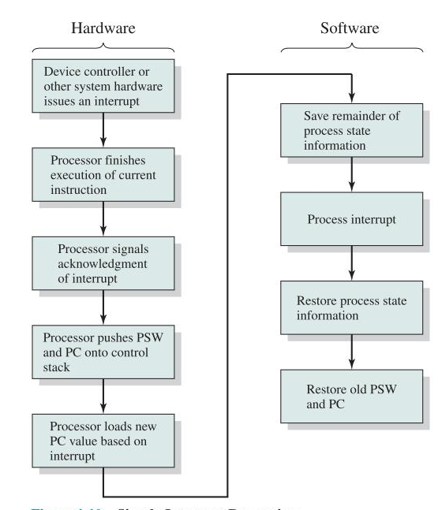
Interrupt
Processing

Slide 28
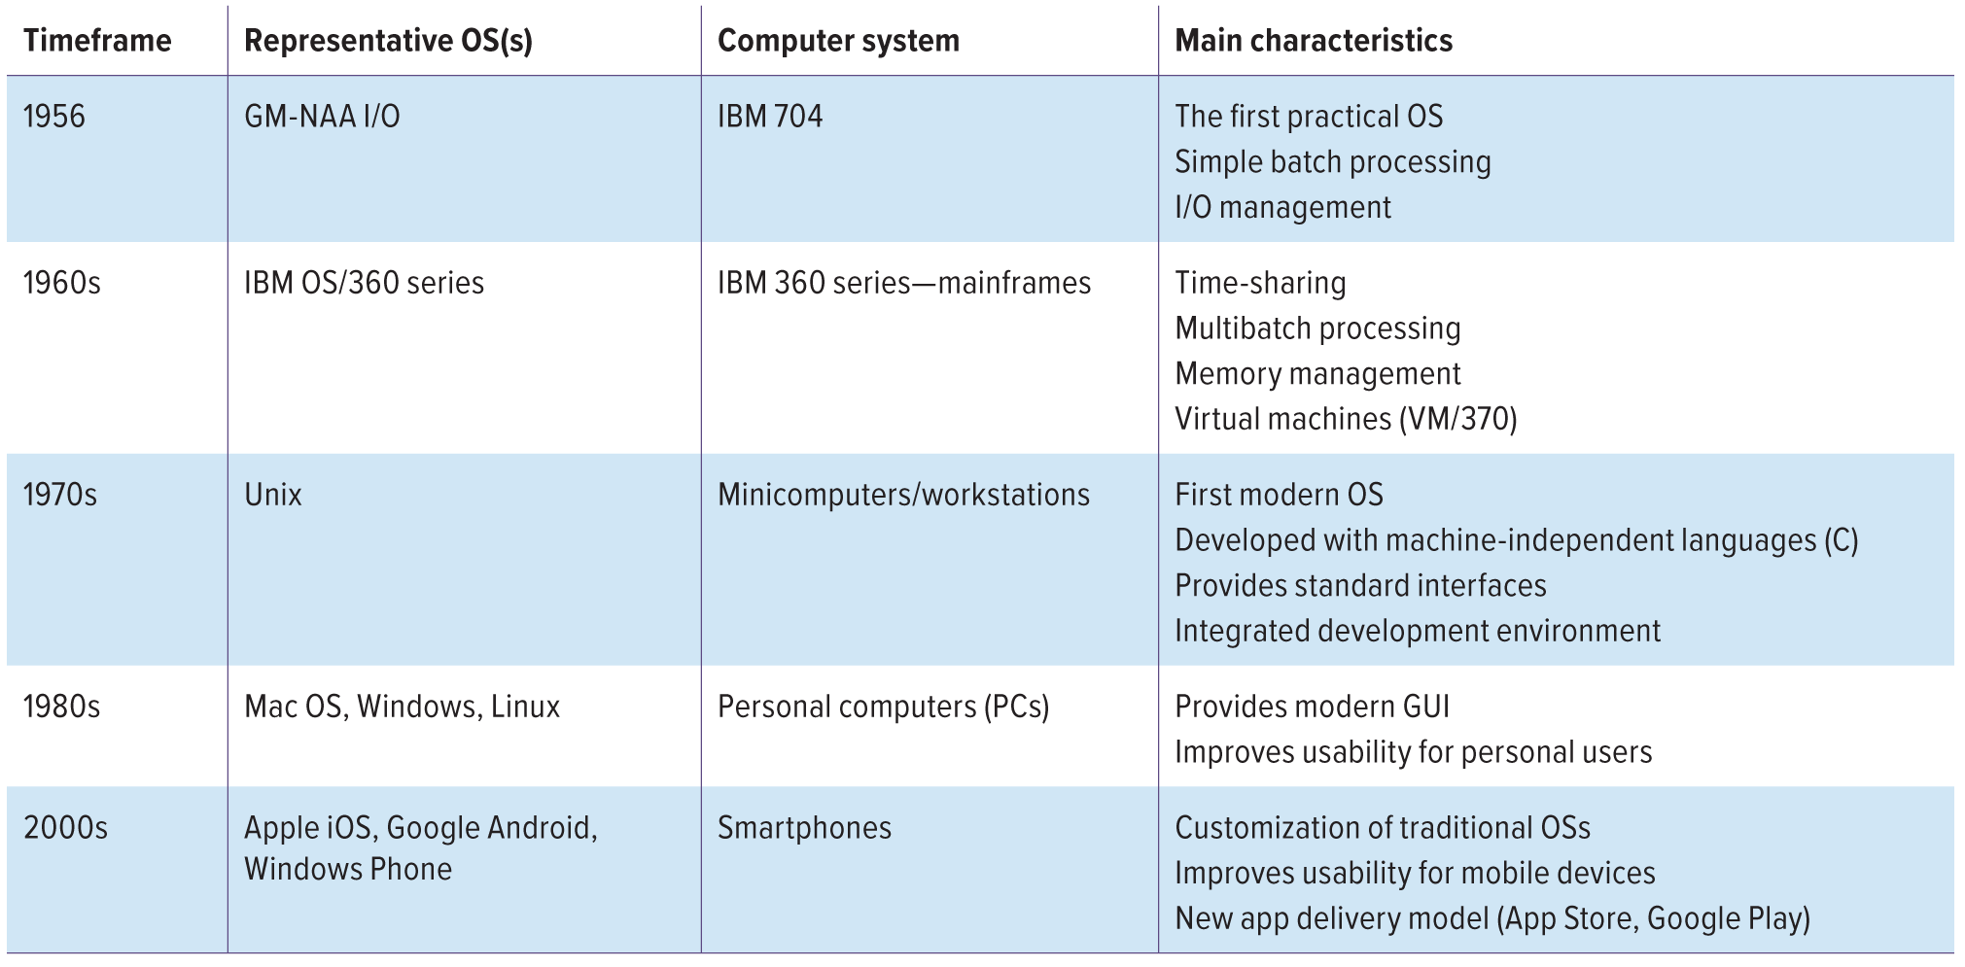
Evolution of Operating System

Slide 29
Evolution of Operating System
Serial Processing
Simple Batch Systems
Multi Programmed Batch Systems
Time-Sharing Systems
https://forms.gle/EKV9Du184pEik7dt8

Slide 30
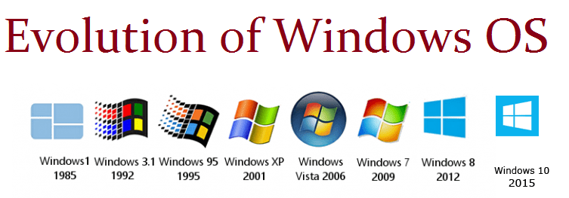

Slide 31
Operating System Spectrum
Monitors and Small Kernels
    special purpose and embedded systems, real-time systems
Batch and multiprogramming
Timesharing
    workstations, servers, minicomputers, timeframes
Transaction systems
Personal Computing Systems
Mobile Platforms, devices (of all sizes)
‹#›

Slide 32
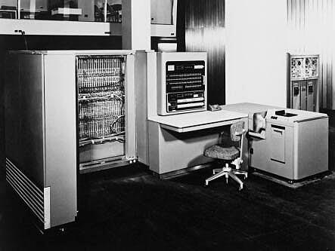
Early Systems - Bare Machine (1950s)
Structure
    Large machines run from console
    Single user system
      Programmer/User as operator
    Paper tape or punched cards
Early software
    Assemblers, compilers, linkers, loaders, device drivers, libraries of common subroutines.
Secure execution
Inefficient use of expensive resources
    Low CPU utilization, high setup time.
Hardware – expensive ; Human – cheap
From John Ousterhout slides
‹#›

Slide 33
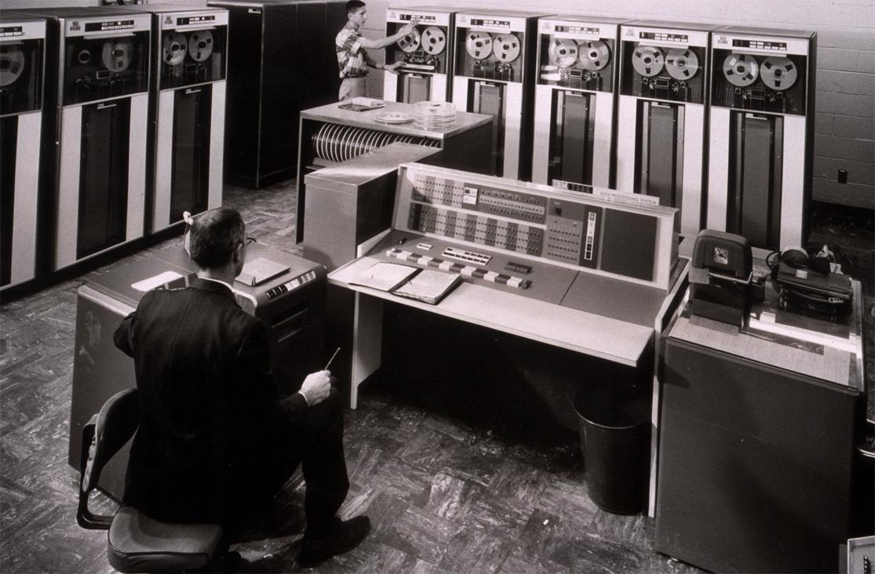
Simple Batch Systems (1960’s)
Reduce setup time by batching jobs with similar requirements.
Add a card reader, Hire an operator
  User is NOT the operator
  Automatic job sequencing
    Forms a rudimentary OS.
  Resident Monitor
    Holds initial control, control transfers to job and then back to monitor.
  Problem
    Need to distinguish job from job and data from program.
From John Ousterhout slides
‹#›

Slide 34
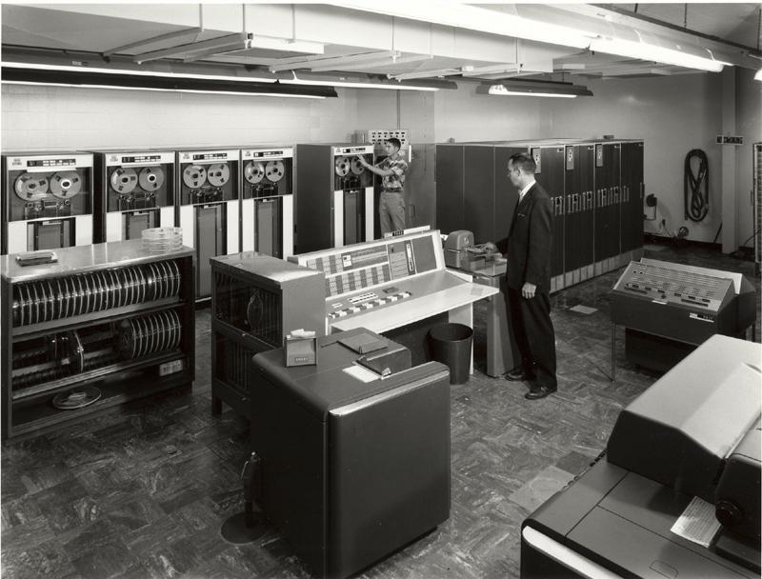
Supervisor/Operator Control
  Secure monitor that controls job processing
    Special cards indicate what to do.
    User program prevented from performing I/O
  Separate user from computer
    User submits card deck
    cards put on tape
    tape processed by operator
    output written to tape
    tape printed on printer
  Problems
    Long turnaround time - up to 2 DAYS!!!
    Low CPU utilization
      I/O and CPU could not overlap; slow mechanical devices.
IBM 7094
From John Ousterhout slides
‹#›

Slide 35
Batch Systems - Issues
  Solutions to speed up I/O:
  Offline Processing
    load jobs into memory from tapes, card reading and line printing are done offline.
  Spooling
    Use disk (random access device) as large storage for reading as many input files as possible and storing output files until output devices are ready to accept them.
    Allows overlap - I/O of one job with computation of another.
    Introduces notion of a job pool that allows OS choose next job to run so as to increase CPU utilization.
‹#›

Slide 36
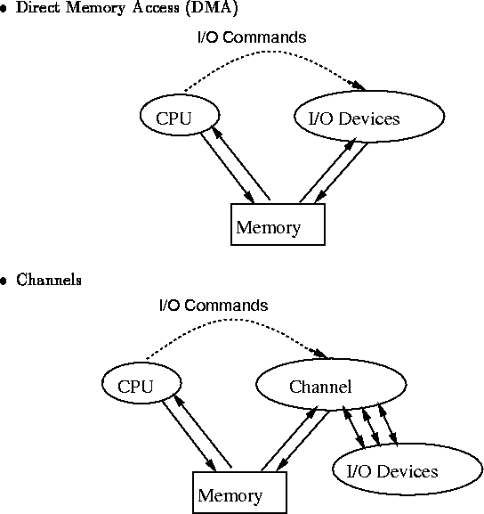
Speeding up I/O
‹#›

Slide 37
Batch Systems - I/O completion
How do we know that I/O is complete?
  Polling:
    Device sets a flag when it is busy.
    Program tests the flag in a loop waiting for completion of I/O.
  Interrupts:
    On completion of I/O, device forces CPU to jump to a specific instruction address that contains the interrupt service routine.
    After the interrupt has been processed, CPU returns to code it was executing prior to servicing the interrupt.
‹#›

Slide 38
Multiprogramming
Use interrupts to run multiple programs simultaneously
    When a program performs I/O, instead of polling, execute another program till interrupt is received.
Requires secure memory, I/O for each program.
Requires intervention if program loops indefinitely.
Requires CPU scheduling to choose the next job to run.
‹#›

Slide 39
Timesharing
Hardware – getting cheaper; Human – getting expensive
Programs queued for execution in FIFO order.
Like multiprogramming, but timer device interrupts after a quantum (timeslice).
    Interrupted program is returned to end of FIFO
    Next program is taken from head of FIFO
Control card interpreter replaced by command language interpreter.
‹#›

Slide 40
Timesharing (cont.)
Interactive (action/response)
  when OS finishes execution of one command, it seeks the next control statement from user.
File systems
    online filesystem is required for users to access data and code.
Virtual memory
  Job is swapped in and out of memory to disk.
‹#›

Slide 41
Personal Computing Systems
Hardware – cheap ; Human – expensive
Single user systems, portable.
I/O devices - keyboards, mice, display screens, small printers.
Laptops and palmtops, Smart cards, Wireless devices.
Single user systems may not need advanced CPU utilization or protection features.
Advantages:
  user convenience, responsiveness, ubiquitous
‹#›

Slide 42
Parallel Systems
Multiprocessor systems with more than one CPU in close communication.
Improved Throughput, economical, increased reliability.
Kinds:
      Vector and pipelined
      Symmetric and asymmetric multiprocessing
      Distributed memory vs. shared memory
Programming models:
      Tightly coupled vs. loosely coupled ,message-based vs. shared variable
‹#›

Slide 43
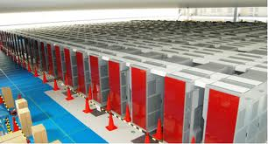
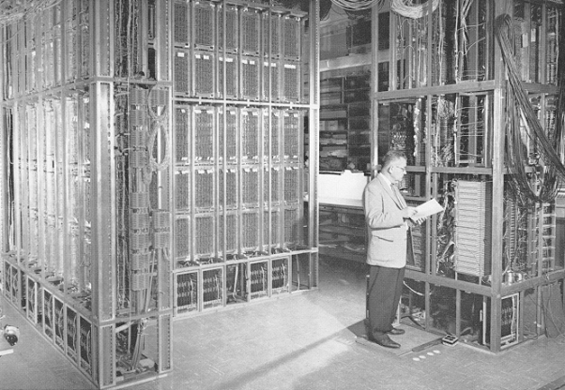
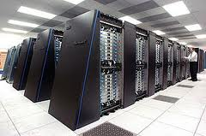
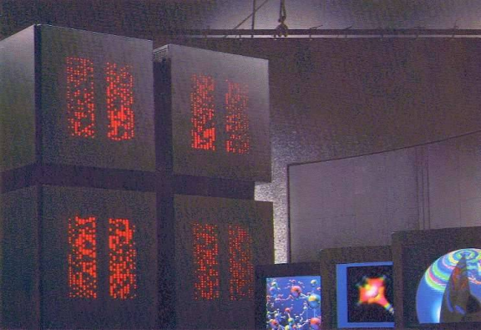
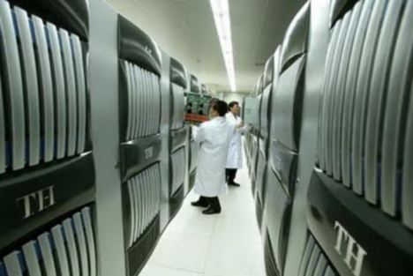
Parallel Computing Systems
ILLIAC 2 (UIllinois)
Climate modeling, earthquake simulations, genome analysis, protein folding, nuclear fusion research, …..
K-computer(Japan)
Tianhe-1(China)
IBM Blue Gene
Connection Machine (MIT)
‹#›

Slide 44
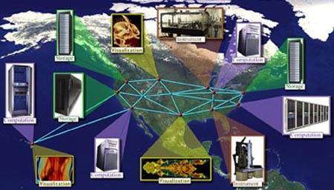
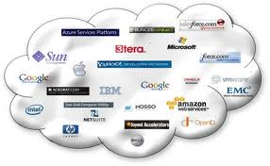
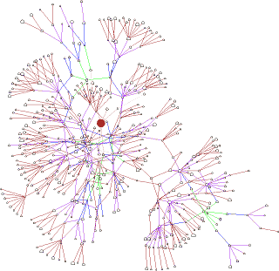
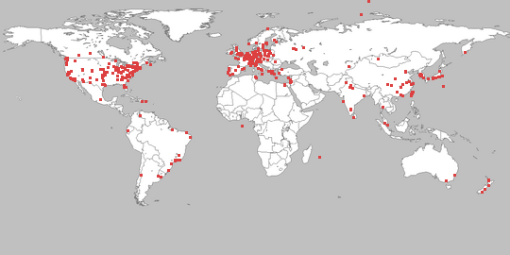
Distributed Computing Systems
Globus Grid Computing Toolkit
Cloud Computing Offerings
PlanetLab
Gnutella P2P Network
https://www.ics.uci.edu/~ics143/lectures.html
‹#›

Slide 45


Real-time systems
Correct system function depends on timeliness
Feedback/control loops
Sensors and actuators
Hard real-time systems -
    Failure if response time too long.
    Secondary storage is limited
Soft real-time systems -
    Less accurate if response time is too long.
    Useful in applications such as multimedia, virtual reality.
‹#›

Slide 46
Memory Hierarchy
How much? -- applications will likely be developed to use it
How fast? -- To achieve greatest performance
How expensive? -- the cost of memory must be reasonable
The following relationships hold true for variety of technologies:
  • Faster access time, greater cost per bit
  • Greater capacity, smaller cost per bit
  • Greater capacity, slower access speed

Slide 47
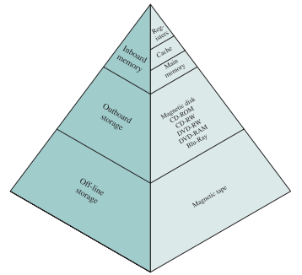
A typical hierarchy is illustrated in
the below Figure. As one goes down
the hierarchy, the following occur:
Decreasing cost per bit
Increasing capacity
Increasing access time
Decreasing frequency of access
to the memory by the processor .

Slide 48
System Calls
System calls provide an interface to the services made available by an operating system
These calls are generally available as routines written in C and C++
Eg: simple program to read data from one ﬁle and copy them to another ﬁle.
Typically, application developers design programs according to an application programming interface (API).
The API speciﬁes a set of functions that are available to an application programmer, including the parameters that are passed to each function and the return values the programmer can expect.
Three of the most common APIs available to application programmers are : the Windows API for Windows systems, the POSIX API for POSIX-based systems, and the Java API for programs that run on the Java virtual machine.

Slide 49
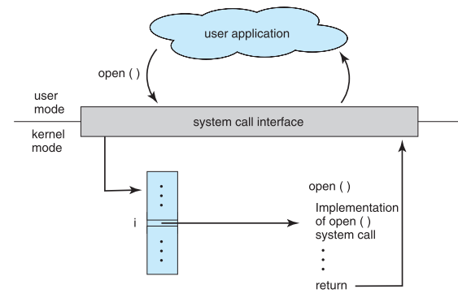
Three general methods are used to pass parameters to the operating system. The simplest approach is to pass the parameters in registers.
In some cases the parameters are generally stored in a block, or table, in memory, and the address of the block is passed as a parameter in a register.

Slide 50
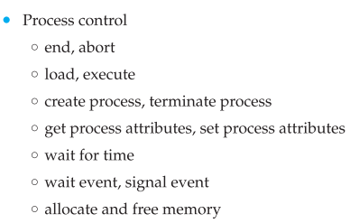
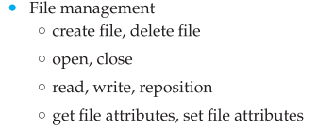
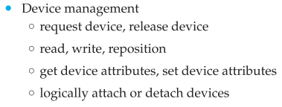
Types of System Calls

Slide 51
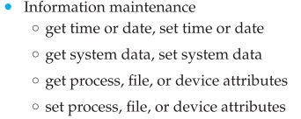
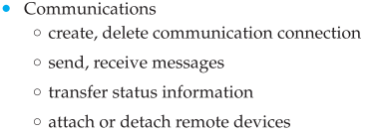

Slide 52
Operating System Structure
Different structures of the operating systems are:
Monolithic Systems
Layered Systems
Virtual Machines
Exo kernels
Client-Server Systems

Slide 53
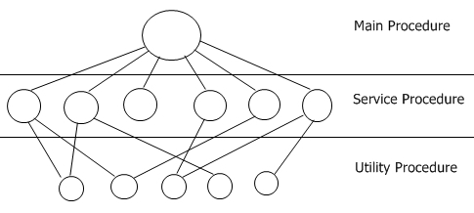
Monolithic Systems
Oldest architecture used for OS development.
Monolithic systems provides a basic structure for the operating system.
  A main program that invokes the requested service procedure.
  A set of service procedures that carry out the system calls
  A set of utility procedures that help the service procedure
Division of procedures into three layers

Slide 54
A.k.a., “The Big Mess” or spaghetti code
Prominent in the early days
The structure consists of no-structure
The system is a collection of procedures
Each procedure can call any other procedure
No information hiding (as opposed to modules, packages, classes)
A little structure, imposed by exposing a set of system calls to the outside
Supporting these system calls through utility procedures (check data passed to system call, move data around …)

Slide 55
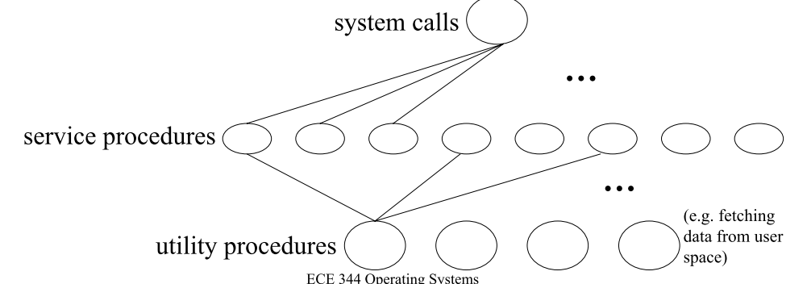
  1. a main procedure requesting the services
  2. a set of service procedures that carry out system calls
  3. a set of utility procedures supporting the system calls

Slide 56
Pros & Cons
Tightly integrated code in one address space
Unreliable, as a bug anywhere in the kernel can bring down the whole system
Tight integration has high potential for efficient use of resources and for efficient code
Early designs lacked potential for extension
Modern designs can load executable modules dynamically (i.e., extensible)
– E.g., Linux, FreeBSD, Solaris

Slide 57
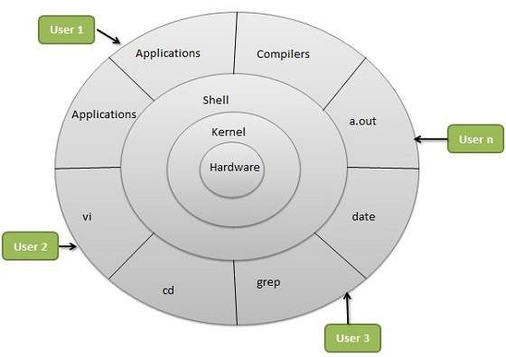
Layered System
OS is divided into number of layers.
A layered design of the operating system architecture attempts to achieve robustness by structuring the architecture into layers with different privileges.

Slide 58
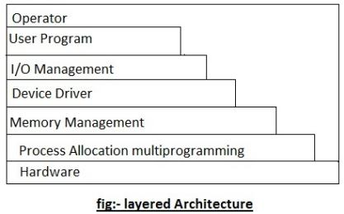
Layered System
Layer 5- user programs are found.
Layer 4 - take care of managing the I/O devices and buffering the information streams to and from them.
Layer 3- handles the communication between each process and the operator console.
Layer 2 - Memory management.
Layer 1 - Allocation of the processor, switching between processes.
Layer 0 – Hardware.
Layer 5
Layer 4
Layer 3
Layer 2
Layer 1
Layer 0

Slide 59
      Advantages
The main advantage of the layered approach is simplicity of construction
This approach simpliﬁes debugging and system veriﬁcation.
Each layer hides the existence of certain data structures, operations, and hardware from higher-level layers
      Disadvantages
The major difﬁculty with the layered approach involves appropriately deﬁning the various layers.
they tend to be less efﬁcient than other types as Each layer adds overhead to the system call.

Slide 60
Microkernels
As UNIX expanded, the kernel became large and difﬁcult to manage.
Researchers at Carnegie Mellon University developed an operating system called Mach that modularized the kernel using the microkernel approach.
This method structures the operating system by removing all nonessential components from the kernel and implementing them as system and user-level programs.
Microkernels provide minimal process and memory management, in addition to a communication facility
The main function of the microkernel is to provide communication between the client program and the various services that are also running in user space.

Slide 61
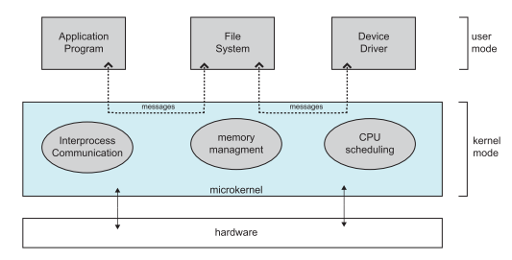

Slide 62
One beneﬁt of the microkernel approach is that it makes extending the operating system easier.
All new services are added to user space and consequently do not require modiﬁcation of the kernel.
The resulting operating system is easier to port from one hardware design to another.
The microkernel also provides more security and reliability, since most services are running as user rather than kernel processes.
If a service fails, the rest of the operating system remains untouched.
The performance of microkernels can suffer due to increased system-function overhead

Slide 63
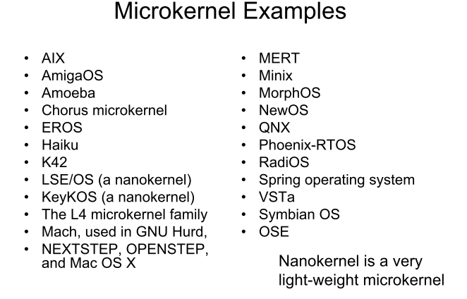

Slide 64
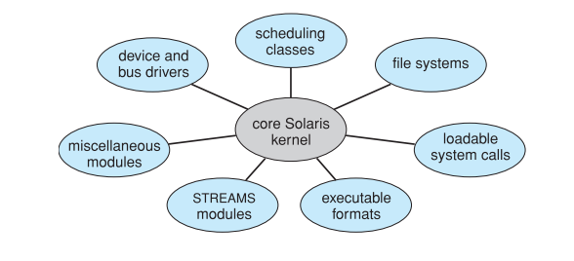
Modules
Best current methodology for operating-system design involves using loadable kernel modules.

Slide 65
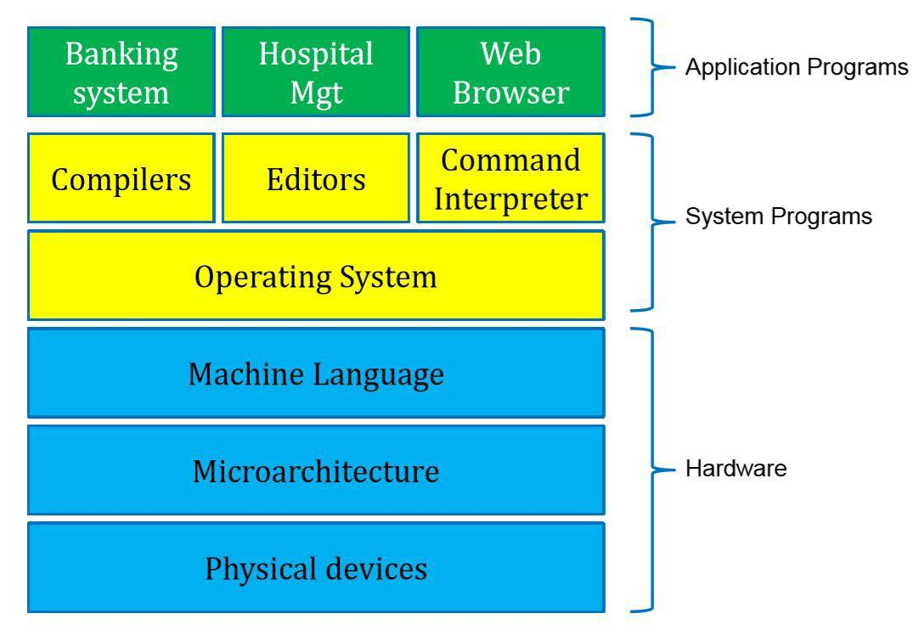
System Programs
System programs provide a convenient environment for program development and execution.
Some of them are simply user interface to system calls ; others are considerably more complex.
Most users’ view of the operation system is defined by system programs, not the actual system calls.

Slide 66
Generation and System Boot
OS GENERATION:
  The operating systems are designed to run on any of a class of machines at a variety of sites with a variety of peripheral configurations.
  The Computer system must then be configured or generated for each specific computer site, a process sometimes known as system generation SYSGEN
SYSTEM BOOT:
  The procedure of starting a computer by loading the kernel is known as booting the system.
  A small piece of code known as the bootstrap program or bootstrap loader locates the kernel, loads it into main memory, and starts its execution.

Slide 67
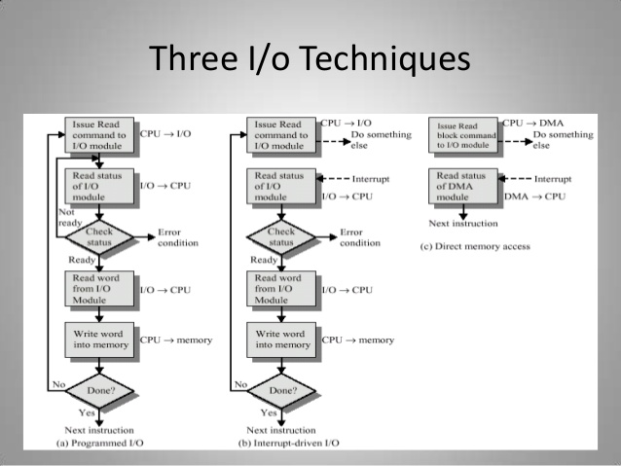
Thus, both of these forms of I/O suffer from two inherent drawbacks:
1. The I/O transfer rate is limited by the speed with which the processor can test
and service a device.
2. The processor is tied up in managing an I/O transfer; a number of instructions
must be executed for each I/O transfer.

Slide 68
When large volumes of data are to be moved, a more efficient technique is required: direct memory access (DMA). The DMA function can be performed by a separate module on the system bus or it can be incorporated into an I/O module.
When the processor wishes to read or write a block of data, it issues a command to the DMA module, by sending to the DMA module the following information:
  • Whether a read or write is requested
  • The address of the I/O device involved
  • The starting location in memory to read data from or write data to
  • The number of words to be read or written

