Slide 1
UNIT II - PROCESS SCHEDULING
Processes- Process Concept, Process Scheduling, Operations on Processes,
Inter process Communication; CPU Scheduling algorithms; OS – examples

Slide 2
Objectives
A process (job) is a program in execution.
The main objective of the process management module of operating system is to manage the process submission to the system in a manner to minimize the idle time of various processors (CPU, I/O processors e.t.c) of the computer system.
To understand the creation and deletion of processes, scheduling of various system resources to different processes requesting them.
To describe the various mechanisms for synchronization and communication among processes using shared memory and message passing
To introduce CPU scheduling, which is the basis for multiprogrammed operating systems
To describe various CPU-scheduling algorithms and examine the scheduling algorithms of several operating systems

Slide 3
What is a Process ?
An operating system executes a variety of programs:
  Batch system – jobs
  Time-shared systems – user programs or tasks
Textbook uses the terms job and process almost interchangeably
Process – a program in execution; process execution must progress in sequential fashion
Multiple parts
  The program code, also called text section
  Current activity including program counter, processor registers
  Stack containing temporary data
    Function parameters, return addresses, local variables
  Data section containing global variables
  Heap containing memory dynamically allocated during run time

Slide 4
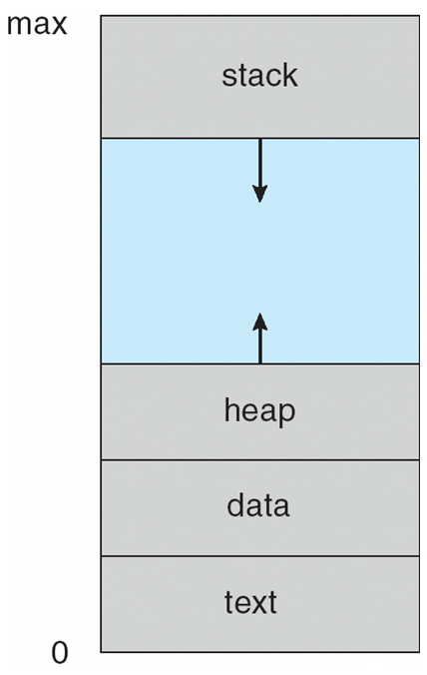
Process ?
Program is passive entity stored on disk, process is active
  Program becomes process when executable file loaded into memory
Execution of program started via GUI mouse clicks, command line entry of its name, etc.
One program several processes
  Consider multiple users executing the same program

Slide 5
A process control block (PCB) is a data structure used by computer operating systems to store all the information about a process. It is also known as a process descriptor.
Identifier
When a process is created (initialized or installed), the operating system creates a corresponding process control block.
Information in a process control block is updated during the transition of process states.
When the process terminates, its PCB is returned to the pool from which new PCBs are drawn.
Each process has a single PCB.
Status
Priority
Program Counter
Memory pointers
Context Data
I/O status Information
Accounting Information

Slide 6
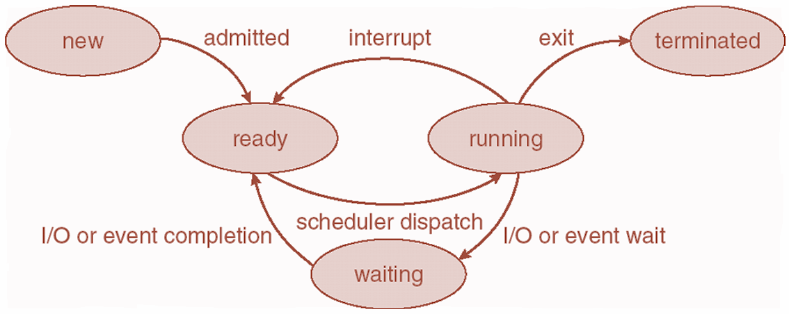
Process State- Five State Model
As a process executes, it changes state
  new: The process is being created
  running: Instructions are being executed
  waiting: The process is waiting for some event to occur
  ready: The process is waiting to be assigned to a processor
  terminated: The process has finished execution

Slide 7
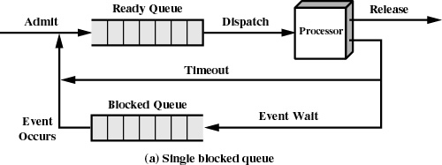
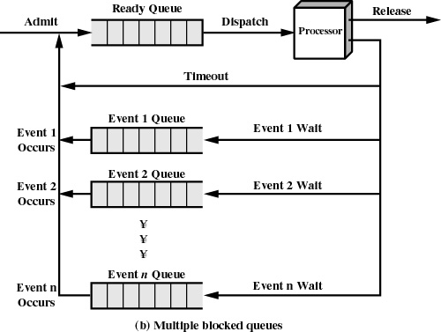
We can use number of queues for each event
Can have number of ready queues, one for each priority level.
What if ready queue is completed and processor waiting for I/O ?
Processor will be idle for most of the time, Solution ?
  Main Memory can be expanded
  Swapping – Moving part or all of the process from main memory to disk. Maintains it in suspended queue.

Slide 8
Six State Model
Dispatch
New
Admit
Ready
Running
Time out
Release
Exit
Activate
Event Wait
Event Occur
Suspend
Blocked
Suspend
Suspend : Process is in secondary memory and blocked

Slide 9
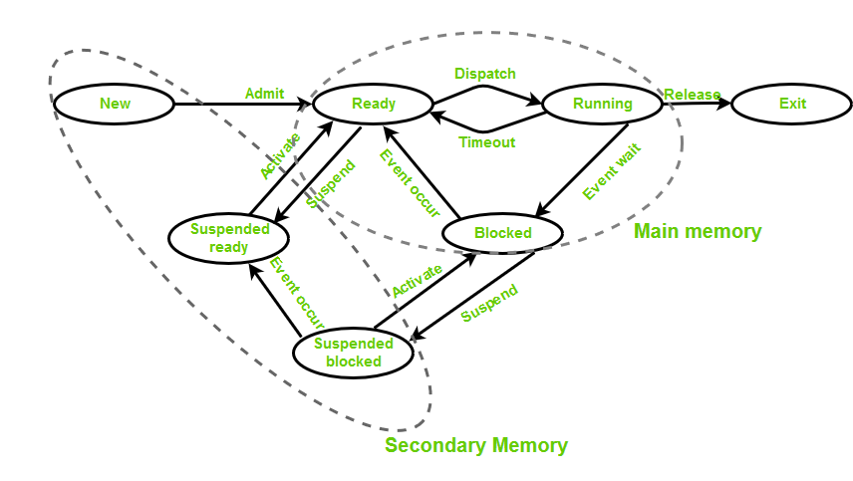
Seven State Model
Ready / Suspend : Process is in secondary memory is available executing as soon as it is loaded into main memory.
Blocked / Suspend : Process is in secondary memory and waiting an event.

Slide 10
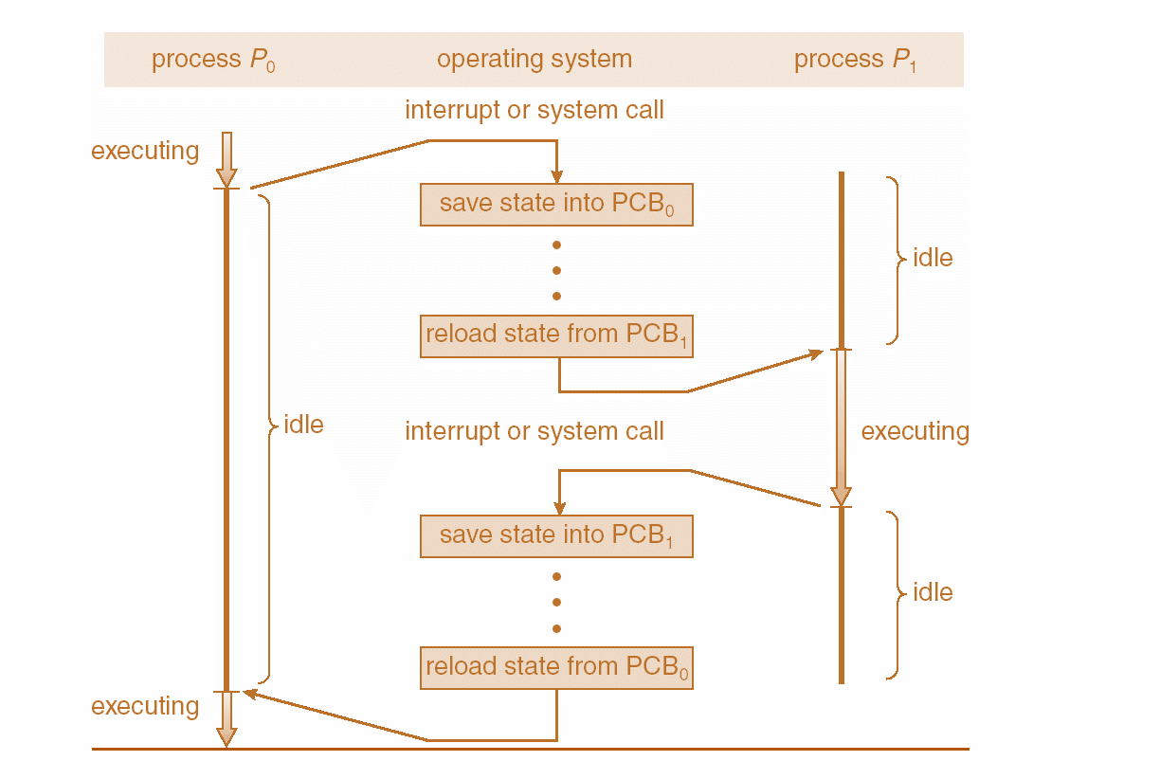
Context Switching

Slide 11
When CPU switches to another process, the system must save the state of the old process and load the saved state for the new process.
Context-switch time is overhead; the system does no useful work while switching– an area needing optimization.
Time dependent on hardware support.
Process Representation in Linux-
Represented by the C structure task_struct
pid t_pid; /* process identifier */
long state; /* state of the process */
unsigned int time_slice /* scheduling information */
struct task_struct *parent; /* this process’s parent */
struct list_head children; /* this process’s children */
struct files_struct *files; /* list of open files */
struct mm_struct *mm; /* address space of this process */

Slide 12
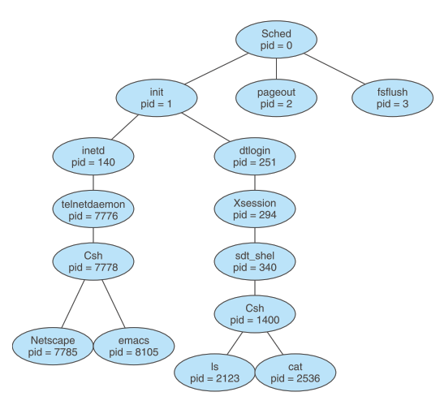
Operations on Processes - The processes can execute concurrently, and they may be created and deleted dynamically.
Process Creation
Parent process create children processes, which, in turn create other processes, forming a tree of processes
create-process system call
Process tree for the Solaris operating system. The process at the top of the tree is the sched process,with pid of 0. The sched process creates several children processes—including pageout and fsflush. These processes are responsible for managing memory and ﬁle systems.
The sched process also creates the init process, which serves as the root parent process for all user processes.
Networking
user
login screen

Slide 13
Resource sharing options
  sub process may be able to obtain its resources directly from the operating system
  Parent and children share all resources
  Children share subset of parent’s resources
  Parent and child share no resources
  Sub process may be constrained to a subset of the resources of the parent process.
Execution options
  Parent and children execute concurrently
  Parent waits until children terminate
There are also two possibilities for the address space of the new process:
  The child process is a duplicate of the parent process (it has the same program and data as the parent).
  The child process has a new program loaded into it

Slide 14
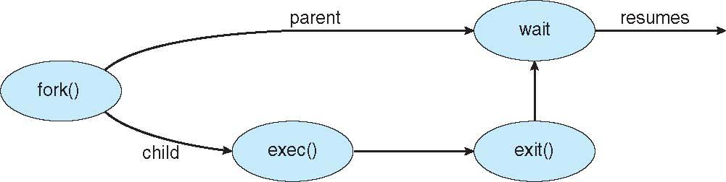
Process Creation
Address space
  Child duplicate of parent
  Child has a program loaded into it
UNIX examples
  fork() system call creates new process
  exec() system call used after a fork() to replace the process’ memory space with a new program

Slide 15
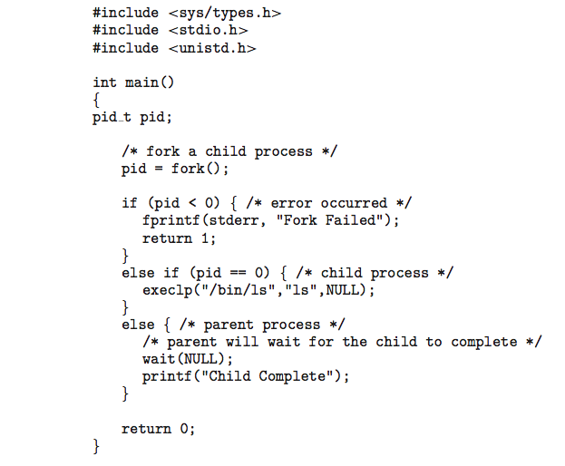
C Program Forking Separate Process

Slide 16
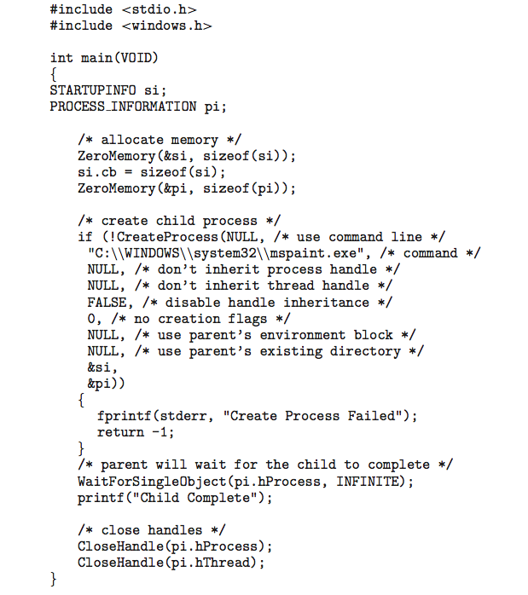
Creating a Separate Process via Windows API

Slide 17
Process Termination
Process executes last statement and then asks the operating system to delete it using the exit() system call.
  Returns status data from child to parent (via wait())
  Process’ resources are deallocated by operating system
Parent may terminate the execution of children processes using the abort() system call. Some reasons for doing so:
  Child has exceeded allocated resources
  Task assigned to child is no longer required
  The parent is exiting and the operating systems does not allow a child to continue if its parent terminates

Slide 18
When a process terminates, its resources are deallocated by the operating system. However, its entry in the process table must remain there until the parent calls wait(), because the process table contains the process’s exit status.
A process that has terminated, but whose parent has not yet called wait(), is known as a zombie process.
    All processes transition to this state when they terminate, but generally they exist as zombies only brieﬂy. Once the parent calls wait(), the process identiﬁer of the zombie process and its entry in the process table are released.
What would happen if a parent did not invoke wait() and instead terminated, thereby leaving its child processes as orphans. Linux and UNIX address this scenario by assigning the init process as the new parent to orphan processes.
The init process periodically invokes wait()

Slide 19
Process Scheduling
Maximize CPU use, quickly switch processes onto CPU for time sharing
Process scheduler selects among available processes for next execution on CPU
Maintains scheduling queues of processes
  Job queue – set of all processes in the system
  Ready queue – set of all processes residing in main memory, ready and waiting to execute
  Device queues – set of processes waiting for an I/O device
  Processes migrate among the various queues

Slide 20
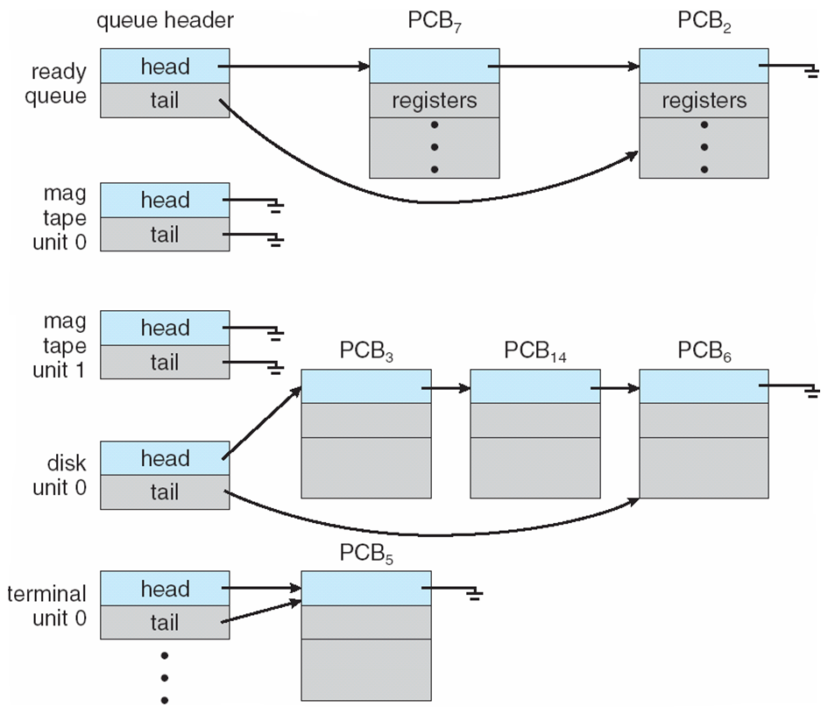
Ready Queue And Various I/O Device Queues

Slide 21
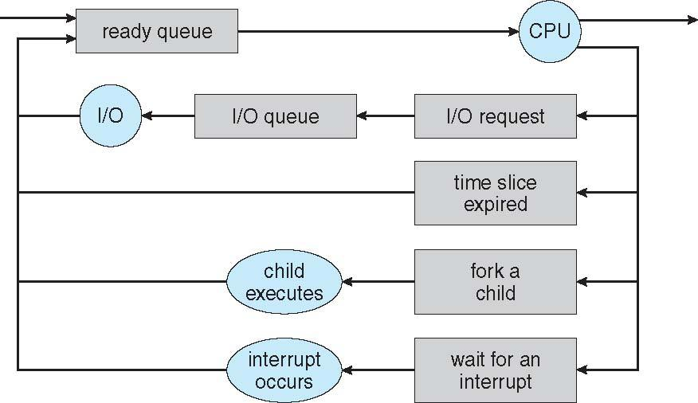
Representation of Process Scheduling
Queueing diagram represents queues, resources, flows

Slide 22
Schedulers
Short-term scheduler (or CPU scheduler) – selects one of the processes from the ready queue and schedules them for execution
  Sometimes the only scheduler in a system
  Short-term scheduler is invoked frequently (milliseconds) ⇒ (must be fast)
Long-term scheduler (or job scheduler) –selects processes from the storage pool in the secondary memory and loads them into the ready queue in the main memory for execution.
  Long-term scheduler is invoked infrequently (seconds, minutes) ⇒ (may be slow)
  The long-term scheduler controls the degree of multiprogramming
Processes can be described as either:
  I/O-bound process – spends more time doing I/O than computations, many short CPU bursts
  CPU-bound process – spends more time doing computations; few very long CPU bursts
Long-term scheduler strives for good process mix

Slide 23
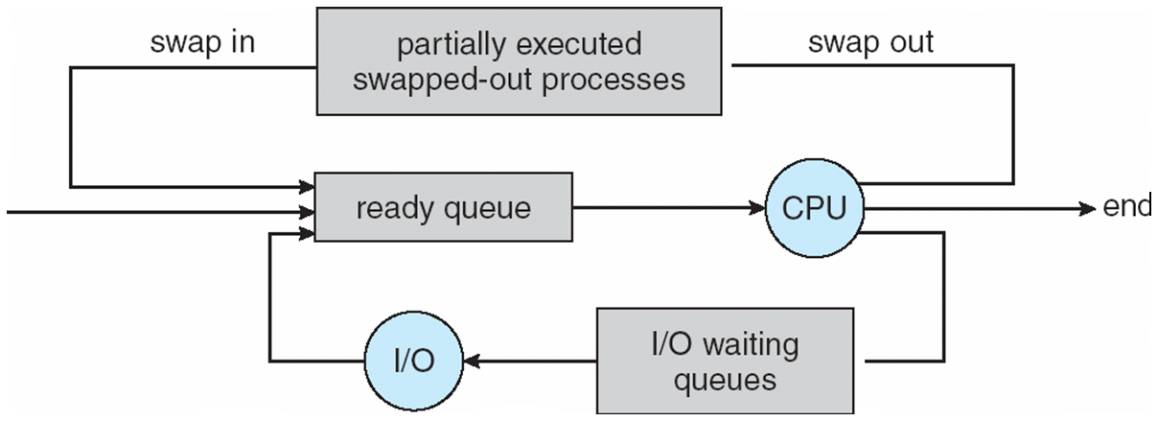
Medium Term Scheduling
Medium-term scheduler can be added if degree of multiple programming needs to decrease
  Remove process from memory, store on disk, bring back in from disk to continue execution: swapping
  Swapping is also useful to improve the mix of I/O bound and CPU bound processes in the memory

Slide 24
CPU Scheduler
Short-term scheduler selects from among the processes in ready queue, and allocates the CPU to one of them
  Queue may be ordered in various ways
CPU scheduling decisions may take place when a process:
  1. Switches from running to waiting state
  2. Switches from running to ready state
  3. Switches from waiting to ready
  Terminates
Scheduling under 1 and 4 is non-preemptive
All other scheduling is preemptive
  Consider access to shared data
  Consider preemption while in kernel mode
  Consider interrupts occurring during crucial OS activities

Slide 25
Dispatcher
Under non-preemptive scheduling, once the CPU has been allocated to a process, the process
keeps the CPU until it releases the CPU either by terminating or by switching to the
waiting state.
This scheduling method was used by Microsoft Windows 3.x. Windows 95 introduced preemptive scheduling, and all subsequent versions of Windows operating systems have used preemptive scheduling.
Preemptive scheduling can result in race conditions when data are shared among several processes.
Dispatcher module gives control of the CPU to the process selected by the short-term scheduler; this involves:
  switching context
  switching to user mode
  jumping to the proper location in the user program to restart that program
Dispatch latency – time it takes for the dispatcher to stop one process and start another running

Slide 26
Scheduling Criteria
CPU utilization – keep the CPU as busy as possible
Throughput – # of processes that complete their execution per time unit
Turnaround time – amount of time to execute a particular process
Waiting time – amount of time a process has been waiting in the ready queue
Response time – amount of time it takes from when a request was submitted until the first response is produced, not output (for time-sharing environment)
Scheduling Algorithm Optimization Criteria
  Max CPU utilization
  Max throughput
  Min turnaround time
  Min waiting time
  Min response time

Slide 27
First- Come, First-Served (FCFS) Scheduling
Process Burst Time
P₁ 24
P₂ 3
P₃ 3

Slide 28

Suppose that the processes arrive in the order: P₁ , P₂ , P₃
The Gantt Chart for the schedule is:
Waiting time for P₁ = 0; P₂ = 24; P₃ = 27
Average waiting time: (0 + 24 + 27)/3 = 17

Slide 29
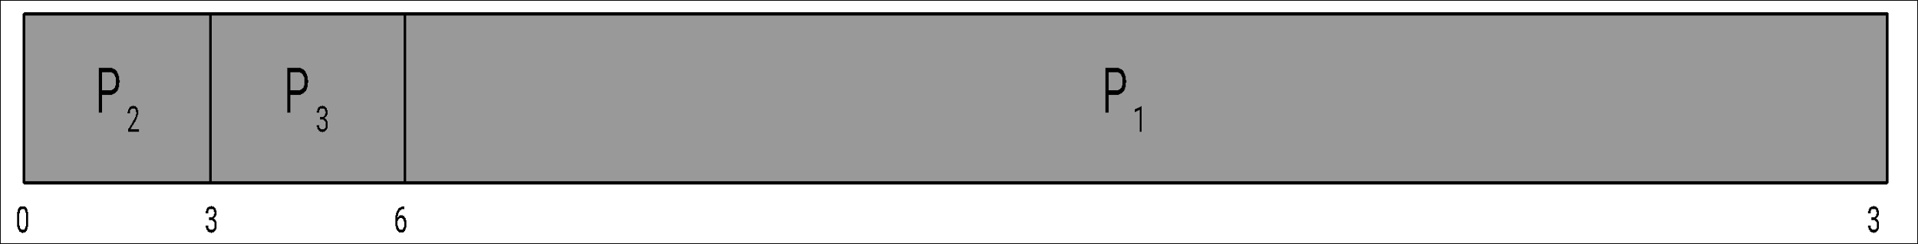
FCFS Scheduling (Cont.)
Suppose that the processes arrive in the order:
P₂ , P₃ , P₁
The Gantt chart for the schedule is:
Waiting time for P₁ = 6; P₂ = 0; P₃ = 3
Average waiting time: (6 + 0 + 3)/3 = 3
Much better than previous case
Convoy effect - short process behind long process
  Consider one CPU-bound and many I/O-bound processes

Slide 30
Shortest-Job-First (SJF) Scheduling
Associate with each process the length of its next CPU burst
  Use these lengths to schedule the process with the shortest time
SJF is optimal – gives minimum average waiting time for a given set of processes
  The difficulty is knowing the length of the next CPU request
  Could ask the user
SJF scheduling is used frequently in long-term scheduling.

Slide 31
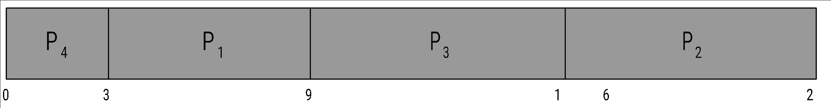
Example of SJF
Process Burst Time
P₁ 6
P₂ 8
P₃ 7
P₄ 3
SJF scheduling chart
Average waiting time = (3 + 16 + 9 + 0) / 4 = 7

Slide 32
Consider the following five processes each having its own unique burst time and arrival time.
Process Queue | Burst time | Arrival time
P1 | 6 | 2
P2 | 2 | 5
P3 | 8 | 1
P4 | 3 | 0
P5 | 4 | 4

Slide 33
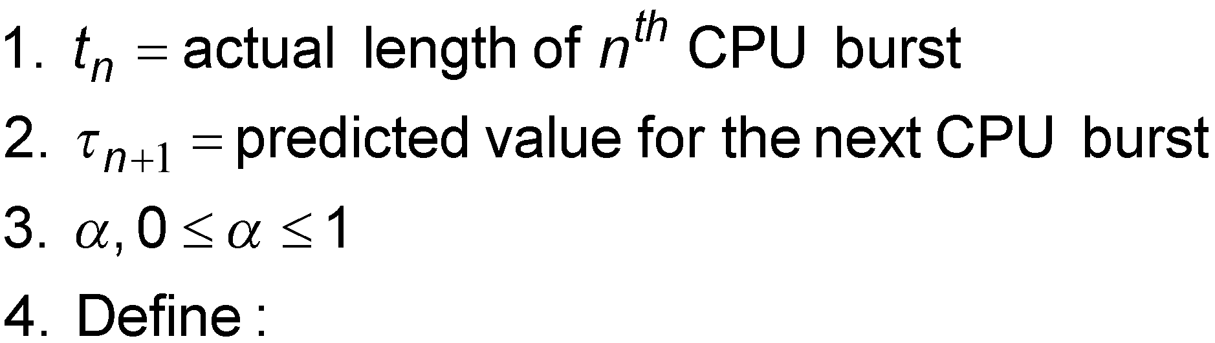
Determining Length of Next CPU Burst
Can only estimate the length – should be similar to the previous one
  Then pick process with shortest predicted next CPU burst
Can be done by using the length of previous CPU bursts, using exponential averaging
Commonly, α set to ½
Preemptive version called shortest-remaining-time-first

Slide 34
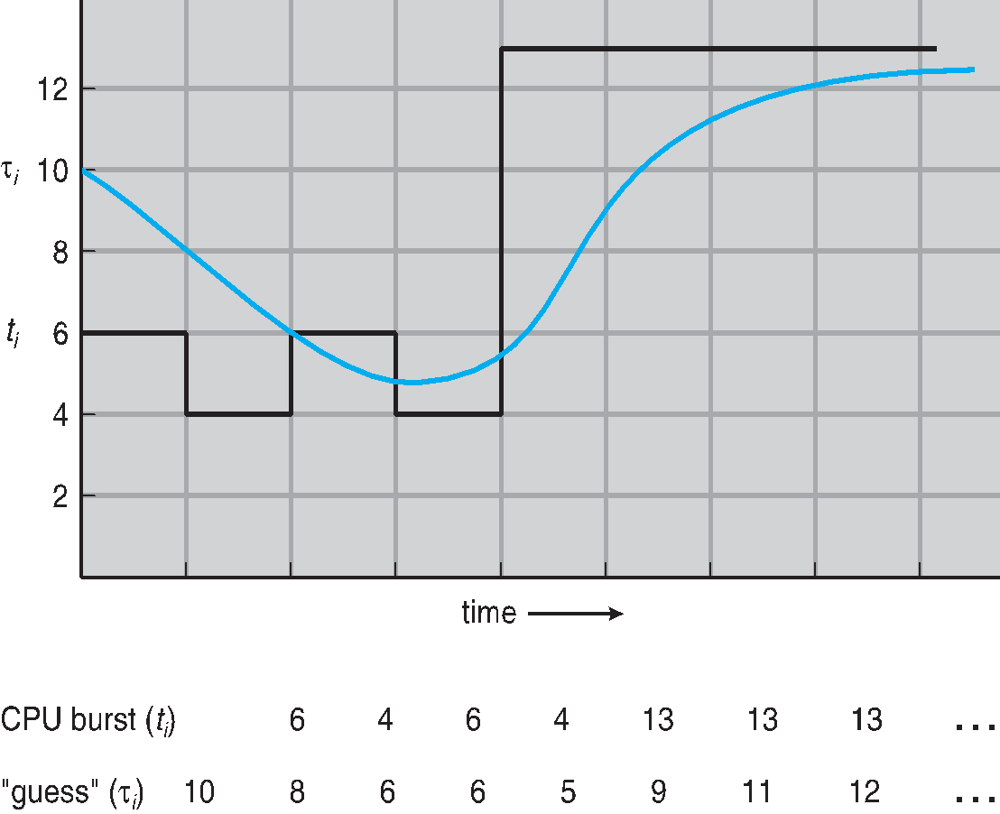
Prediction of the Length of the Next CPU Burst

Slide 35
Examples of Exponential Averaging
α =0
  τ_{n+1} = τ_{n}
  Recent history does not count
α =1
  τ_{n+1} = α t_{n}
  Only the actual last CPU burst counts
If we expand the formula, we get:
    τ_{n+1} = α t_{n}+(1 - α)α t_{n} ₋₁ + …
    +(1 - α )^{j} α t_{n} _{-j} + …
    +(1 - α )^{n +1} τ₀
Since both α and (1 - α) are less than or equal to 1, each successive term has less weight than its predecessor

Slide 36
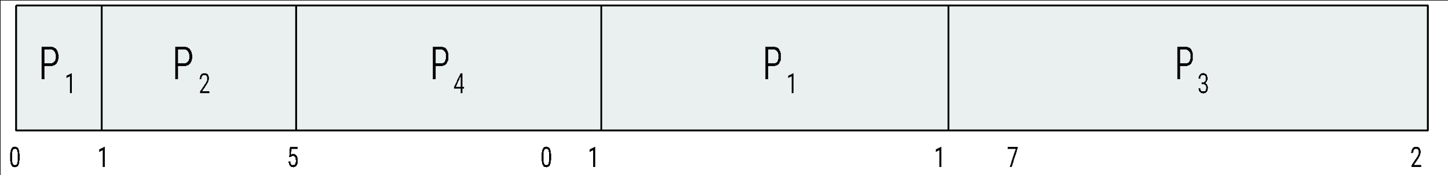
Example of Shortest-remaining-time-first
Now we add the concepts of varying arrival times and preemption to the analysis
Process Arrival Time Burst Time
P₁ 0 8
P₂ 1 4
P₃ 2 9
P₄ 3 5
Preemptive SJF Gantt Chart
Average waiting time = [(10-1)+(1-1)+(17-2)+5-3)]/4 = 26/4 = 6.5 msec

Slide 37
Priority Scheduling
A priority number (integer) is associated with each process
The CPU is allocated to the process with the highest priority (smallest integer ≡ highest priority)
  Preemptive
  Non-preemptive
SJF is priority scheduling where priority is the inverse of predicted next CPU burst time
Problem ≡ Starvation – low priority processes may never execute
Solution ≡ Aging – as time progresses increase the priority of the process
Priorities can be deﬁned either internally or externally.
Internally deﬁned priorities - time limits, memory requirements, the number of open ﬁles, and the ratio of average I/O burst to average CPU burst have been used in computing priorities.
External priorities are set by criteria outside the operating system, such as the importance of the process, the type and amount of funds being paid for computer use, the department sponsoring the work, and other

Slide 38
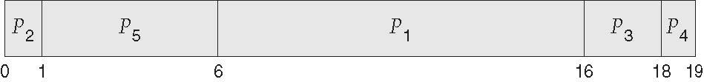
Example of Priority Scheduling
Process Burst Time Priority
P₁ 10 3
P₂ 1 1
P₃ 2 4
P₄ 1 5
P₅ 5 2
Priority scheduling Gantt Chart
Average waiting time = 8.2 msec

Slide 39
Round Robin (RR)
Each process gets a small unit of CPU time (time quantum q), usually 10-100 milliseconds. After this time has elapsed, the process is preempted and added to the end of the ready queue.
If there are n processes in the ready queue and the time quantum is q, then each process gets 1/n of the CPU time in chunks of at most q time units at once. No process waits more than (n-1)q time units.
Timer interrupts every quantum to schedule next process
Performance
  q large ⇒ FIFO
  q small ⇒ q must be large with respect to context switch, otherwise overhead is too high

Slide 40
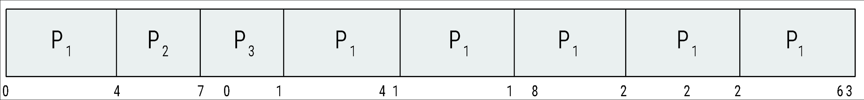
Example of RR with Time Quantum = 4
Process Burst Time
P₁ 24
P₂ 3
P₃ 3
The Gantt chart is:
Typically, higher average turnaround than SJF, but better response
q should be large compared to context switch time
q usually 10ms to 100ms, context switch < 10 usec

Slide 41
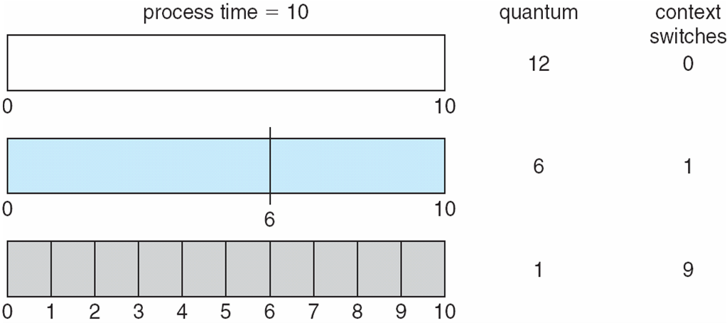
Time Quantum and Context Switch Time

Slide 42
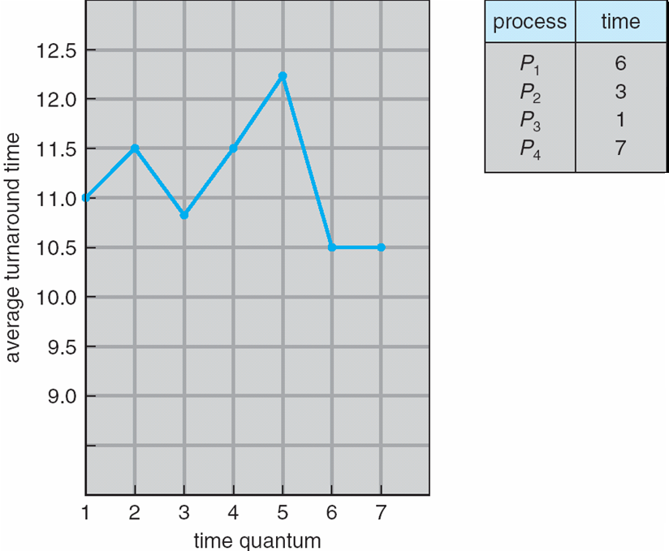
Turnaround Time Varies With The Time Quantum
80% of CPU bursts should be shorter than q

Slide 43
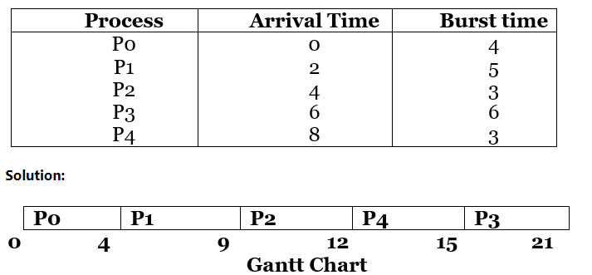
Highest Response ratio Next
Criteria – Response Ratio
Mode – Non-Preemptive
A Response Ratio is calculated for each of the available jobs and the Job with the highest response ratio is given priority over the others.
Response Ratio = (W + S)/S
Here, W is the waiting time of the process so far and S is the Burst time of the process.
Performance of HRRN –
Shorter Processes are favoured. Aging without service increases ratio, longer jobs can get past shorter jobs.
Advantages
Its performance is better than SJF Scheduling.
It limits the waiting time of longer jobs and also supports shorter jobs.
Disadvantages
It can't be implemented practically.
This is because the burst time of all the processes can not be known in advance.

Slide 44
Multilevel Queue
Ready queue is partitioned into separate queues, eg:
  foreground (interactive)
  background (batch)
Process permanently in a given queue
Each queue has its own scheduling algorithm:
  foreground – RR
  background – FCFS
Scheduling must be done between the queues:
  Fixed priority scheduling; (i.e., serve all from foreground then from background). Possibility of starvation.
  Time slice – each queue gets a certain amount of CPU time which it can schedule amongst its processes; i.e., 80% to foreground in RR
  20% to background in FCFS

Slide 45
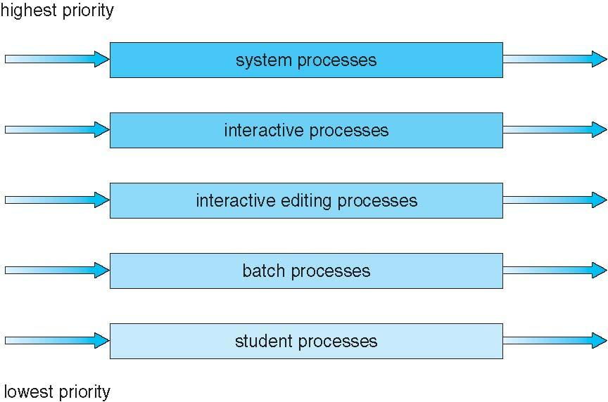
Multilevel Queue Scheduling

Slide 46
Multilevel Feedback Queue
A process can move between the various queues; aging can be implemented this way
Multilevel-feedback-queue scheduler defined by the following parameters:
  number of queues
  scheduling algorithms for each queue
  method used to determine when to upgrade a process
  method used to determine when to demote a process
  method used to determine which queue a process will enter when that process needs service

Slide 47
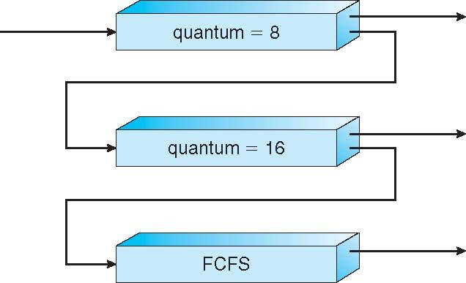
Example of Multilevel Feedback Queue
Three queues:
  Q₀ – RR with time quantum 8 milliseconds
  Q₁ – RR time quantum 16 milliseconds
  Q₂ – FCFS
Scheduling
  A new job enters queue Q₀ which is served FCFS
    When it gains CPU, job receives 8 milliseconds
    If it does not finish in 8 milliseconds, job is moved to queue Q₁
  At Q₁ job is again served FCFS and receives 16 additional milliseconds
    If it still does not complete, it is preempted and moved to queue Q₂

Slide 48
Multiple-Processor Scheduling
If multiple CPUs are available, load sharing becomes possible
CPU scheduling more complex when multiple CPUs are available
Homogeneous processors within a multiprocessor
Asymmetric multiprocessing – only one processor accesses the system data structures, alleviating the need for data sharing
Symmetric multiprocessing (SMP) – each processor is self-scheduling, all processes in common ready queue, or each has its own private queue of ready processes
  Currently, most common
Processor affinity – process has affinity for processor on which it is currently running
  soft affinity
  hard affinity
  Variations including processor sets

Slide 49
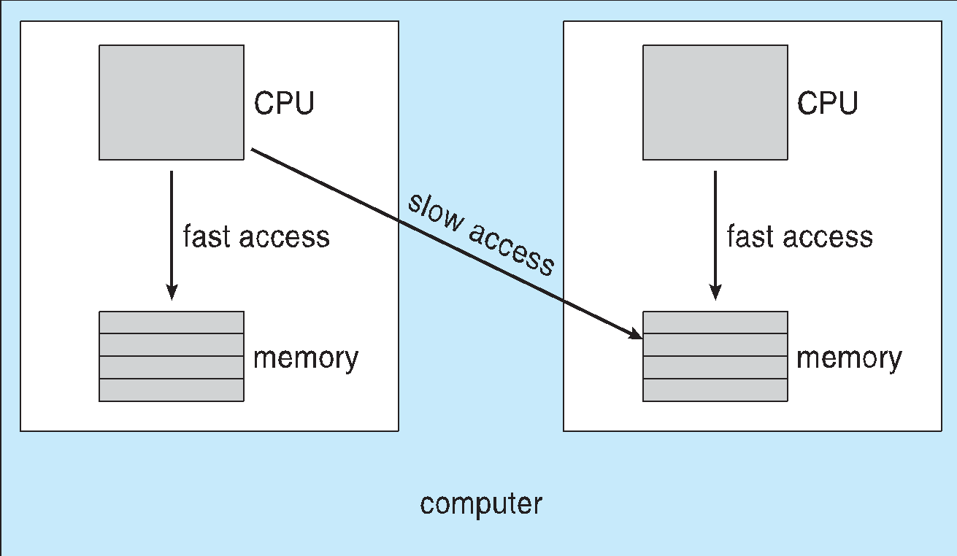
NUMA and CPU Scheduling
Note that memory-placement algorithms can also consider affinity

Slide 50
Multiple-Processor Scheduling – Load Balancing
If SMP, need to keep all CPUs loaded for efficiency
Load balancing attempts to keep workload evenly distributed
Push migration – Periodic task checks load on each processor, and if found pushes task from overloaded CPU to other CPUs
Pull migration – idle processors pulls waiting task from busy processor
Multicore Processors
Recent trend to place multiple processor cores on same physical chip
Faster and consumes less power
Multiple threads per core also growing
Takes advantage of memory stall to make progress on another thread while memory retrieve happens

Slide 51
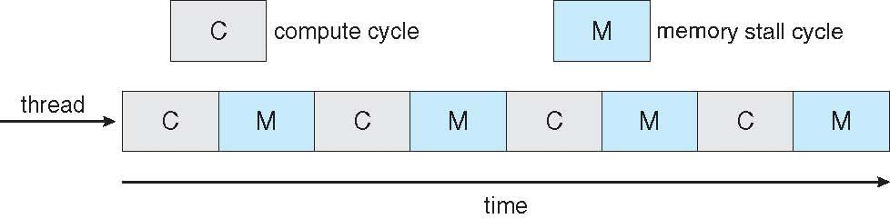

Multithreaded Multicore System

Slide 52
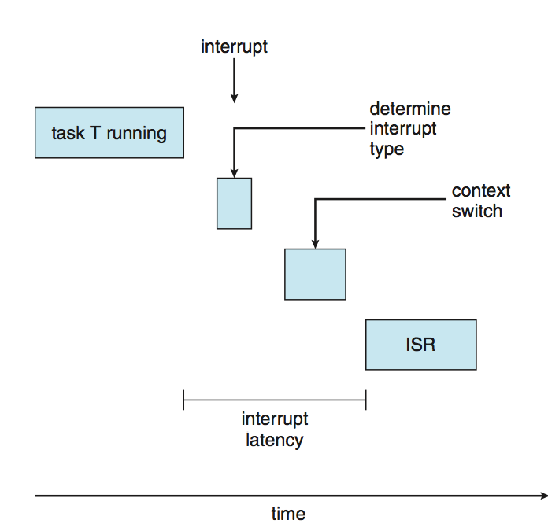
Real-Time CPU Scheduling
Can present obvious challenges
Soft real-time systems – no guarantee as to when critical real-time process will be scheduled
Hard real-time systems – task must be serviced by its deadline
Two types of latencies affect performance
  Interrupt latency – time from arrival of interrupt to start of routine that services interrupt
  Dispatch latency – time for schedule to take current process off CPU and switch to another

Slide 53
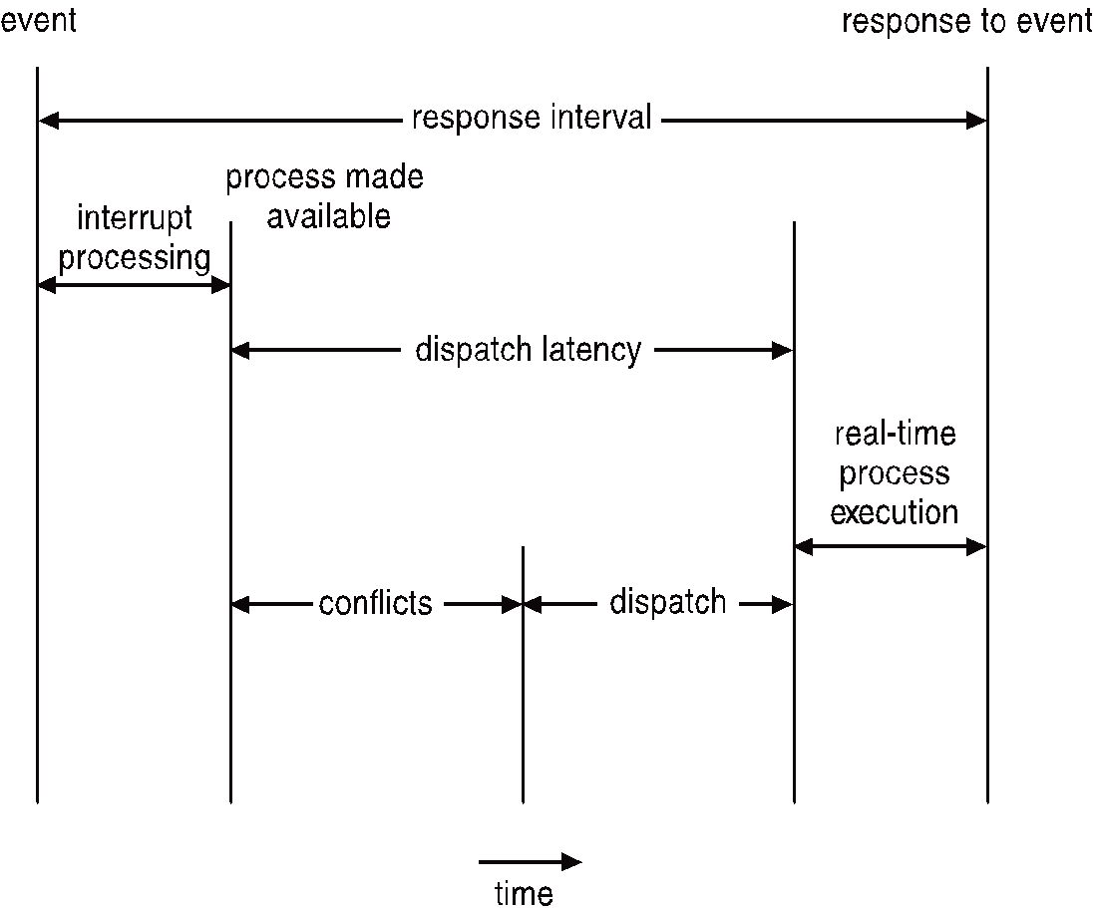
Real-Time CPU Scheduling (Cont.)
Conflict phase of dispatch latency:
  Preemption of any process running in kernel mode
  Release by low-priority process of resources needed by high-priority processes

Slide 54
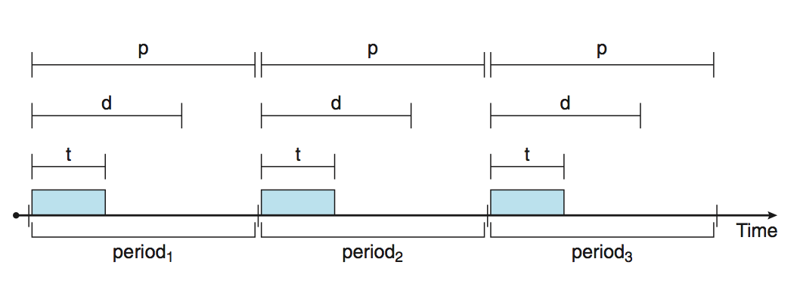
Priority-based Scheduling
For real-time scheduling, scheduler must support preemptive, priority-based scheduling
  But only guarantees soft real-time
For hard real-time must also provide ability to meet deadlines
Processes have new characteristics: periodic ones require CPU at constant intervals
  Has processing time t, deadline d, period p
  0 ≤ t ≤ d ≤ p
  Rate of periodic task is 1/p

Slide 55
What is unusual about this form of scheduling is that a process may have to announce its deadline requirements to the scheduler.
admission-control algorithm- the scheduler does one of two things. It either admits the process, guaranteeing that the process will complete on time, or rejects the request as impossible if it cannot guarantee that the task will be serviced by its deadline.
Rate-Monotonic Scheduling
The rate-monotonic scheduling algorithm schedules periodic tasks using a static priority policy with preemption.
Upon entering the system, each periodic task is assigned a priority inversely based on its period.
Assumes that every time a process acquires the CPU, the duration of its CPU burst is the same.

Slide 56
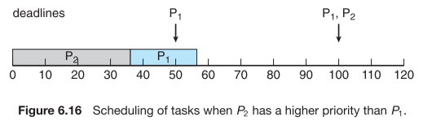
Let’s consider an example.
P 1 and P 2 . The periods for P 1=50 and P 2 =100,
The processing times are t 1 = 20 for P 1 and t 2 = 35 for P 2 .
The deadline for each process requires that it complete its CPU burst by the start of its next period.
Suppose we assign P 2 a higher priority than P 1.
so the scheduler has caused
P1 to miss its deadline.

Slide 57
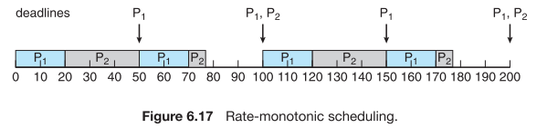
Rate-Monotonic Scheduling
P 1 and P 2 . The periods for P 1=50 and P 2 =100,
The processing times are t 1 = 20 for P 1 and t 2 = 35 for P 2 .
P1 starts ﬁrst and completes its CPU burst at time 20, thereby meeting its ﬁrst deadline
P2 starts running at this point and runs until time 50. At this time, it is preempted by P1 , although it still has 5 milliseconds remaining in its CPU burst. P1 completes its CPU burst at time 70, at which point the scheduler resumes P2 . P2 completes its CPU burst at time 75, also meeting its ﬁrst deadline. The system is idle until time 100, when P1 is scheduled again.

Slide 58
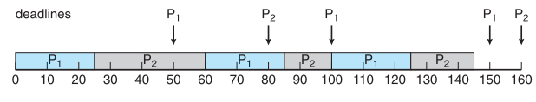
Earliest-Deadline-First Scheduling
Earliest-deadline-ﬁrst (EDF) scheduling dynamically assigns priorities according to deadline. The earlier the deadline, the higher the priority; the later the deadline, the lower the priority.
when a process becomes runnable, it must announce its deadline requirements to the system
P1 has values of p1 = 50 and t1 = 25 and that
P2 has values of p2 = 80 and t2 = 35.
https://forms.gle/B2ZKyp5eHNyXEAab6

Slide 59
Interprocess Communication
Processes within a system may be independent or cooperating
Cooperating process can affect or be affected by other processes, including sharing data
Clearly, any process that shares data with other processes is a cooperating process.
Reasons for cooperating processes:
  Information sharing
  Computation speedup
  Modularity
  Convenience
  Cooperating processes need Interprocess communication (IPC)
Two models of IPC
  Shared memory
  Message passing

Slide 60
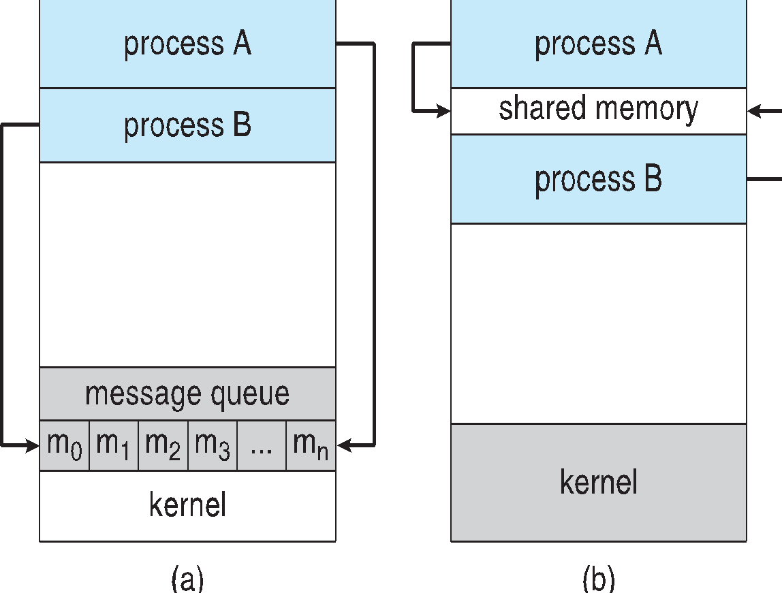
Communications Models
Message passing is useful for exchanging smaller amounts of data.
Message passing is also easier to implement than shared memory.
Message-passing systems are typically implemented using system calls and thus require the more time-consuming task of kernel intervention.
Shared memory allows maximum speed and convenience of communication. System calls are required only to establish shared-memory regions.
Once shared memory is established, all accesses are treated as routine memory accesses, and no assistance from the kernel is required.
(a) Message passing. (b) shared memory.

Slide 61
Shared-Memory Systems
  Communicating processes to establish a region of shared memory.
  Shared-memory region resides in the address space of the process.
  Other processes that wish to communicate using this shared-memory segment must attach it to their address space.
  Shared memory requires that two or more processes can exchange information by reading and writing data in the shared areas.
  The processes are also responsible for ensuring that they are not writing to the same location simultaneously.
Producer-Consumer Problem
Paradigm for cooperating processes, producer process produces information that is consumed by a consumer process
  unbounded-buffer places no practical limit on the size of the buffer
  bounded-buffer assumes that there is a fixed buffer size

Slide 62
Bounded-Buffer – Shared-Memory Solution
The producer and consumer must be synchronized, so that the consumer does not try to consume an item that has not yet been produced
Shared data
      #define BUFFER_SIZE 10
      typedef struct {
      . . .
      } item;
      item buffer[BUFFER_SIZE];
      int in = 0;
      int out = 0;
Solution is correct, but can only use BUFFER_SIZE-1 elements
The shared buffer is implemented as a circular array with two logical pointers:
in and out. The variable in points to the next free position in the buffer;
Out points to the ﬁrst full position in the buffer. The buffer is empty when in == out;
the buffer is full when ((in + 1) % BUFFER SIZE) == out.

Slide 63
Bounded-Buffer – Producer
Bounded Buffer – Consumer
item next_produced;
while (true) {
/* produce an item in next produced */
while (((in + 1) % BUFFER_SIZE) == out)
; /* do nothing */
buffer[in] = next_produced;
in = (in + 1) % BUFFER_SIZE;
}
item next_consumed;
while (true) {
while (in == out)
; /* do nothing */
next_consumed = buffer[out];
out = (out + 1) % BUFFER_SIZE;
/* consume the item in next consumed */
}

Slide 64
Interprocess Communication – Message Passing
Message passing provides a mechanism to allow processes to communicate
Mechanism for processes to communicate and synchronize their actions without sharing the same address space (useful in a distributed environment)
Chat participants communicate with one another by exchanging messages
Message system – processes communicate with each other without resorting to shared variables
IPC facility provides two operations:
  send(message)
  receive(message)
The message size is either fixed or variable

Slide 65
Message Passing (Cont.)
If processes P and Q wish to communicate, they need to:
  Establish a communication link between them
  Exchange messages via send/receive
Implementation issues:
  How are links established
  Can a link be associated with more than two processes?
  How many links can there be between every pair of communicating processes?
  What is the capacity of a link?
  Is the size of a message that the link can accommodate fixed or variable?
  Is a link unidirectional or bi-directional

Slide 66
Message Passing (Cont.)
Implementation of communication link
  Physical:
    Shared memory
    Hardware bus
    Network
  Logical:
    Direct or indirect
    Synchronous or asynchronous
    Automatic or explicit buffering

Slide 67
Direct Communication
Naming- Processes must name each other explicitly:
  send (P, message) – send a message to process P
  receive(Q, message) – receive a message from process Q
Properties of communication link
  Links are established automatically
  A link is associated with exactly one pair of communicating processes
  Between each pair there exists exactly one link
  The link may be unidirectional, but is usually bi-directional

Slide 68
Indirect Communication
Messages are directed and received from mailboxes (also referred to as ports)
  Each mailbox has a unique id
  Processes can communicate only if they share a mailbox
Properties of communication link
  Link established only if processes share a common mailbox
  A link may be associated with many processes
  Each pair of processes may share several communication links
  Link may be unidirectional or bi-directional

Slide 69
Indirect Communication
The messages are sent to and received from mailboxes, or ports.
Operations
  create a new mailbox (port)
  send and receive messages through mailbox
  destroy a mailbox
Primitives are defined as:
send(A, message) – send a message to mailbox A
receive(A, message) – receive a message from mailbox A
communication link has the following properties:
  • A link is established between a pair of processes only if both members of the pair have a shared mailbox.
  • A link may be associated with more than two processes.
  • Between each pair of communicating processes, there may be a number of different links, with each link corresponding to one mailbox.

Slide 70
Indirect Communication
Mailbox sharing
  P₁, P₂, and P₃ share mailbox A
  P₁, sends; P₂ and P₃ receive
  Who gets the message?
Solutions
  Allow a link to be associated with at most two processes
  Allow only one process at a time to execute a receive operation
  Allow the system to select arbitrarily the receiver. Sender is notified who the receiver was.

Slide 71
Synchronization
Message passing may be either blocking or non-blocking
Blocking is considered synchronous
  Blocking send -- the sender is blocked until the message is received
  Blocking receive -- the receiver is blocked until a message is available
Non-blocking is considered asynchronous
  Non-blocking send -- the sender sends the message and continue
  Non-blocking receive -- the receiver receives:
    A valid message, or
    Null message
Different combinations possible
  If both send and receive are blocking, we have a rendezvous

Slide 72
Synchronization (Cont.)
Producer-consumer becomes trivial
message next_produced;
while (true) {
/* produce an item in next produced */
send(next_produced);
}
message next_consumed;
while (true) {
receive(next_consumed);
/* consume the item in next consumed */
}

Slide 73
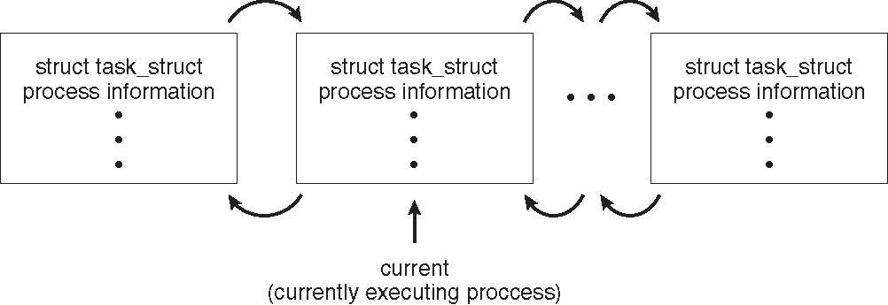
Process Representation in Linux
OS Examples
Represented by the C structure task_struct
pid t_pid; /* process identifier */
long state; /* state of the process */
unsigned int time_slice /* scheduling information */
struct task_struct *parent; /* this process’s parent */
struct list_head children; /* this process’s children */
struct files_struct *files; /* list of open files */
struct mm_struct *mm; /* address space of this process */

Slide 74
Usually after fork() call, the child process and the parent process would perform different tasks. If the same task needs to be run, then for each fork() call it would run 2 power n times, where n is the number of times fork() is invoked.
#include <stdio.h>
#include <sys/types.h>
#include <unistd.h>
int main() {
fork();
printf("Called fork() system call\n");
return 0;
}

Slide 75
Examples of IPC Systems - POSIX
POSIX Shared Memory
  Process first creates shared memory segment
  shm_fd = shm_open(name, O CREAT | O RDWR, 0666);
  Also used to open an existing segment to share it
  Set the size of the object
ftruncate(shm fd, 4096);
  Now the process could write to the shared memory
  sprintf(shared memory, "Writing to shared memory");

Slide 76
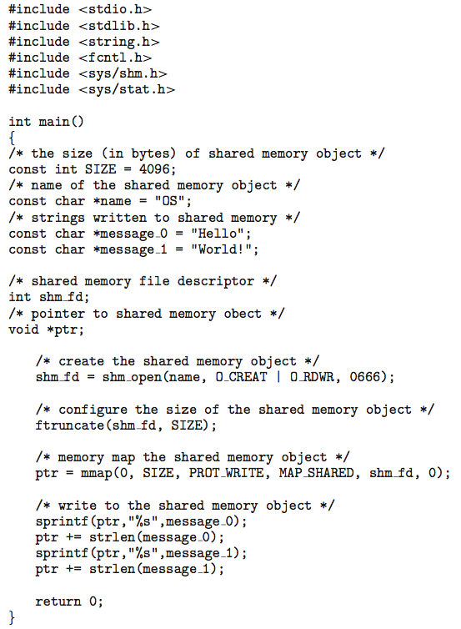
IPC POSIX Producer

Slide 77
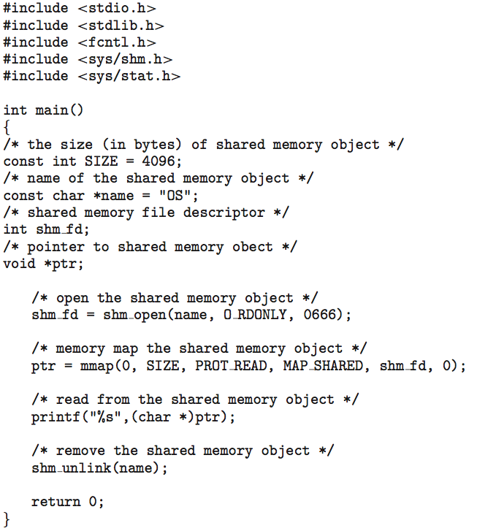
IPC POSIX Consumer

Slide 78
Examples of IPC Systems – Windows
Message-passing centric via advanced local procedure call (LPC) facility
  Only works between processes on the same system
  Uses ports (like mailboxes) to establish and maintain communication channels
  Communication works as follows:
    The client opens a handle to the subsystem’s connection port object.
    The client sends a connection request.
    The server creates two private communication ports and returns the handle to one of them to the client.
    The client and server use the corresponding port handle to send messages or callbacks and to listen for replies.

Slide 79
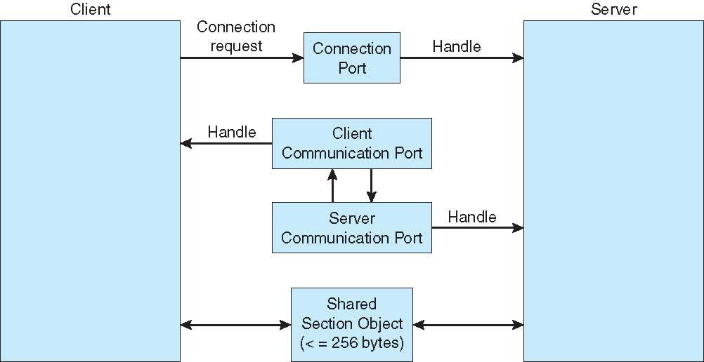
Local Procedure Calls in Windows

Slide 80
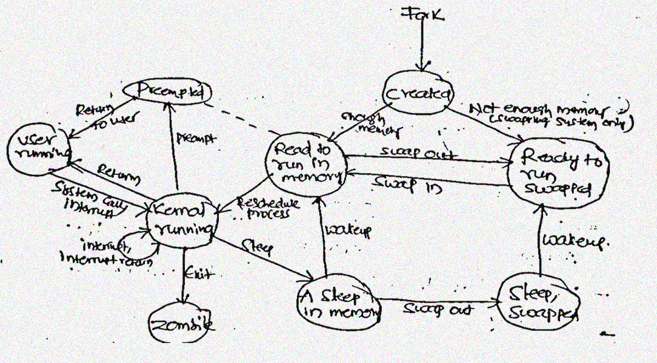
UNIX Process states
v

Slide 81
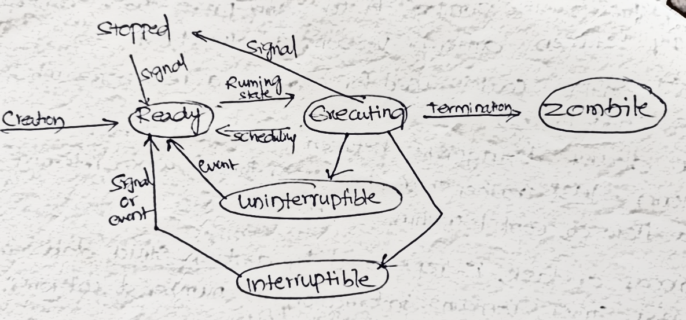
LINUX Process states

Slide 82
Solaris Scheduling
Solaris uses priority-based thread scheduling where each thread belongs to
one of six classes:
1. Time sharing (TS)
2. Interactive (IA)
3. Real time (RT)
4. System (SYS)
5. Fair share (FSS)
6. Fixed priority (FP)

Slide 83
Windows Scheduling
Windows schedules threads using a priority-based preemptive scheduling
Algorithm.
The Windows scheduler ensures that the highest-priority thread will always run.
The portion of the Windows kernel that handles scheduling is called the dispatcher.
A thread selected to run by the dispatcher will run until it is preempted by a higher-priority thread, until it terminates, until its time quantum ends, or until it calls a blocking system call, such as for I/O.
If a higher-priority real-time thread becomes ready while a lower-priority thread is running, the lower-priority thread will be preempted. This preemption gives a real-time thread preferential access to the CPU when the thread needs such access.

Slide 84
The base priorities for each priority class are:
REALTIME PRIORITY CLASS—24
HIGH PRIORITY CLASS—13
ABOVE NORMAL PRIORITY CLASS—10
NORMAL PRIORITY CLASS—8
BELOW NORMAL PRIORITY CLASS—6
IDLE PRIORITY CLASS—4

Slide 85
Linux Scheduling
provides a scheduling algorithm that runs in constant time—known as O(1)—regardless of the number of tasks on the system.
The Linux scheduler is a preemptive, priority-based algorithm with two separate priority ranges: a real-time range from 0 to 99 and a nice value ranging from 100 to 140.
Linux assigns higher-priority tasks longer time quanta and lower-priority tasks shorter time quanta
The kernel maintains a list of all runnable tasks in a runqueue data structure. Each processor maintains its own runqueue and schedules itself independently. Each runqueue contains two priority arrays: active and expired.

