Slide 1
Unit-III:
Threads, Process Synchronization & Deadlocks

Slide 2
Process
The unit or resource allocation and a unit of protection.
A virtual address space that holds the process image.
Protected access to:
  processors
  other processes
  files
  I/O resources

Slide 3
Threads
A thread is a basic unit of CPU utilization, consisting of a program counter, a stack, and a set of registers, ( and a thread ID. )
Traditional ( heavyweight ) processes have a single thread of control –
  There is one program counter, and one sequence of instructions that can be carried out at any given time.
Single sequence stream within a process
A thread is a path of execution within a process. A process can contain multiple threads.
Process are used to group the resources together and threads are the entities scheduled for execution on the CPU
A thread of execution is the smallest sequence of programmed instructions that can be managed independently by a scheduler
The threads of a process share its executable code and the values of its dynamically allocated variables and non-thread-local global variables at any given time.

Slide 4
Process vs Threads
Resource Ownership
Process includes a virtual address space to hold the process image
  the OS performs a protection function to prevent unwanted interference between processes with respect to resources
Scheduling/Execution
Follows an execution path that may be interleaved with other processes
  a process has an execution state (Running, Ready, etc.) and a dispatching priority and is scheduled and dispatched by the OS
The unit of dispatching is referred to as a thread or lightweight process
The unit of resource ownership is referred to as a process or task
Multithreading - The ability of an OS to support multiple, concurrent paths of execution within a single process

Slide 5
Threads
Most modern applications are multithreaded
Threads run within application
Multiple tasks with the application can be implemented by separate threads
  Update display
  Fetch data
  Spell checking
  Answer a network request
Process creation is heavy-weight while thread creation is light-weight
Can simplify code, increase efficiency
Kernels are generally multithreaded

Slide 6
One or More Threads in a Process
Each thread has:
An execution state (Running, Ready, etc.)
Saved thread context when not running
An execution stack
Some per-thread static storage for local variables.
Access to the memory resources of its process (all threads of a process share this)

Slide 7
Thread Process Model
Single-Threaded Process Model
Multithreaded Process Model
Thread Control Block
Thread Control Block
Thread Control Block
Process
Control
Block
User
Stack
Process
Control
Block
User
Stack
User
Stack
User
Stack
Kernel
Stack
User
Address
Space
User
Address
Space
Kernel
Stack
Kernel
Stack
Kernel
Stack

Slide 8
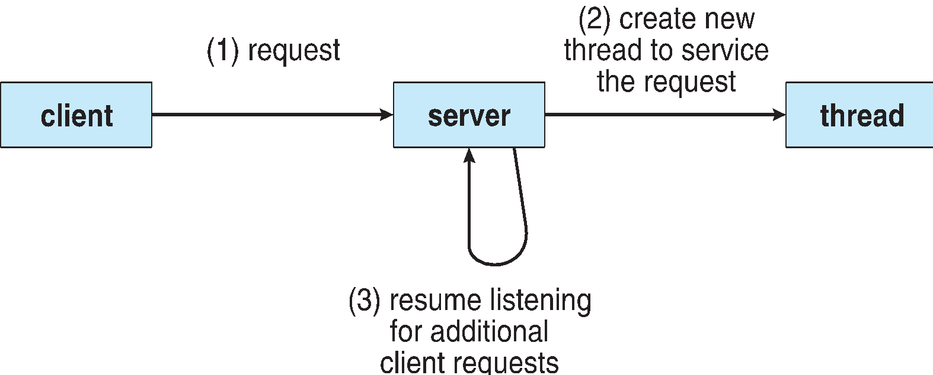
Multithreaded Server Architecture

Slide 9
Benefits of Threads
Responsiveness – may allow continued execution if part of process is blocked, especially important for user interfaces
Resource Sharing – threads share resources of process, easier than shared memory or message passing
Economy – cheaper than process creation, thread switching lower overhead than context switching
Scalability – process can take advantage of multiprocessor architectures

Slide 10
Benefits of Threads
Takes less time to create a new thread than a process
Less time to terminate a thread than a process
Switching between two threads takes less time than switching between processes.
Threads enhance efficiency in communication between programs.
In an OS that supports threads, scheduling and dispatching is done on a thread basis
Most of the state information dealing with execution is maintained in thread-level data structures
  Suspending a process involves suspending all threads of the process.
  Termination of a process terminates all threads within the process.

Slide 11
Multicore Programming
Multicore or multiprocessor systems putting pressure on programmers, challenges include:
  Dividing activities
  Balance
  Data splitting
  Data dependency
  Testing and debugging
Parallelism implies a system can perform more than one task simultaneously
Concurrency supports more than one task making progress
  Single processor / core, scheduler providing concurrency

Slide 12
Multicore Programming (Cont.)
Types of parallelism
  Data parallelism – distributes subsets of the same data across multiple cores, same operation on each
  Task parallelism – distributing threads across cores, each thread performing unique operation
As # of threads grows, so does architectural support for threading
  CPUs have cores as well as hardware threads
  Consider Oracle SPARC T4 with 8 cores, and 8 hardware threads per core

Slide 13
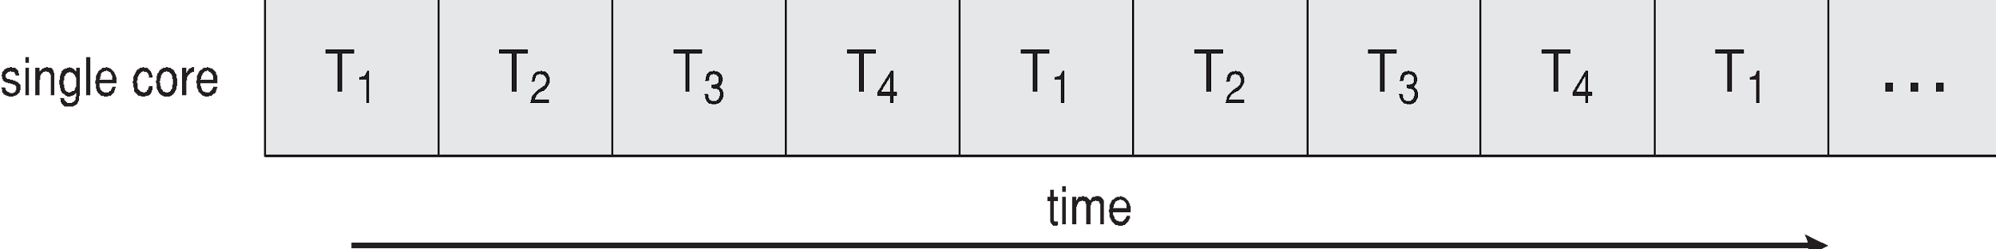
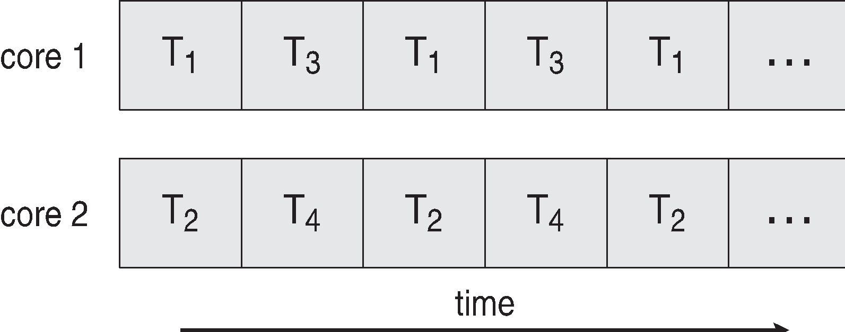
Concurrency vs. Parallelism
Concurrent execution on single-core system:
Parallelism on a multi-core system:

Slide 14
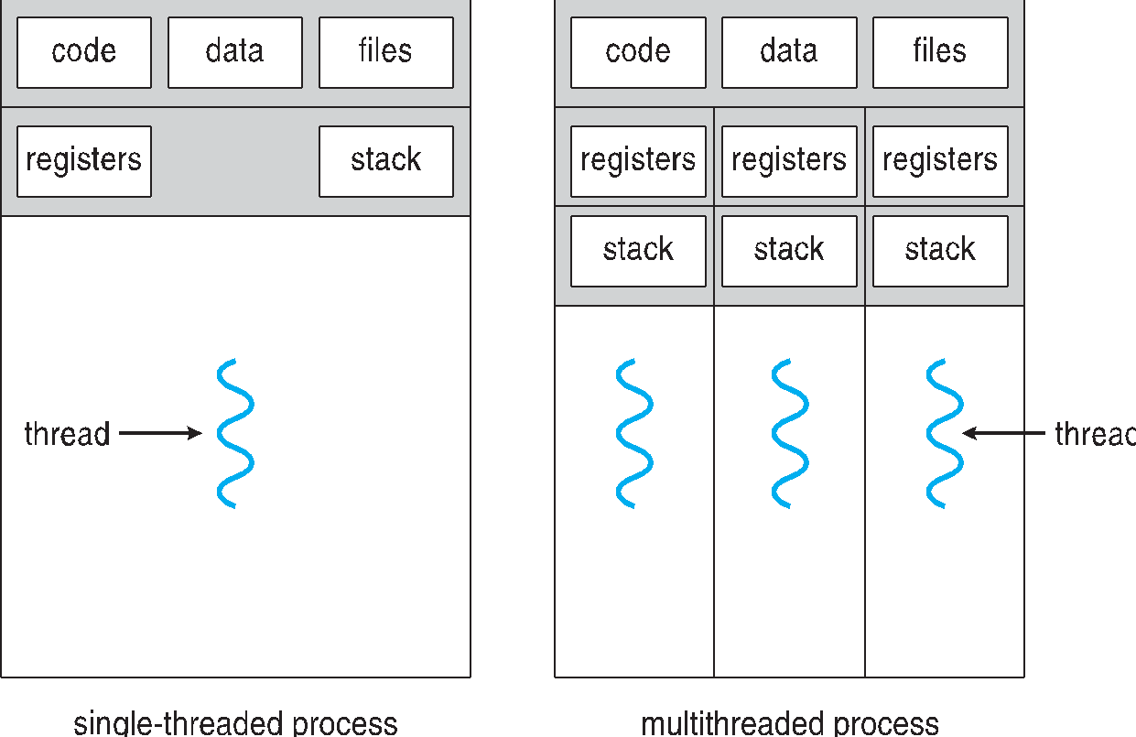
Single and Multithreaded Processes

Slide 15
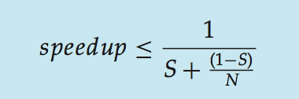
Amdahl’s Law
Identifies performance gains from adding additional cores to an application that has both serial and parallel components
S is serial portion
N processing cores
That is, if application is 75% parallel / 25% serial, moving from 1 to 2 cores results in speedup of 1.6 times
As N approaches infinity, speedup approaches 1 / S
Serial portion of an application has disproportionate effect on performance gained by adding additional cores
But does the law take into account contemporary multicore systems?

Slide 16
Thread Execution States
The key states for a thread are:
  Running
  Ready
  Blocked
Thread operations associated with a change in thread state are:
  Spawn
  Block
  Unblock
  Finish

Slide 17
Remote Procedure Call Using Thread
RPC
Request
RPC
Request
(a) RPC Request Using Single Thread
Process 1
Server
Server
RPC
Request
Server
(b) RPC Using One Thread
per Server (on a uniprocessor)
Thread A (Process 1)
Thread B (Process 1)
RPC
Request
Server
Blocked, waiting for response to RPC
Blocked, waiting for processor, which is in use by Thread B
Running

Slide 18
Multithreading Example on a Uniprocessor
Time
I/O
request
Request
Complete
Time quantum
Expires
Thread A (Process 1)
Thread B (Process 1)
Time quantum
Expires
Process created
Blocked
Ready
Running

Slide 19
Thread Synchronization
It is necessary to synchronize the activities of the various threads
  All threads of a process share the same address space and other resources
  Any alteration of a resource by one thread affects the other threads in the same process

Slide 20
Types of Threads
User Level Thread (ULT):
  All threads are management is done by the application.
  The kernel is not aware of the existence of threads.
Kernel Level Thread (KLT):
  Thread management is done by the kernel
    No thread management is done by the application
    Windows is an example of this approach.

Slide 21
Types of Threads
User
Space
Threads
Library
User
Space
Kernel
Space
Kernel
Space
P
P
(a) Pure User Level Threads
(b) Pure Kernel Level Threads

Slide 22
User Threads and Kernel Threads
User threads - management done by user-level threads library
Three primary thread libraries:
  POSIX Pthreads
  Windows threads
  Java threads
Kernel threads - Supported by the Kernel
Examples – virtually all general purpose operating systems, including:
  Windows
  Solaris
  Linux
  Tru64 UNIX
  Mac OS X

Slide 23
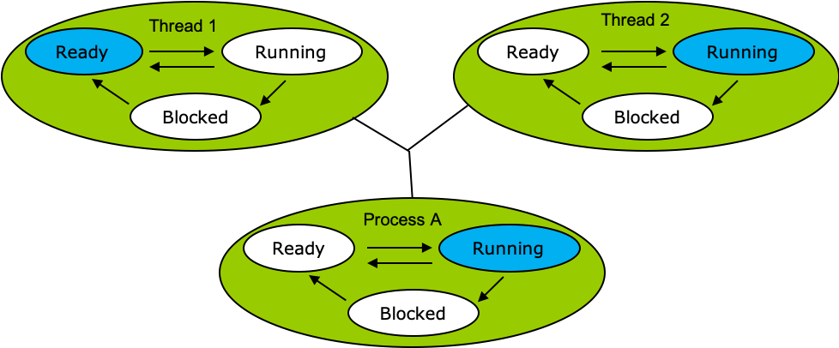
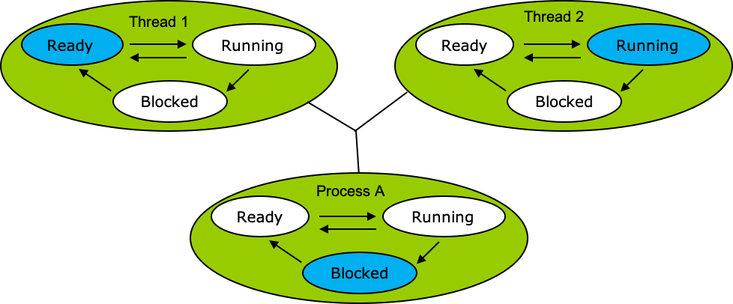
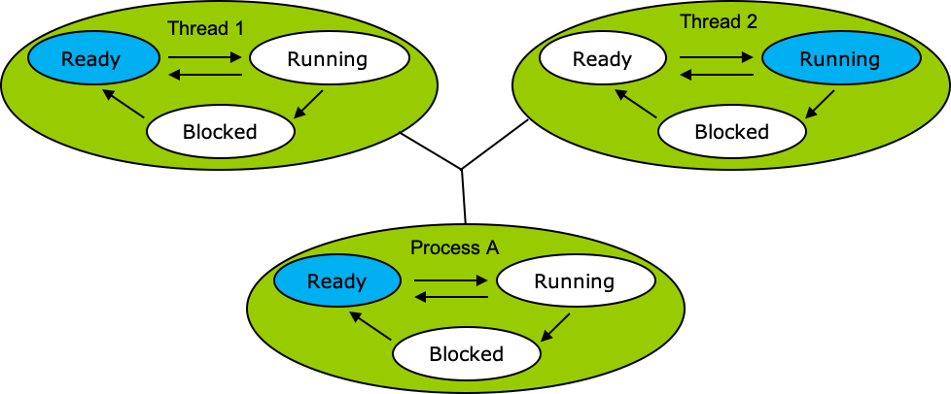
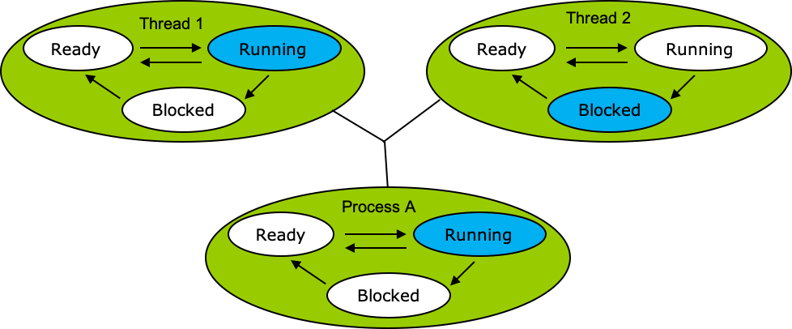
Relationships Between User-Level Thread States and Process States
(a)
(b)
(c)
(d)
Colored state is the current state

Slide 24
Advantages of ULTs
ULTs can run on any OS
Scheduling can be application specific
Thread switching doesnot require kernel mode privileges.
Disadvantages of ULTs
In a typical OS many system calls are blocking
  As a result, when a ULT executes a system call, not only is that thread blocked, but all of the threads within the process are blocked
In a pure ULT strategy, a multithreaded application cannot take advantage of multiprocessing

Slide 25
Overcoming the disadvantages of ULT
Jacketing:
Converts a blocking system call into a non-blocking system call
Writing an application as multiple processes rather than multiple
threads

Slide 26
Advantages of KLTs
The kernel can simultaneously schedule multiple threads from the same process on multiple processors
If one thread in a process is blocked, the kernel can schedule another thread of the same process
Kernel routines can be multithreaded
Disadvantages of KLTs:
The transfer of control from one thread to another within the same process requires a mode switch to the kernel.

Slide 27
Multithreading Models
Many-to-One
One-to-One
Many-to-Many

Slide 28
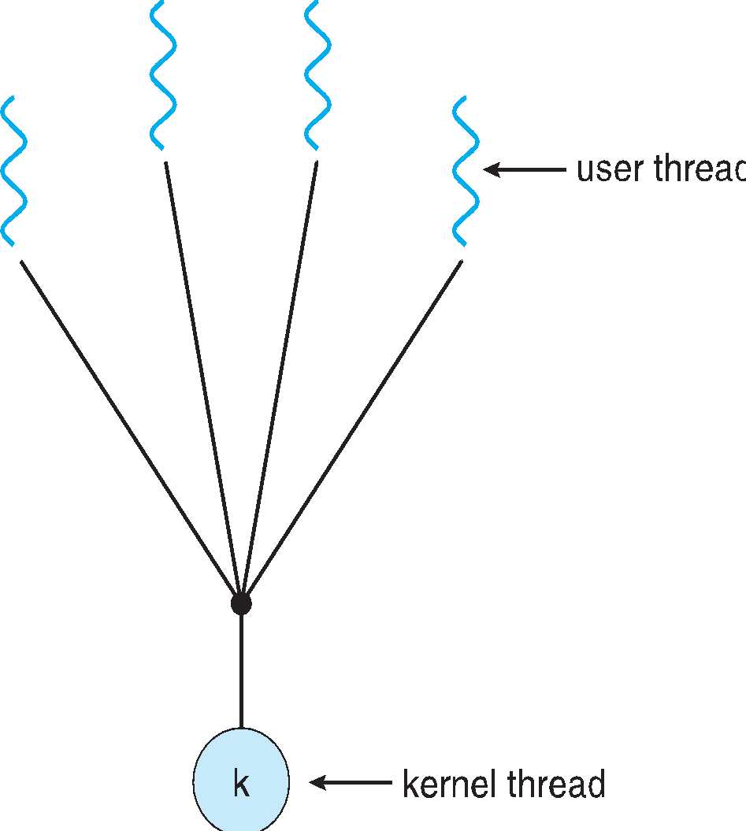
Many-to-One
Many user-level threads mapped to single kernel thread
One thread blocking causes all to block
Multiple threads may not run in parallel on muticore system because only one may be in kernel at a time
Few systems currently use this model
Examples:
  Solaris Green Threads
  GNU Portable Threads

Slide 29
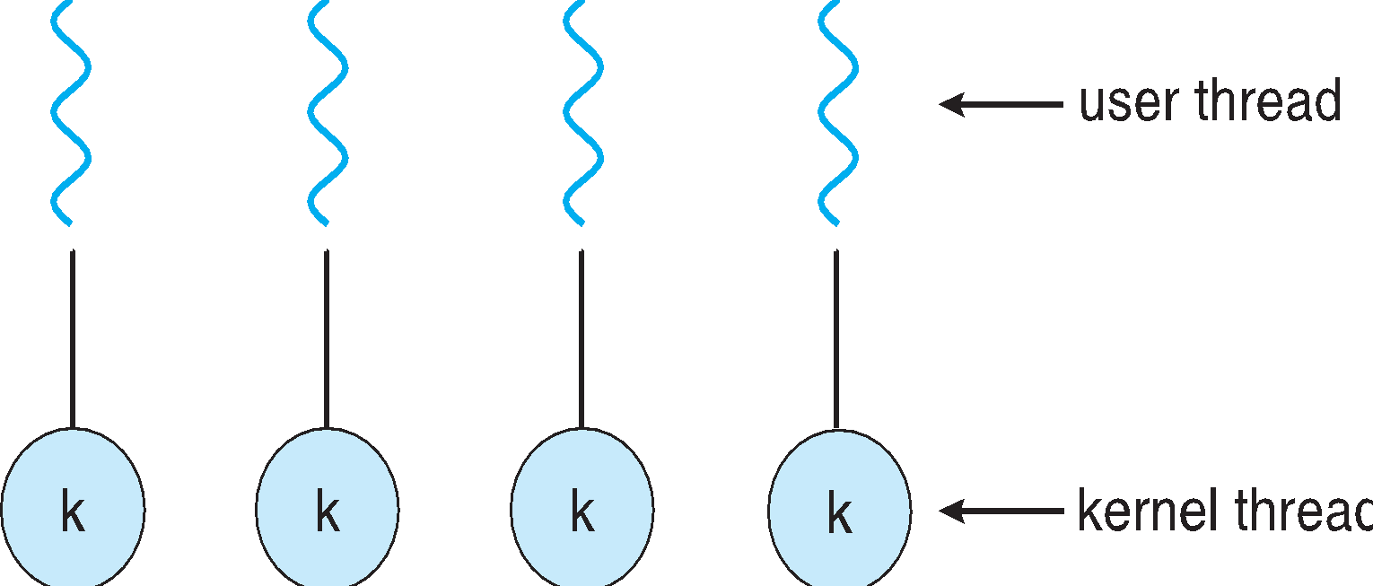
One-to-One
Each user-level thread maps to kernel thread
Creating a user-level thread creates a kernel thread
More concurrency than many-to-one
Number of threads per process sometimes restricted due to overhead
Examples
  Windows
  Linux
  Solaris 9 and later

Slide 30
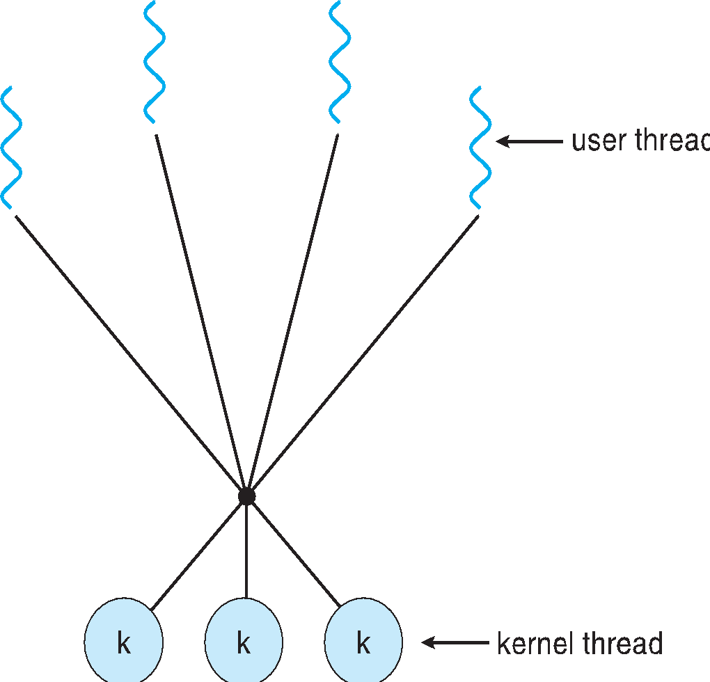
Many-to-Many Model
Allows many user level threads to be mapped to many kernel threads
Allows the operating system to create a sufficient number of kernel threads
Solaris prior to version 9
Windows with the ThreadFiber package

Slide 31
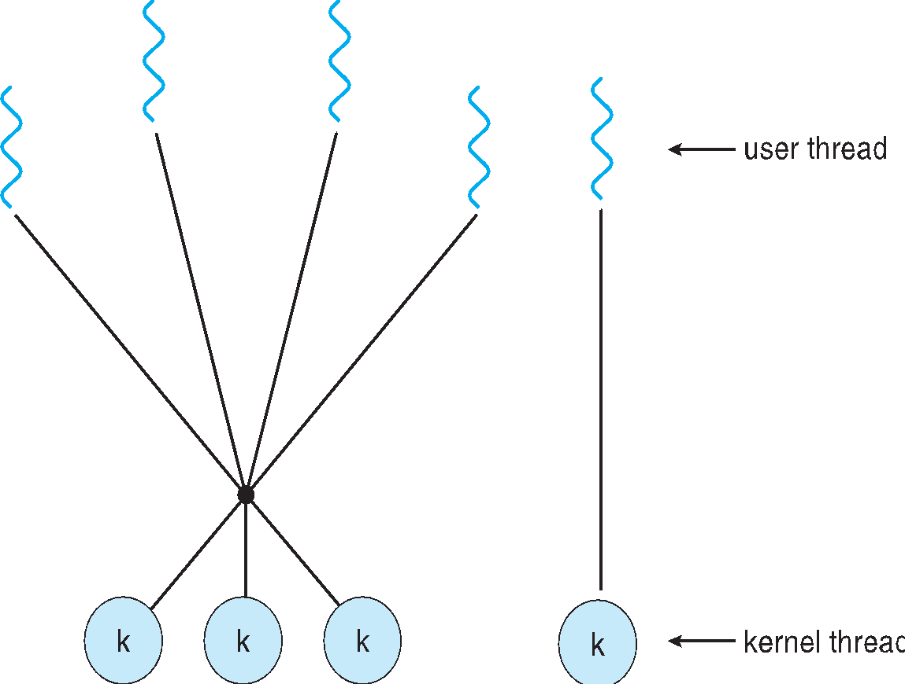
Two-level Model
Similar to M:M, except that it allows a user thread to be bound to kernel thread
Examples
  IRIX
  HP-UX
  Tru64 UNIX
  Solaris 8 and earlier

Slide 32
Process Synchronization

Slide 33
Objectives
To present the concept of process synchronization.
To introduce the critical-section problem, whose solutions can be used to ensure the consistency of shared data
To present both software and hardware solutions of the critical-section problem
To examine several classical process-synchronization problems
To explore several tools that are used to solve process synchronization problems

Slide 34
Background
Processes can execute concurrently
  May be interrupted at any time, partially completing execution
Concurrent access to shared data may result in data inconsistency
Maintaining data consistency requires mechanisms to ensure the orderly execution of cooperating processes
Illustration of the problem:
Suppose that we wanted to provide a solution to the consumer-producer problem that fills all the buffers. We can do so by having an integer counter that keeps track of the number of full buffers. Initially, counter is set to 0. It is incremented by the producer after it produces a new buffer and is decremented by the consumer after it consumes a buffer.

Slide 35
Producer
while (true) {
/* produce an item in next produced */
while (counter == BUFFER_SIZE) ;
/* do nothing */
buffer[in] = next_produced;
in = (in + 1) % BUFFER_SIZE;
counter++;
}

Slide 36
Consumer
while (true) {
while (counter == 0)
; /* do nothing */
next_consumed = buffer[out];
out = (out + 1) % BUFFER_SIZE;
counter--;
/* consume the item in next consumed */
}

Slide 37
Race Condition
counter++ could be implemented as
register1 = counter
register1 = register1 + 1
counter = register1
counter-- could be implemented as
register2 = counter
register2 = register2 - 1
counter = register2
Consider this execution interleaving with “count = 5” initially:
  S0: producer execute register1 = counter {register1 = 5}
  S1: producer execute register1 = register1 + 1 {register1 = 6}
  S2: consumer execute register2 = counter {register2 = 5}
  S3: consumer execute register2 = register2 – 1 {register2 = 4}
  S4: producer execute counter = register1 {counter = 6 }
  S5: consumer execute counter = register2 {counter = 4}

Slide 38
Critical Section Problem
Consider system of n processes {p₀, p₁, … p_{n-1}}
Each process has critical section segment of code
  Process may be changing common variables, updating table, writing file, etc
  When one process in critical section, no other may be in its critical section
Critical section problem is to design protocol to solve this
Each process must ask permission to enter critical section in entry section, may follow critical section with exit section, then remainder section

Slide 39
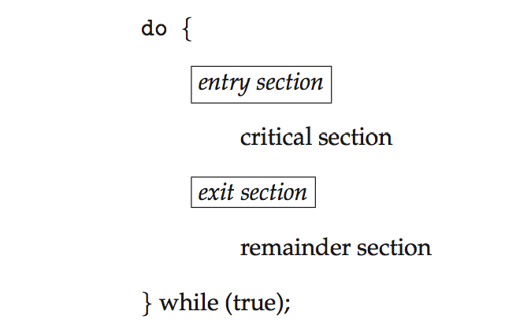
Critical Section
General structure of process P_{i}

Slide 40
Algorithm for Process P_{i}
do {
while (turn == j);
critical section
turn = j;
remainder section
} while (true);

Slide 41
Solution to Critical-Section Problem
1. Mutual Exclusion - If process P_{i} is executing in its critical section, then no other processes can be executing in their critical sections
2. Progress - If no process is executing in its critical section and there exist some processes that wish to enter their critical section, then the selection of the processes that will enter the critical section next cannot be postponed indefinitely
3. Bounded Waiting - A bound must exist on the number of times that other processes are allowed to enter their critical sections after a process has made a request to enter its critical section and before that request is granted
  Assume that each process executes at a nonzero speed
  No assumption concerning relative speed of the n processes

Slide 42
Critical-Section Handling in OS
Two approaches depending on if kernel is preemptive or non- preemptive
  Preemptive – allows preemption of process when running in kernel mode
  Non-preemptive – runs until exits kernel mode, blocks, or voluntarily yields CPU
    Essentially free of race conditions in kernel mode

Slide 43
Peterson’s Solution
Good algorithmic description of solving the problem
Two process solution
Assume that the load and store machine-language instructions are atomic; that is, cannot be interrupted
The two processes share two variables:
  int turn;
  Boolean flag[2]
The variable turn indicates whose turn it is to enter the critical section
The flag array is used to indicate if a process is ready to enter the critical section. flag[i] = true implies that process P_{i} is ready!

Slide 44
Algorithm for Process P_{i} and P_{j}
do {
flag[i] = true;
turn = j;
while (flag[j] && turn = = j);
critical section
flag[i] = false;
remainder section
} while (true);
The structure of process P_{i} in Peterson’s solution.
do {
flag[j] = true;
turn = i;
while (flag[i] && turn = = i);
critical section
flag[j] = false;
remainder section
} while (true);
The structure of process P_{j} in Peterson’s solution.

Slide 45
Peterson’s Solution (Cont.)
Provable that the three CS requirement are met:
1. Mutual exclusion is preserved
P_{i} enters CS only if:
either flag[j] = false or turn = i
2. Progress requirement is satisfied
3. Bounded-waiting requirement is met

Slide 46
Synchronization Hardware
Many systems provide hardware support for implementing the critical section code.
All solutions below based on idea of locking
  Protecting critical regions via locks
Uniprocessors – could disable interrupts
  Currently running code would execute without preemption
  Generally too inefficient on multiprocessor systems
    Operating systems using this not broadly scalable
Modern machines provide special atomic hardware instructions
    Atomic = non-interruptible
  Either test memory word and set value
  Or swap contents of two memory words

Slide 47
Solution to Critical-section Problem Using Locks
do {
acquire lock
critical section
release lock
remainder section
} while (TRUE);

Slide 48
test_and_set Instruction
Definition:
boolean test_and_set (boolean *target)
{
boolean rv = *target;
*target = TRUE;
return rv:
}
Executed atomically
Returns the original value of passed parameter
Set the new value of passed parameter to “TRUE”.

Slide 49
Solution using test_and_set()
Shared Boolean variable lock, initialized to FALSE
Solution:
do {
while (test_and_set(&lock))
; /* do nothing */
/* critical section */
lock = false;
/* remainder section */
} while (true);

Slide 50
compare_and_swap Instruction
Definition:
int compare_and_swap(int *value, int expected, int new_value) {
int temp = *value;
if (*value == expected)
*value = new_value;
return temp;
}
Executed atomically
Returns the original value of passed parameter “value”
Set the variable “value” the value of the passed parameter “new_value” but only if “value” ==“expected”. That is, the swap takes place only under this condition.

Slide 51
Solution using compare_and_swap
Shared integer “lock” initialized to 0;
Solution:
do {
while (compare_and_swap(&lock, 0, 1) != 0)
; /* do nothing */
/* critical section */
lock = 0;
/* remainder section */
} while (true);

Slide 52
Bounded-waiting Mutual Exclusion with test_and_set
do {
waiting[i] = true;
key = true;
while (waiting[i] && key)
key = test_and_set(&lock);
waiting[i] = false;
/* critical section */
j = (i + 1) % n;
while ((j != i) && !waiting[j])
j = (j + 1) % n;
if (j == i)
lock = false;
else
waiting[j] = false;
/* remainder section */
} while (true);

Slide 53
Mutex Locks
Previous solutions are complicated and generally inaccessible to application programmers
OS designers build software tools to solve critical section problem
Simplest is mutex lock
Protect a critical section by first acquire() a lock then release() the lock
  Boolean variable indicating if lock is available or not
Calls to acquire() and release() must be atomic
  Usually implemented via hardware atomic instructions
But this solution requires busy waiting
  This lock therefore called a spinlock

Slide 54
acquire() and release()
acquire() {
while (!available)
; /* busy wait */
available = false;;
}
release() {
available = true;
}
do {
acquire lock
critical section
release lock
remainder section
} while (true);

Slide 55
Semaphore

Slide 56
Semaphore
Synchronization tool that provides more sophisticated ways (than Mutex locks) for process to synchronize their activities.
Semaphore S – integer variable
Can only be accessed via two indivisible (atomic) operations
  wait() and signal()
    Originally called P() and V()
Definition of the wait() operation
  wait(S) {
  while (S <= 0)
  ; // busy wait
  S--;
  }
Definition of the signal() operation
  signal(S) {
  S++;
  }

Slide 57
Semaphore Usage
Counting semaphore – integer value can range over an unrestricted domain
Binary semaphore – integer value can range only between 0 and 1
  Same as a mutex lock
Can solve various synchronization problems
Consider P₁ and P₂ that require S₁ to happen before S₂
Create a semaphore “synch” initialized to 0
  P1:
  S₁;
  signal(synch);
  P2:
  wait(synch);
  S₂;
Can implement a counting semaphore S as a binary semaphore

Slide 58
Semaphore Implementation
Must guarantee that no two processes can execute the wait() and signal() on the same semaphore at the same time
Thus, the implementation becomes the critical section problem where the wait and signal code are placed in the critical section
  Could now have busy waiting in critical section implementation
    But implementation code is short
    Little busy waiting if critical section rarely occupied
Note that applications may spend lots of time in critical sections and therefore this is not a good solution

Slide 59
Semaphore Implementation with no Busy waiting
With each semaphore there is an associated waiting queue
Each entry in a waiting queue has two data items:
  value (of type integer)
  pointer to next record in the list
Two operations:
  block – place the process invoking the operation on the appropriate waiting queue
  wakeup – remove one of processes in the waiting queue and place it in the ready queue
typedef struct{
int value;
struct process *list;
} semaphore;

Slide 60
Implementation with no Busy waiting (Cont.)
wait(semaphore *S) {
S->value--;
if (S->value < 0) {
add this process to S->list;
block();
}
}
signal(semaphore *S) {
S->value++;
if (S->value <= 0) {
remove a process P from S->list;
wakeup(P);
}
}

Slide 61
Deadlock and Starvation
Deadlock – two or more processes are waiting indefinitely for an event that can be caused by only one of the waiting processes
Let S and Q be two semaphores initialized to 1
P₀ P₁
wait(S); wait(Q);
wait(Q); wait(S);
... ...
signal(S); signal(Q);
signal(Q); signal(S);
Starvation – indefinite blocking
  A process may never be removed from the semaphore queue in which it is suspended
Priority Inversion – Scheduling problem when lower-priority process holds a lock needed by higher-priority process
  Solved via priority-inheritance protocol

Slide 62
Classical Problems of Synchronization
Classical problems used to test newly-proposed synchronization schemes
  Bounded-Buffer Problem
  Readers and Writers Problem
  Dining-Philosophers Problem

Slide 63
Bounded-Buffer Problem
n buffers, each can hold one item
Semaphore mutex initialized to the value 1
Semaphore full initialized to the value 0
Semaphore empty initialized to the value n

Slide 64
Bounded Buffer Problem (Cont.)
The structure of the producer process
do {
...
/* produce an item in next_produced */
...
wait(empty);
wait(mutex);
...
/* add next produced to the buffer */
...
signal(mutex);
signal(full);
} while (true);

Slide 65
Bounded Buffer Problem (Cont.)
The structure of the consumer process
Do {
wait(full);
wait(mutex);
...
/* remove an item from buffer to next_consumed */
...
signal(mutex);
signal(empty);
...
/* consume the item in next consumed */
...
} while (true);

Slide 66
Readers-Writers Problem
A data set is shared among a number of concurrent processes
  Readers – only read the data set; they do not perform any updates
  Writers – can both read and write
Problem – allow multiple readers to read at the same time
  Only one single writer can access the shared data at the same time
Several variations of how readers and writers are considered – all involve some form of priorities
Shared Data
  Data set
  Semaphore rw_mutex initialized to 1
  Semaphore mutex initialized to 1
  Integer read_count initialized to 0

Slide 67
Readers-Writers Problem (Cont.)
The structure of a writer process
do {
wait(rw_mutex);
...
/* writing is performed */
...
signal(rw_mutex);
} while (true);

Slide 68
Readers-Writers Problem (Cont.)
The structure of a reader process
do {
wait(mutex);
read_count++;
if (read_count == 1)
wait(rw_mutex);
signal(mutex);
...
/* reading is performed */
...
wait(mutex);
read count--;
if (read_count == 0)
signal(rw_mutex);
signal(mutex);
} while (true);

Slide 69
Readers-Writers Problem Variations
First variation – no reader kept waiting unless writer has permission to use shared object
Second variation – once writer is ready, it performs the write ASAP
Both may have starvation leading to even more variations
Problem is solved on some systems by kernel providing reader-writer locks

Slide 70
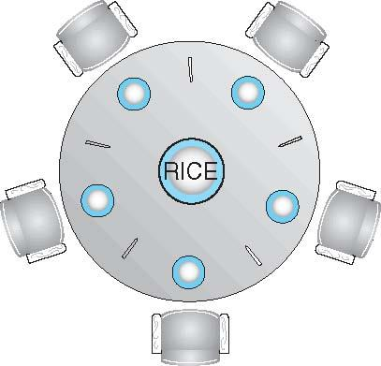
Dining-Philosophers Problem
Philosophers spend their lives alternating thinking and eating
Don’t interact with their neighbors, occasionally try to pick up 2 chopsticks (one at a time) to eat from bowl
  Need both to eat, then release both when done
In the case of 5 philosophers
  Shared data
    Bowl of rice (data set)
    Semaphore chopstick [5] initialized to 1

Slide 71
Dining-Philosophers Problem Algorithm
The structure of Philosopher i:
    do {
    wait (chopstick[i] );
    wait (chopStick[ (i + 1) % 5] );
    // eat
    signal (chopstick[i] );
    signal (chopstick[ (i + 1) % 5] );
    // think
    } while (TRUE);
What is the problem with this algorithm?

Slide 72
Dining-Philosophers Problem Algorithm (Cont.)
Deadlock handling
  Allow at most 4 philosophers to be sitting simultaneously at the table.
  Allow a philosopher to pick up the forks only if both are available (picking must be done in a critical section.
  Use an asymmetric solution -- an odd-numbered philosopher picks up first the left chopstick and then the right chopstick.
  Even-numbered philosopher picks up first the right chopstick and then the left chopstick.
Priority Inversion – Scheduling problem when lower-priority process holds a lock needed by higher-priority process
  Solved via priority-inheritance protocol

Slide 73
Problems with Semaphores
Incorrect use of semaphore operations:
  signal (mutex) …. wait (mutex)
  wait (mutex) … wait (mutex)
  Omitting of wait (mutex) or signal (mutex) (or both)
Deadlock and starvation are possible.

Slide 74
Monitors

Slide 75
Monitors
A high-level abstraction that provides a convenient and effective mechanism for process synchronization
Abstract data type, internal variables only accessible by code within the procedure
Only one process may be active within the monitor at a time
But not powerful enough to model some synchronization schemes
    monitor monitor-name
    {
    // shared variable declarations
    procedure P1 (…) { …. }
    procedure Pn (…) {……}
    Initialization code (…) { … }
    }
    }

Slide 76
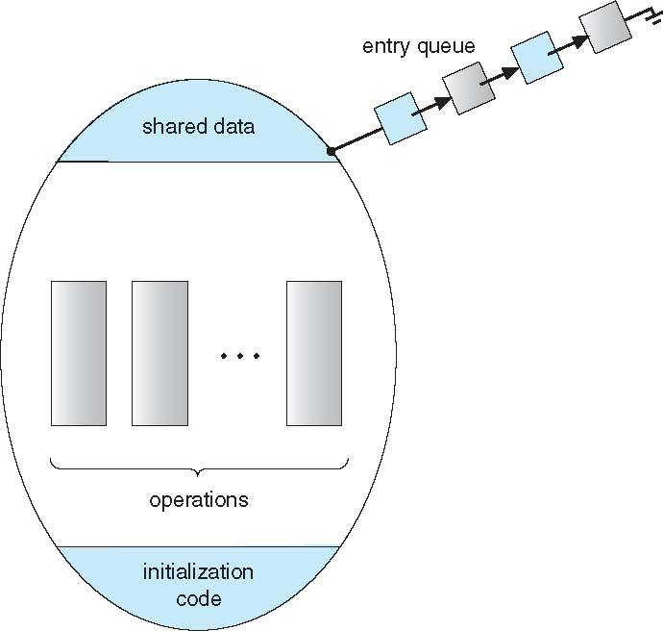
Schematic view of a Monitor

Slide 77
Condition Variables
condition x, y;
Two operations are allowed on a condition variable:
  x.wait() – a process that invokes the operation is suspended until x.signal()
  x.signal() – resumes one of processes (if any) that invoked x.wait()
    If no x.wait() on the variable, then it has no effect on the variable

Slide 78
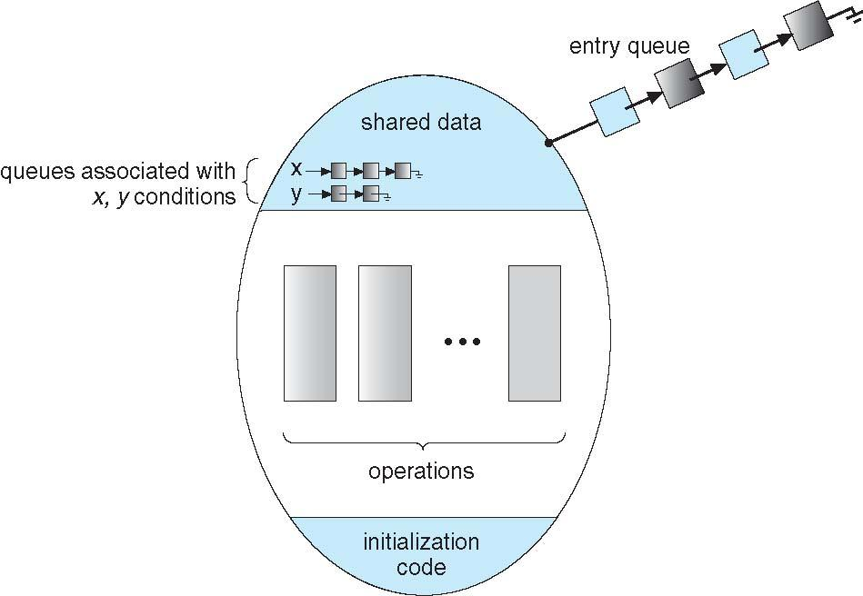
Monitor with Condition Variables

Slide 79
Condition Variables Choices
If process P invokes x.signal(), and process Q is suspended in x.wait(), what should happen next?
  Both Q and P cannot execute in parallel.
  If Q is resumed, then P must wait
Options include
  Signal and wait – P waits until Q either leaves the monitor or it waits for another condition
  Signal and continue – Q waits until P either leaves the monitor or it waits for another condition
  Both have pros and cons – language implementer can decide
  Monitors implemented in Concurrent Pascal compromise
    P executing signal immediately leaves the monitor, Q is resumed
  Implemented in other languages including Mesa, C#, Java

Slide 80
Monitor Solution to Dining Philosophers
monitor DiningPhilosophers
{
enum { THINKING; HUNGRY, EATING) state [5] ;
condition self [5];
void pickup (int i) {
state[i] = HUNGRY;
test(i);
if (state[i] != EATING) self[i].wait;
}
void putdown (int i) {
state[i] = THINKING;
// test left and right neighbors
test((i + 4) % 5);
test((i + 1) % 5);
}

Slide 81
Solution to Dining Philosophers (Cont.)
void test (int i) {
if ((state[(i + 4) % 5] != EATING) &&
(state[i] == HUNGRY) &&
(state[(i + 1) % 5] != EATING) ) {
state[i] = EATING ;
self[i].signal () ;
}
}
initialization_code() {
for (int i = 0; i < 5; i++)
state[i] = THINKING;
}
}

Slide 82
Solution to Dining Philosophers (Cont.)
Each philosopher i invokes the operations pickup() and putdown() in the following sequence:
DiningPhilosophers.pickup(i);
EAT
DiningPhilosophers.putdown(i);
No deadlock, but starvation is possible

Slide 83
Monitor Implementation Using Semaphores
Variables
semaphore mutex; // (initially = 1)
semaphore next; // (initially = 0)
int next_count = 0;
Each procedure F will be replaced by
wait(mutex);
…
body of F;
…
if (next_count > 0)
signal(next)
else
signal(mutex);
Mutual exclusion within a monitor is ensured

Slide 84
Monitor Implementation – Condition Variables
For each condition variable x, we have:
semaphore x_sem; // (initially = 0)
int x_count = 0;
The operation x.wait can be implemented as:
x_count++;
if (next_count > 0)
signal(next);
else
signal(mutex);
wait(x_sem);
x_count--;

Slide 85
Monitor Implementation (Cont.)
The operation x.signal can be implemented as:
if (x_count > 0) {
next_count++;
signal(x_sem);
wait(next);
next_count--;
}

Slide 86
Resuming Processes within a Monitor
If several processes queued on condition x, and x.signal() executed, which should be resumed?
FCFS frequently not adequate
conditional-wait construct of the form x.wait(c)
  Where c is priority number
  Process with lowest number (highest priority) is scheduled next

Slide 87
Single Resource allocation
Allocate a single resource among competing processes using priority numbers that specify the maximum time a process plans to use the resource
R.acquire(t);
...
access the resurce;
...
R.release;
Where R is an instance of type ResourceAllocator

Slide 88
A Monitor to Allocate Single Resource
monitor ResourceAllocator
{
boolean busy;
condition x;
void acquire(int time) {
if (busy)
x.wait(time);
busy = TRUE;
}
void release() {
busy = FALSE;
x.signal();
}
initialization code() {
busy = FALSE;
}
}

Slide 89
Deadlocks

Slide 90
Deadlocks
System Model
Deadlock Characterization
Methods for Handling Deadlocks
Deadlock Prevention
Deadlock Avoidance
Deadlock Detection
Recovery from Deadlock
a waiting process is never again able to change state, because the resources it has requested are held by other waiting processes. This situation is called a deadlock.

Slide 91
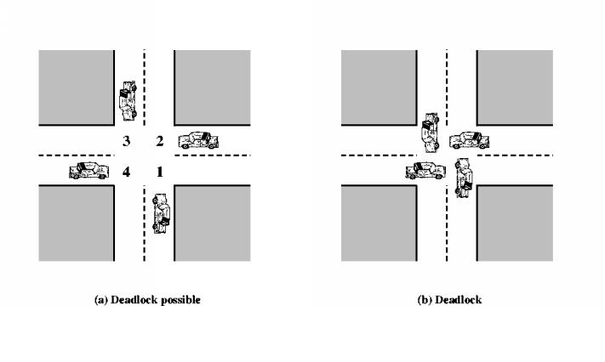
System Model
System consists of resources
Resource types R₁, R₂, . . ., R_{m}
    CPU cycles, memory space, I/O devices
Each resource type R_{i} has W_{i} instances.
Each process utilizes a resource as follows:
  request
  use
  release

Slide 92
Deadlock Characterization
Deadlock can arise if four conditions hold simultaneously.
Mutual exclusion: only one process at a time can use a resource
Hold and wait: a process holding at least one resource is waiting to acquire additional resources held by other processes
No preemption: a resource can be released only voluntarily by the process holding it, after that process has completed its task
Circular wait: there exists a set {P₀, P₁, …, P_{n}} of waiting processes such that P₀ is waiting for a resource that is held by P₁, P₁ is waiting for a resource that is held by P₂, …, P_{n–1} is waiting for a resource that is held by P_{n}, and P_{n} is waiting for a resource that is held by P₀.

Slide 93
Deadlock with Mutex Locks
Deadlocks can occur via system calls, locking, etc.
Let’s see how deadlock can occur in a multithreaded Pthread program using mutex locks.
  The pthread_mutex_init() function initializes an unlocked mutex.
  Mutex locks are acquired and released using pthread_mutex_lock() and pthread_mutex_unlock(), respectively.
  If a thread attempts to acquire a locked mutex, the call to pthread_mutex_lock() blocks the thread until the owner of the mutex lock invokes pthread_mutex_unlock().

Slide 94
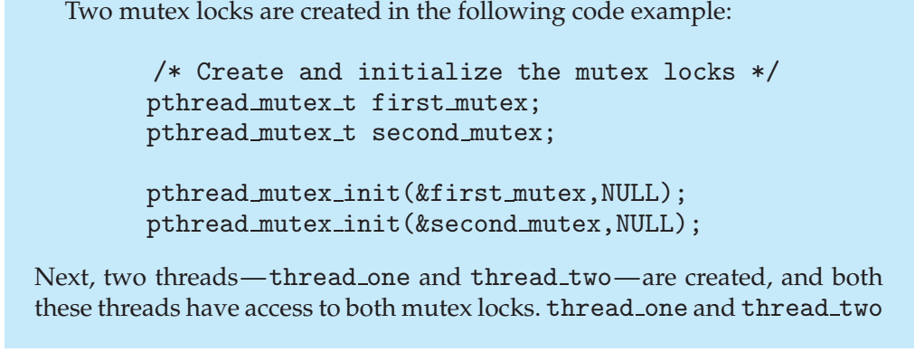
Deadlock with Mutex Locks

Slide 95
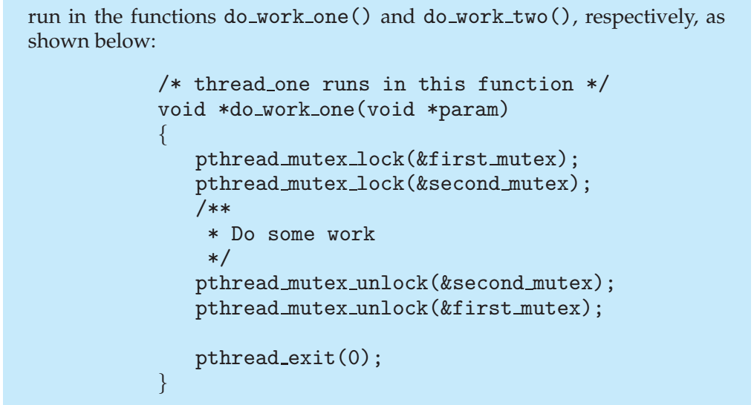
Deadlock with Mutex Locks

Slide 96
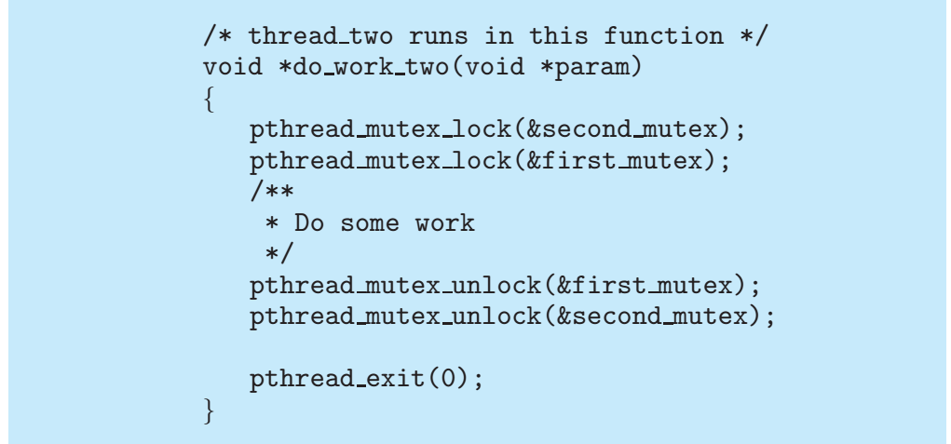
Deadlock with Mutex Locks

Slide 97
Deadlock with Mutex Locks
In this example, thread one attempts to acquire the mutex locks in the order
  (1) first_mutex, (2) second_mutex,
  while thread two attempts to acquire the mutex locks in the order (1) second_mutex, (2) first_mutex.
Deadlock is possible if thread one acquires first_mutex while thread two acquires second_mutex.

Slide 98
Deadlock with Mutex Locks
Note that, even though deadlock is possible, it will not occur if thread one can acquire and release the mutex locks for first_mutex and second_mutex before thread two attempts to acquire the locks.
The order in which the threads run depends on how they are scheduled by the CPU scheduler.
This example illustrates a problem with handling deadlocks:
  it is difficult to identify and test for deadlocks that may occur only under certain scheduling circumstances.

Slide 99
Resource-Allocation Graph
A set of vertices V and a set of edges E.
V is partitioned into two types:
  P = {P₁, P₂, …, P_{n}}, the set consisting of all the processes in the system
  R = {R₁, R₂, …, R_{m}}, the set consisting of all resource types in the system
request edge – directed edge P_{i} → R_{j}
assignment edge – directed edge R_{j} → P_{i}

Slide 100
Resource-Allocation Graph (Cont.)
Process
Resource Type with 4 instances
P_{i} requests instance of R_{j}
P_{i} is holding an instance of R_{j}
P_{i}
R_{j}
P_{i}
R_{j}

Slide 101
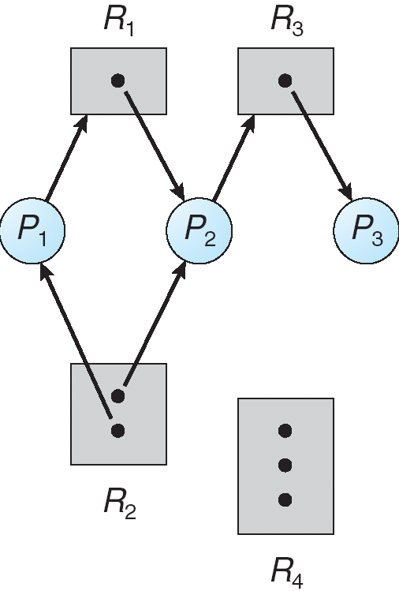
Example of a Resource Allocation Graph

Slide 102
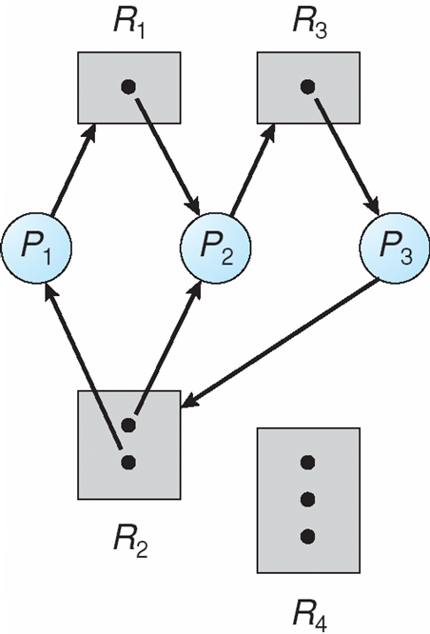
Resource Allocation Graph With A Deadlock

Slide 103
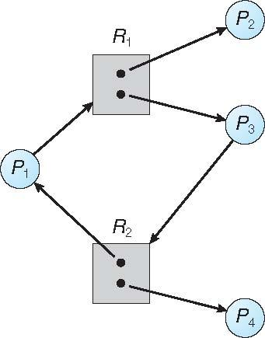
Graph With A Cycle But No Deadlock

Slide 104
Basic Facts
If graph contains no cycles ⇒ no deadlock
If graph contains a cycle ⇒
  if only one instance per resource type, then deadlock
  if several instances per resource type, possibility of deadlock

Slide 105
Methods for Handling Deadlocks
Ensure that the system will never enter a deadlock state:
  Deadlock prevention
  Deadlock avoidance
Allow the system to enter a deadlock state and then recover
Ignore the problem and pretend that deadlocks never occur in the system; used by most operating systems, including UNIX

Slide 106
Deadlock Prevention
Restrain the ways request can be made
Mutual Exclusion – not required for sharable resources (e.g., read-only files); must hold for non-sharable resources
Hold and Wait – must guarantee that whenever a process requests a resource, it does not hold any other resources
  Require process to request and be allocated all its resources before it begins execution, or allow process to request resources only when the process has none allocated to it.
  Low resource utilization; starvation possible

Slide 107
Deadlock Prevention (Cont.)
No Preemption –
  If a process that is holding some resources requests another resource that cannot be immediately allocated to it, then all resources currently being held are released
  Preempted resources are added to the list of resources for which the process is waiting
  Process will be restarted only when it can regain its old resources, as well as the new ones that it is requesting
  we preempt the desired resources from the waiting process and allocate them to the requesting process. If the resources are neither available nor held by a waiting process, the requesting process must wait.
Circular Wait – impose a total ordering of all resource types, and require that each process requests resources in an increasing order of enumeration

Slide 108
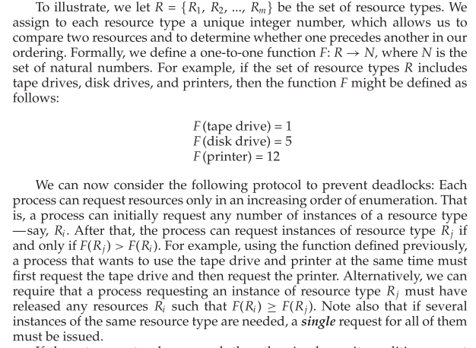

Slide 109
Deadlock Example
/* thread one runs in this function */
void *do_work_one(void *param)
{
pthread_mutex_lock(&first_mutex);
pthread_mutex_lock(&second_mutex);
/** * Do some work */
pthread_mutex_unlock(&second_mutex);
pthread_mutex_unlock(&first_mutex);
pthread_exit(0);
}
/* thread two runs in this function */
void *do_work_two(void *param)
{
pthread_mutex_lock(&second_mutex);
pthread_mutex_lock(&first_mutex);
/** * Do some work */
pthread_mutex_unlock(&first_mutex);
pthread_mutex_unlock(&second_mutex);
pthread_exit(0);
}

Slide 110
Deadlock Example with Lock Ordering
void transaction(Account from, Account to, double amount)
{
mutex lock1, lock2;
lock1 = get_lock(from);
lock2 = get_lock(to);
acquire(lock1);
acquire(lock2);
withdraw(from, amount);
deposit(to, amount);
release(lock2);
release(lock1);
}
Transactions 1 and 2 execute concurrently.
Transaction 1 transfers $25 from account A to account B, and
Transaction 2 transfers $50 from account B to account A

Slide 111
Deadlock Avoidance
Requires that the system has some additional a priori information
available
Simplest and most useful model requires that each process declare the maximum number of resources of each type that it may need
The deadlock-avoidance algorithm dynamically examines the resource-allocation state to ensure that there can never be a circular-wait condition
Resource-allocation state is defined by the number of available and allocated resources, and the maximum demands of the processes

Slide 112
Safe State
When a process requests an available resource, system must decide if immediate allocation leaves the system in a safe state
System is in safe state if there exists a sequence <P₁, P₂, …, P_{n}> of ALL the processes in the systems such that for each P_{i}, the resources that P_{i} can still request can be satisfied by currently available resources + resources held by all the P_{j}, with j < I
That is:
  If P_{i} resource needs are not immediately available, then P_{i} can wait until all P_{j} have finished
  When P_{j} is finished, P_{i} can obtain needed resources, execute, return allocated resources, and terminate
  When P_{i} terminates, P_{i +1} can obtain its needed resources, and so on

Slide 113
Basic Facts
If a system is in safe state ⇒ no deadlocks
If a system is in unsafe state ⇒ possibility of deadlock
Avoidance ⇒ ensure that a system will never enter an unsafe state.

Slide 114
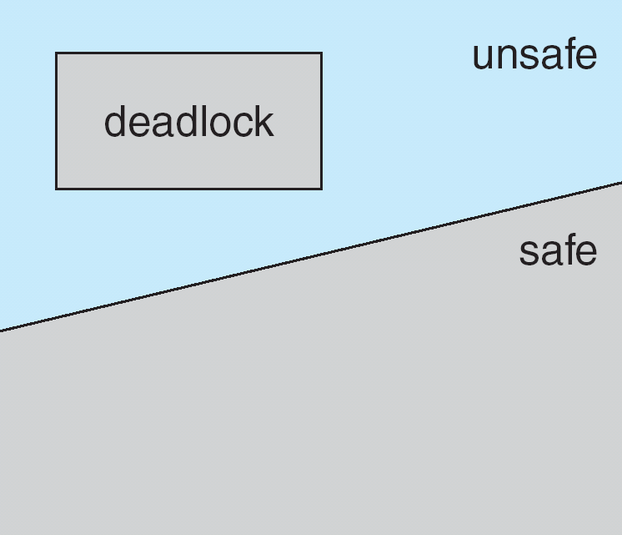
Safe, Unsafe, Deadlock State
To illustrate, we consider a system with twelve magnetic tape drives and three processes: P0 , P1 , and P2 .
Process P0 requires ten tape drives, process P1 may need as many as four tape drives, and process P2 may need up to nine tape drives.
Suppose that, at time t0 , process P0 is holding ﬁve tape drives, process P1 is holding two tape drives, and process P2 is holding two tape drives.
A system can go from a safe state to an unsafe state. Suppose that, at time t1 , process P2 requests and is allocated one more tape drive. The system is no
longer in a safe state.

Slide 115
Avoidance Algorithms
Single instance of a resource type
  Use a resource-allocation graph
Multiple instances of a resource type
  Use the banker’s algorithm

Slide 116
Resource-Allocation Graph Scheme
Claim edge P_{i} → R_{j} indicated that process P_{j} may request resource R_{j}; represented by a dashed line.
Claim edge converts to request edge when a process requests a resource.
Request edge converted to an assignment edge when the resource is allocated to the process.
When a resource is released by a process, assignment edge reconverts to a claim edge.
Resources must be claimed a priori in the system.

Slide 117
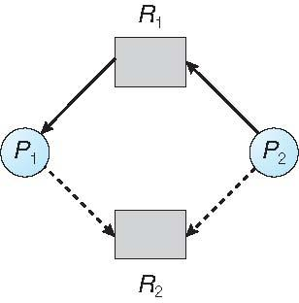
Resource-Allocation Graph

Slide 118
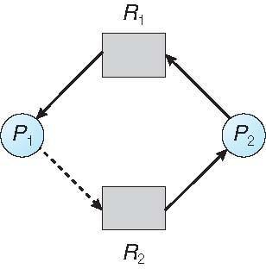
Unsafe State In Resource-Allocation Graph

Slide 119
Resource-Allocation Graph Algorithm
Suppose that process P_{i} requests a resource R_{j}
The request can be granted only if converting the request edge to an assignment edge does not result in the formation of a cycle in the resource allocation graph

Slide 120
Banker’s Algorithm
Multiple instances
Each process must a priori claim maximum use
When a process requests a resource it may have to wait
When a process gets all its resources it must return them in a finite amount of time

Slide 121
Data Structures for the Banker’s Algorithm
Let n = number of processes, and m = number of resources types.
Available: Vector of length m. If available [j] = k, there are k instances of resource type R_{j} available
Max: n x m matrix. If Max [i,j] = k, then process P_{i} may request at most k instances of resource type R_{j}
Allocation: n x m matrix. If Allocation[i,j] = k then P_{i} is currently allocated k instances of R_{j}
Need: n x m matrix. If Need[i,j] = k, then P_{i} may need k more instances of R_{j} to complete its task
    Need [i,j] = Max[i,j] – Allocation [i,j]

Slide 122
Safety Algorithm
1. Let Work and Finish be vectors of length m and n, respectively. Initialize:
      Work = Available
      Finish [i] = false for i = 0, 1, …, n- 1
2. Find an i such that both:
  (a) Finish [i] = false
  (b) Need_{i} ≤ Work
  If no such i exists, go to step 4
3. Work = Work + Allocation_{i}
Finish[i] = true
go to step 2
4. If Finish [i] == true for all i, then the system is in a safe state

Slide 123
Resource-Request Algorithm for Process P_{i}
Request_{i} = request vector for process P_{i}. If Request_{i} [j] = k then process P_{i} wants k instances of resource type R_{j}
  1. If Request_{i} ≤ Need_{i} go to step 2. Otherwise, raise error condition, since process has exceeded its maximum claim
  2. If Request_{i} ≤ Available, go to step 3. Otherwise P_{i} must wait, since resources are not available
  3. Pretend to allocate requested resources to P_{i} by modifying the state as follows:
      Available = Available – Request_{i};
      Allocation_{i} = Allocation_{i} + Request_{i};
      Need_{i} = Need_{i} – Request_{i};
    If safe ⇒ the resources are allocated to P_{i}
    If unsafe ⇒ P_{i} must wait, and the old resource-allocation state is restored

Slide 124
Example of Banker’s Algorithm
5 processes P₀ through P₄;
3 resource types:
A (10 instances), B (5instances), and C (7 instances)
Snapshot at time T₀:
Allocation Max Available
A B C A B C A B C
P₀ 0 1 0 7 5 3 3 3 2
P₁ 2 0 0 3 2 2
P₂ 3 0 2 9 0 2
P₃ 2 1 1 2 2 2
P₄ 0 0 2 4 3 3

Slide 125
Example (Cont.)
The content of the matrix Need is defined to be Max – Allocation
Need
A B C
P₀ 7 4 3
P₁ 1 2 2
P₂ 6 0 0
P₃ 0 1 1
P₄ 4 3 1
The system is in a safe state since the sequence < P₁, P₃, P₄, P₂, P₀> satisfies safety criteria

Slide 126
Example: P₁ Request (1,0,2)
Check that Request ≤ Available (that is, (1,0,2) ≤ (3,3,2) ⇒ true
Allocation Need Available
A B C A B C A B C
P₀ 0 1 0 7 4 3 2 3 0
P₁ 3 0 2 0 2 0
P₂ 3 0 2 6 0 0
P₃ 2 1 1 0 1 1
P₄ 0 0 2 4 3 1
Executing safety algorithm shows that sequence < P₁, P₃, P₄, P₀, P₂> satisfies safety requirement
Can request for (3,3,0) by P₄ be granted?
Can request for (0,2,0) by P₀ be granted?

Slide 127
Deadlock Detection
Allow system to enter deadlock state
Detection algorithm
Recovery scheme

Slide 128
Single Instance of Each Resource Type
Maintain wait-for graph
  Nodes are processes
  P_{i} → P_{j} if P_{i} is waiting for P_{j}
Periodically invoke an algorithm that searches for a cycle in the graph.
If there is a cycle, there exists a deadlock
An algorithm to detect a cycle in a graph requires an order of n² operations, where n is the number of vertices in the graph

Slide 129
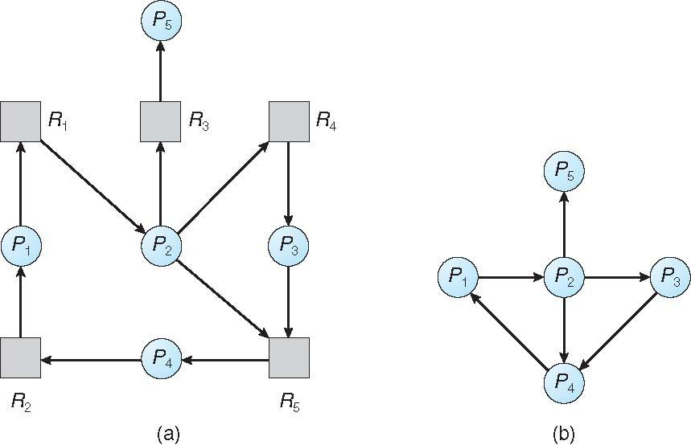
Resource-Allocation Graph and Wait-for Graph
Resource-Allocation Graph
Corresponding wait-for graph

Slide 130
Several Instances of a Resource Type
Available: A vector of length m indicates the number of available resources of each type
Allocation: An n x m matrix defines the number of resources of each type currently allocated to each process
Request: An n x m matrix indicates the current request of each process. If Request [i][j] = k, then process P_{i} is requesting k more instances of resource type R_{j}.

Slide 131
Detection Algorithm
1. Let Work and Finish be vectors of length m and n, respectively Initialize:
  (a) Work = Available
  (b) For i = 1,2, …, n, if Allocation_{i} ≠ 0, then
  Finish[i] = false; otherwise, Finish[i] = true
2. Find an index i such that both:
  (a) Finish[i] == false
  (b) Request_{i} ≤ Work
  If no such i exists, go to step 4

Slide 132
Detection Algorithm (Cont.)
3. Work = Work + Allocation_{i}
Finish[i] = true
go to step 2
4. If Finish[i] == false, for some i, 1 ≤ i ≤ n, then the system is in deadlock state. Moreover, if Finish[i] == false, then P_{i} is deadlocked
Algorithm requires an order of O(m x n²) operations to detect whether the system is in deadlocked state

Slide 133
Example of Detection Algorithm
Five processes P₀ through P₄; three resource types
A (7 instances), B (2 instances), and C (6 instances)
Snapshot at time T₀:
Allocation Request Available
A B C A B C A B C
P₀ 0 1 0 0 0 0 0 0 0
P₁ 2 0 0 2 0 2
P₂ 3 0 3 0 0 0
P₃ 2 1 1 1 0 0
P₄ 0 0 2 0 0 2
Sequence <P₀, P₂, P₃, P₁, P₄> will result in Finish[i] = true for all i

Slide 134
Example (Cont.)
P₂ requests an additional instance of type C
Request
A B C
P₀ 0 0 0
P₁ 2 0 2
P₂ 0 0 1
P₃ 1 0 0
P₄ 0 0 2
State of system?
  Can reclaim resources held by process P₀, but insufficient resources to fulfill other processes; requests
  Deadlock exists, consisting of processes P₁, P₂, P₃, and P₄

Slide 135
Detection-Algorithm Usage
When, and how often, to invoke depends on:
  How often a deadlock is likely to occur?
  How many processes will need to be rolled back?
    one for each disjoint cycle
Of course, invoking the deadlock-detection algorithm for every resource request will incur considerable overhead in computation time. A less expensive alternative is simply to invoke the algorithm at deﬁned intervals—for example, once per hour or whenever CPU utilization drops below 40 percent.
If detection algorithm is invoked arbitrarily, there may be many cycles in the resource graph and so we would not be able to tell which of the many deadlocked processes “caused” the deadlock.
we can invoke the deadlock-detection algorithm every time a request for allocation cannot be granted immediately.

Slide 136
Recovery from Deadlock: Process Termination
Abort all deadlocked processes
Abort one process at a time until the deadlock cycle is eliminated
In which order should we choose to abort?
  Priority of the process
  How long process has computed, and how much longer to completion
  Resources the process has used
  Resources process needs to complete
  How many processes will need to be terminated
  Is process interactive or batch?

Slide 137
Recovery from Deadlock: Resource Preemption
Selecting a victim – minimize cost
Rollback – return to some safe state, restart process for that state
Starvation – same process may always be picked as victim, include number of rollback in cost factor

