Slide 1
Unit-IV: Memory Allocation
SRM University, AP

Slide 2
To provide a detailed description of various ways of organizing memory
hardware.
To explore various techniques of allocating memory to processes.
To discuss in detail how paging works in contemporary computer systems.

Slide 3
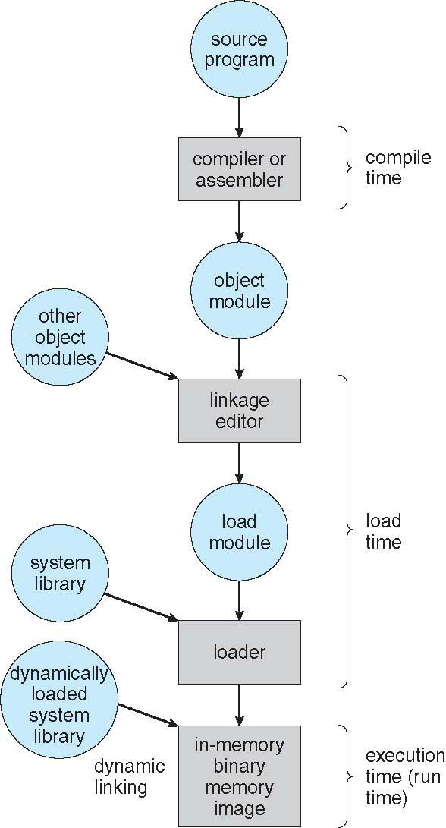
Steps from Program 🡪 Process

Slide 4
Some Background Knowledge
Program must be brought (from disk) into memory and placed within a process for it to be run
Main memory and registers are only storage that CPU can access directly
Memory unit only sees a stream of <addresses + read requests>, or <address + data and write requests>
Register can be accessed in one CPU clock (or less) but Main Memory is not
Cache sits between main memory and CPU registers
Protection of memory required to ensure correct address
Depending on the memory management in use, the process may be moved between disk and memory during its execution
A compiler typically binds these symbolic addresses to relocatable addresses
The linkage editor or loader in turn binds the relocatable addresses to absolute addresses

Slide 5
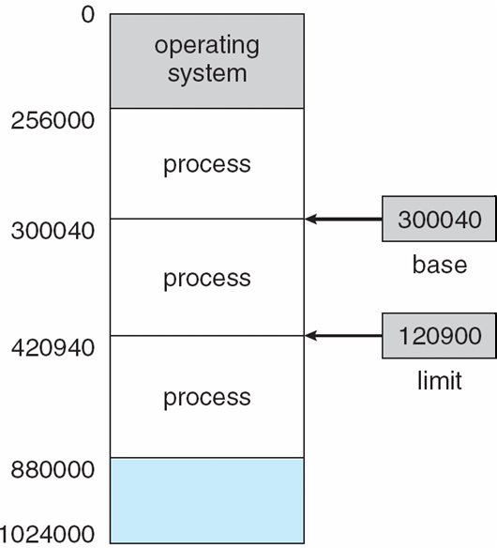
Base and Limit Registers
A pair of base and limit registers define the logical address space
CPU must check every memory access generated in user mode to be sure it is between base and limit for that user
Separate per-process memory space
ability to determine the range of legal
addresses that the process may access.

Slide 6
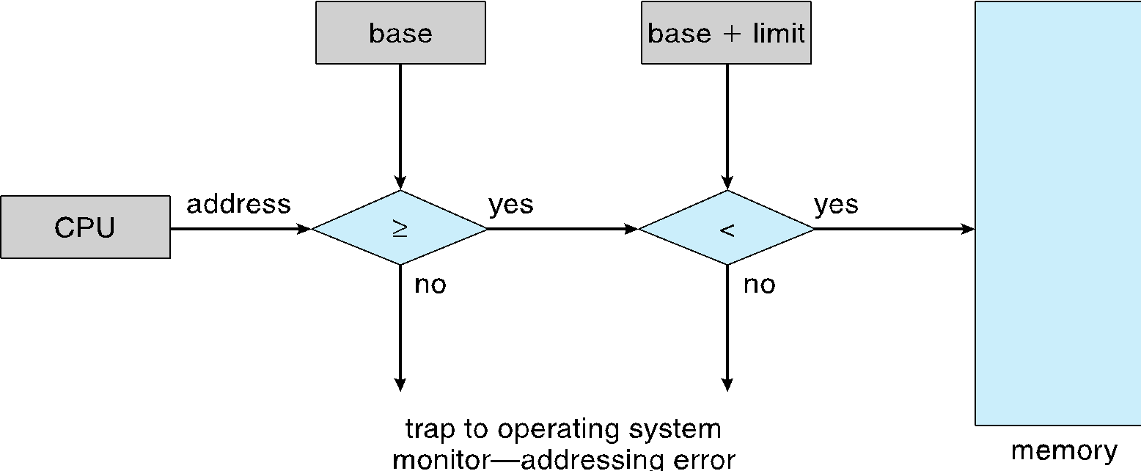
Hardware Address Protection

Slide 7
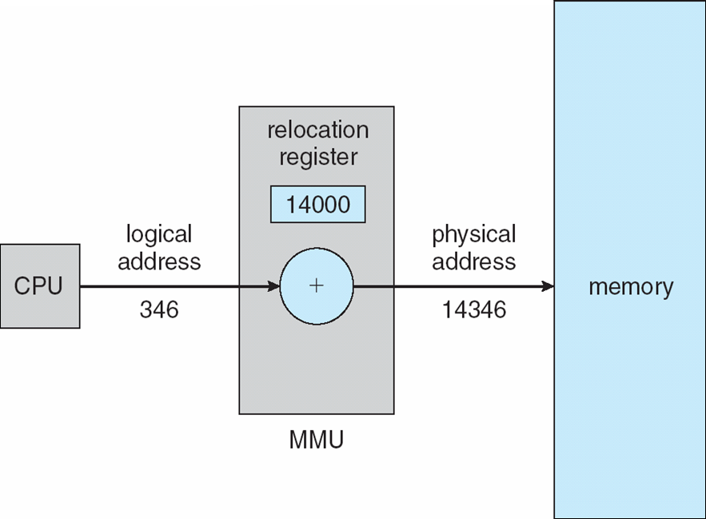
Address Binding
Programs on disk, ready to be brought into memory to execute form an input queue
  Without support, must be loaded into address 0000
Inconvenient to have first user process physical address always at 0000
  How can it not be?
Further, addresses represented in different ways at different stages of a program’s life
  Source code addresses usually symbolic
    Compiled code addresses bind to relocatable addresses
    Example: “346 bytes from beginning of this module” (in the range 0 to max)
  Linker or loader will bind relocatable addresses to absolute addresses
    i.e. 74346 (in the range R + 0 to R + max for a base value R=74000).
  Each binding maps one address space to another

Slide 8
Logical vs. Physical Address Space
The concept of a logical address space that is bound to a separate physical address space is central to proper memory management
  Logical address – generated by the CPU; also referred to as virtual address
  Physical address – address seen by the memory unit
Logical and physical addresses are the same in compile-time and load-time address-binding schemes;
Logical (virtual) and physical addresses differ in execution-time address-binding scheme
Logical address space is the set of all logical addresses generated by a program
Physical address space is the set of all physical addresses generated corresponding to these logical addresses.

Slide 9
Memory-Management Unit (MMU)
Hardware device that at run time maps virtual to physical address
To start, consider simple scheme where the value in the relocation register is added to every address generated by a user process at the time it is sent to memory
  Base register now called relocation register
  MS-DOS on Intel 80x86 used 4 relocation registers
The user program deals with logical addresses; it never sees the real physical addresses
  Execution-time binding occurs when reference is made to location in memory

Slide 10
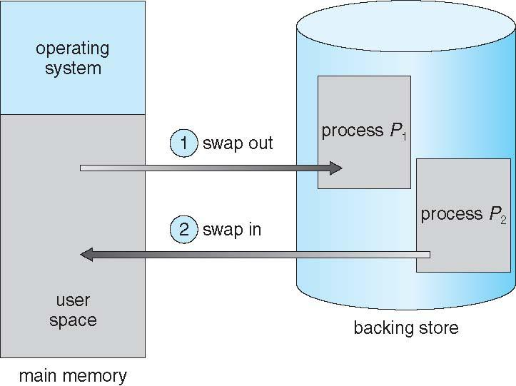
Swapping
Time taking Process
  Fig: Schematic View of Swapping using a disk as a backing store.

Slide 11
Swapping (Cont.)
A process can be swapped temporarily out of memory to a backing store, and then brought back into memory for continued execution
  Total physical memory space of processes can exceed physical memory
Roll out, roll in – Decided by various algorithms(FCFS, Priority, LIFO, etc…)
Major part of swap time is transfer time; total transfer time is directly proportional to the amount of memory swapped
System maintains a ready queue of ready-to-run processes which have memory images on disk
Q: Does the swapped out process need to swap back in to same physical addresses?
Depends on address binding method
  Plus consider pending I/O to / from process memory space

Slide 12
Context Switch Time including Swapping
If next processes to be put on CPU is not in memory, need to swap out a process and swap in target process
Context switch time can then be very high
100MB process swapping to hard disk with transfer rate of 50MB/sec
  Swap out time of 2000 ms
  Plus swap in of same sized process
  Total context switch swapping component time of 4000ms (4 seconds)
Can reduce if reduce size of memory swapped – by knowing how much memory really being used
  System calls to inform OS of memory use via request_memory() and release_memory()

Slide 13
Context Switch Time and Swapping (Cont.)
Other constraints as well on swapping
  Pending I/O – can’t swap out as I/O would occur to wrong process
  Or always transfer I/O to kernel space, then to I/O device
    Known as double buffering, adds overhead
Standard swapping not used in modern operating systems
  But modified version
    Swap only when free memory extremely low
    Partial process are being swapped

Slide 14
Swapping on Mobile Systems
Not typically supported by
Flash memory based (mobile systems) do not support swapping in any form. Why ?
    Small amount of space
    Limited number of write cycles possible otherwise becomes unreliable
    Poor throughput between flash memory and CPU on mobile platform
Instead use other methods to free memory if low
  iOS asks apps to voluntarily relinquish allocated memory
    Read-only data thrown out and reloaded from flash if needed
    Failure to free can result in termination
  Android terminates apps if low free memory, but first writes application state to flash for fast restart
  Both OSes support paging as discussed below

Slide 15
Contiguous Allocation
Main memory must support both OS and user processes
Limited resource, must allocate efficiently
Contiguous allocation is one early method
Main memory usually into two partitions:
  Resident operating system, usually held in low memory with interrupt vector
  User processes then held in high memory
  Each process contained in single contiguous section of memory

Slide 16
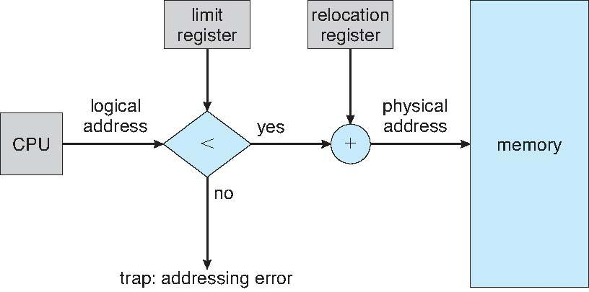
Hardware Support for Relocation and Limit Registers

Slide 17
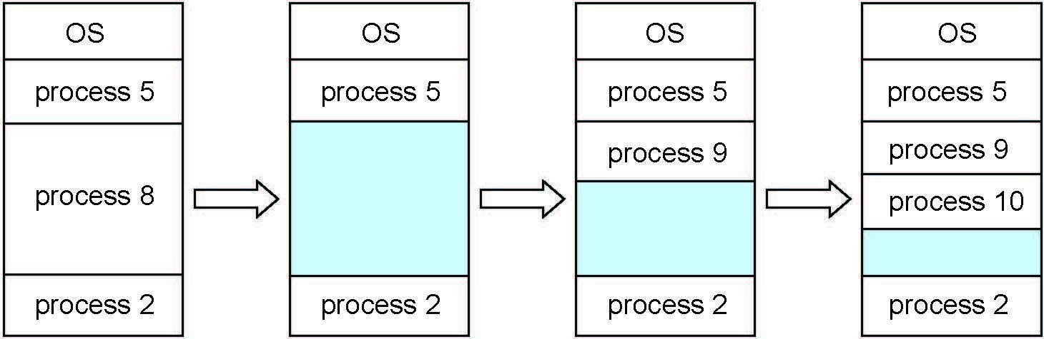
Multiple-partition allocation
Multiple-partition allocation
  Degree of multiprogramming limited by number of partitions
  Variable-partition sizes for efficiency (sized to a given process’ needs)
  Hole – block of available memory; holes of various size are scattered throughout memory
  When a process arrives, it is allocated memory from a hole large enough to accommodate it
  Process exiting frees its partition, adjacent free partitions combined
  Operating system maintains information about:
  a) allocated partitions b) free partitions (hole)

Slide 18
Dynamic Storage-Allocation Problem
How to satisfy a request of size n from a list of free holes?
First-fit: Allocate the first hole that is big enough
Best-fit: Allocate the smallest hole that is big enough; must search entire list, unless ordered by size
  Produces the smallest leftover hole
Worst-fit: Allocate the largest hole; must also search entire list
  Produces the largest leftover hole
First-fit and best-fit better than worst-fit in terms of speed and storage utilization

Slide 19
Fragmentation
External Fragmentation – total memory space exists to satisfy a request, but it is not contiguous
Internal Fragmentation – allocated memory may be slightly larger than requested memory; this size difference is memory internal to a partition, but not being used
First fit analysis reveals that given N blocks allocated, 0.5 N blocks lost to fragmentation
  1/3 may be unusable -> 50-percent rule

Slide 20
Fragmentation (Cont.)
Reduce external fragmentation by compaction
  Shuffle memory contents to place all free memory together in one large block
  Compaction is possible only if relocation is dynamic, and is done at execution time
  I/O problem
    Latch job in memory while it is involved in I/O
    Do I/O only into OS buffers
Now consider that backing store has same fragmentation problems

Slide 21
Segmentation
Memory-management scheme that supports user view of memory
A program is a collection of segments
  A segment is a logical unit such as:
main program
procedure
function
method
object
local variables, global variables
common block
stack
symbol table
arrays

Slide 22
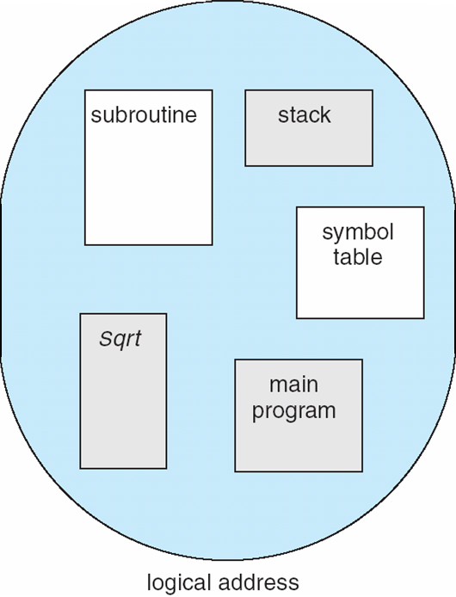
User’s View of a Program

Slide 23
Logical View of Segmentation
1
1
4
2
3
4
2
3
user space
physical memory space

Slide 24
Segmentation Architecture
Logical address consists of a two tuple:
<segment-number, offset>,
Segment table – maps two-dimensional physical addresses; each table entry has:
  base – contains the starting physical address where the segments reside in memory
  limit – specifies the length of the segment
Segment-table base register (STBR) points to the segment table’s location in memory
Segment-table length register (STLR) indicates number of segments used by a program;
segment number s is legal if s < STLR

Slide 25
Segmentation Architecture (Cont.)
Protection
  With each entry in segment table associate:
    validation bit = 0 ⇒ illegal segment
    read/write/execute privileges
Protection bits associated with segments; code sharing occurs at segment level
Since segments vary in length, memory allocation is a dynamic storage-allocation problem
A segmentation example is shown in the following diagram

Slide 26
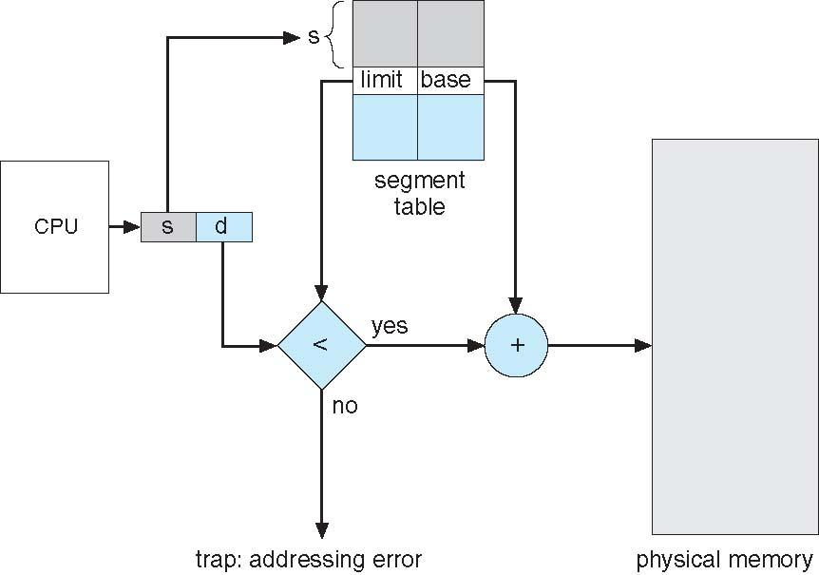
Segmentation Hardware

Slide 27
Paging
Physical address space of a process can be noncontiguous;
  Avoids external fragmentation
  Avoids problem of varying sized memory chunks
Divide physical memory into fixed-sized blocks called frames
  Size is power of 2, between 512 bytes and 16 Mbytes
Divide logical memory into blocks of same size called pages
Keep track of all free frames
To run a program of size N pages, need to find N free frames and load program
Set up a page table to translate logical to physical addresses

Slide 28
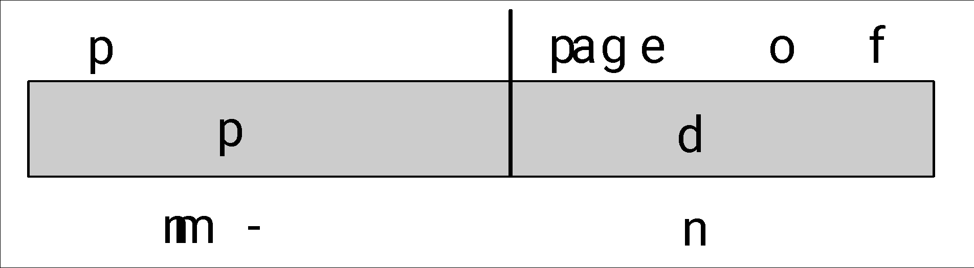
Address Translation Scheme
Address generated by CPU is divided into:
  Page number (p) – used as an index into a page table which contains base address of each page in physical memory
  Page offset (d) – combined with base address to define the physical memory address that is sent to the memory unit
  For given logical address space 2^{m} and page size 2^{n}

Slide 29
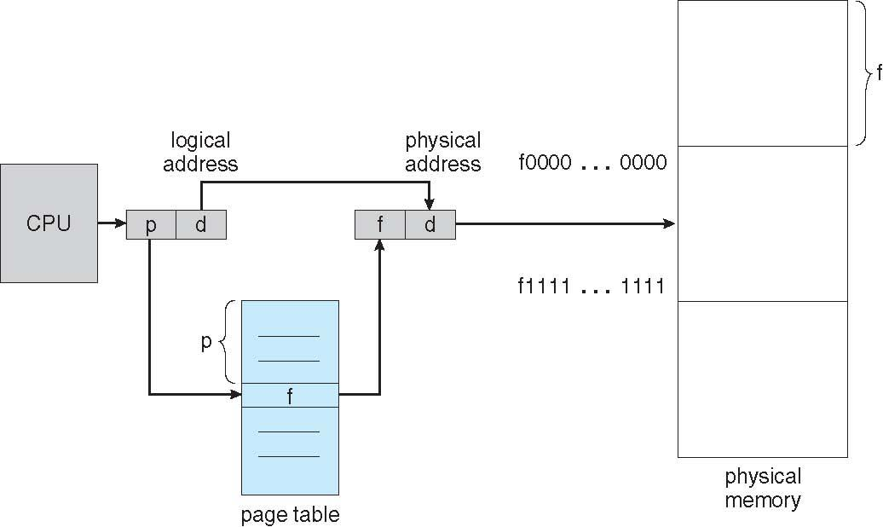
Paging Hardware

Slide 30
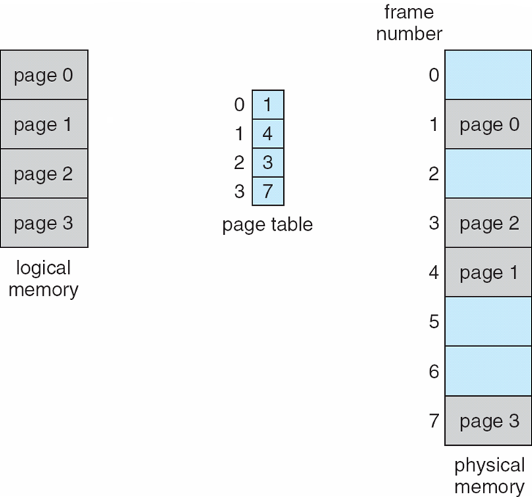
Paging Model of Logical and Physical Memory

Slide 31
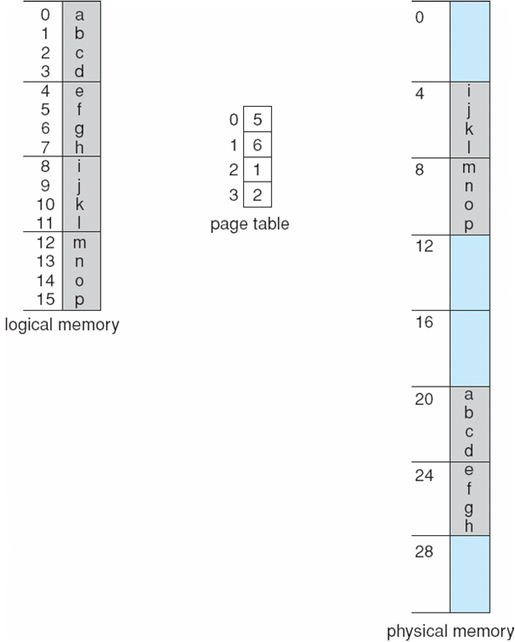
Paging Example
n=2 and m=4 32-byte memory and 4-byte pages

Slide 32
Paging (Cont.)
Calculating internal fragmentation
  Page size = 2,048 bytes
  Process size = 72,766 bytes
  35 pages + 1,086 bytes
  Internal fragmentation of 2,048 - 1,086 = 962 bytes
  Worst case fragmentation = 1 frame – 1 byte
  On average fragmentation = 1 / 2 frame size
So small frame sizes desirable?
  But each page table entry takes memory to track
  Page sizes growing over time
    Solaris supports two page sizes – 8 KB and 4 MB

Slide 33
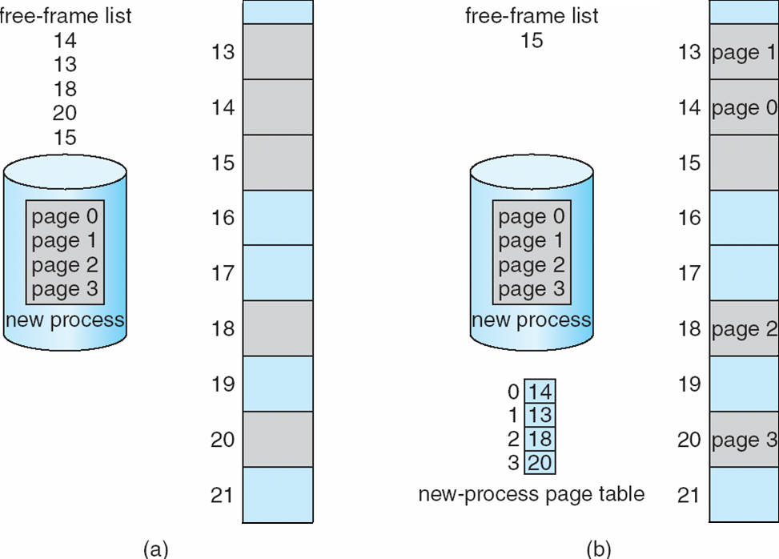
Free Frames
Before allocation
After allocation

Slide 34
Implementation of Page Table
Page table is kept in main memory
Page-table base register (PTBR) points to the page table
Page-table length register (PTLR) indicates size of the page table
In this scheme every data/instruction access requires two memory accesses
  One for the page table and one for the data / instruction
The two memory access problem can be solved by the use of a special fast-lookup hardware cache called associative memory or translation look-aside buffers (TLBs)

Slide 35
Implementation of Page Table (Cont.)
Some TLBs store address-space identifiers (ASIDs) in each TLB entry – uniquely identifies each process to provide address-space protection for that process
  Otherwise need to flush at every context switch
TLBs typically small (64 to 1,024 entries)
On a TLB miss, value is loaded into the TLB for faster access next time
  Replacement policies must be considered
  Some entries can be wired down for permanent fast access

Slide 36
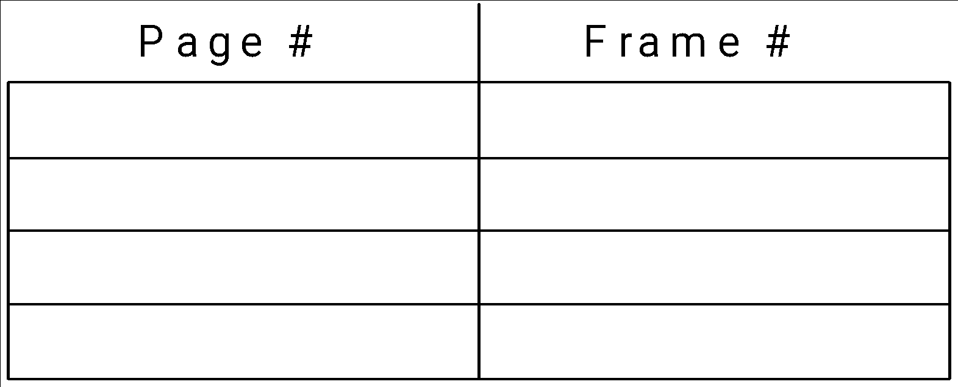
Associative Memory
Associative memory – parallel search
Address translation (p, d)
  If p is in associative register, get frame # out
  Otherwise get frame # from page table in memory

Slide 37
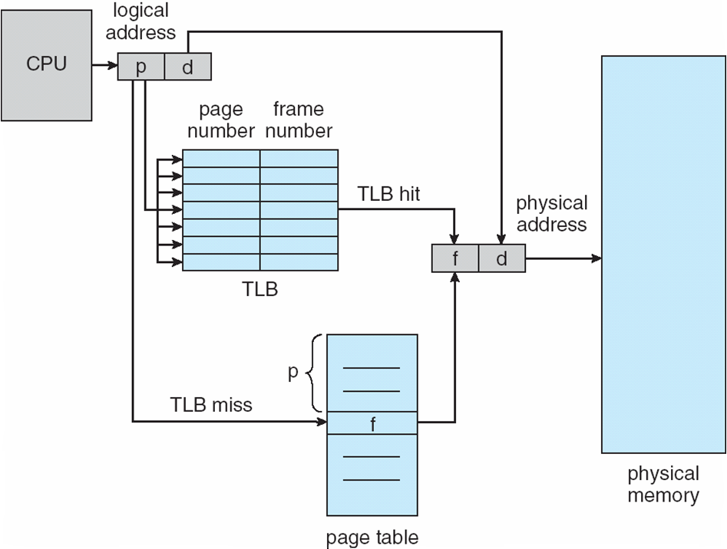
Paging Hardware With TLB

Slide 38
Effective Access Time
Associative Lookup = ε time unit
  Can be < 10% of memory access time
Hit ratio = α
  Hit ratio – percentage of times that a page number is found in the associative registers; ratio related to number of associative registers
Consider α = 80%, ε = 20ns for TLB search, 100ns for memory access
Effective Access Time (EAT)
EAT = (1 + ε) α + (2 + ε)(1 – α)
= 2 + ε – α
Consider α = 80%, ε = 20ns for TLB search, 100ns for memory access
  EAT = 0.80 x 100 + 0.20 x 200 = 120ns
Consider more realistic hit ratio -> α = 99%, ε = 20ns for TLB search, 100ns for memory access
  EAT = 0.99 x 100 + 0.01 x 200 = 101ns

Slide 39
Memory Protection
Memory protection implemented by associating protection bit with each frame to indicate if read-only or read-write access is allowed
  Can also add more bits to indicate page execute-only, and so on
Valid-invalid bit attached to each entry in the page table:
  “valid” indicates that the associated page is in the process’ logical address space, and is thus a legal page
  “invalid” indicates that the page is not in the process’ logical address space
  Or use page-table length register (PTLR)
Any violations result in a trap to the kernel

Slide 40
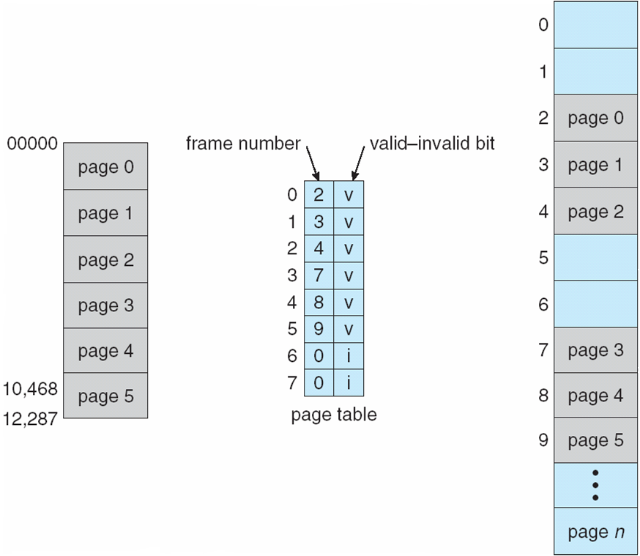
Valid (v) or Invalid (i) Bit In A Page Table

Slide 41
Shared Pages
Shared code
  One copy of read-only (reentrant) code shared among processes (i.e., text editors, compilers, window systems)
  Similar to multiple threads sharing the same process space
  Also useful for interprocess communication if sharing of read-write pages is allowed
Private code and data
  Each process keeps a separate copy of the code and data
  The pages for the private code and data can appear anywhere in the logical address space

Slide 42
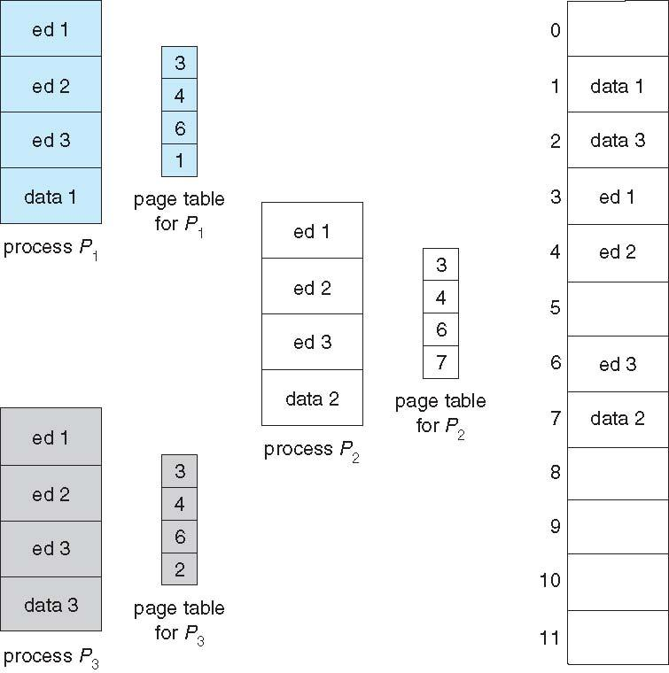
Shared Pages Example

Slide 43
Structure of the Page Table
Memory structures for paging can get huge using straight-forward methods
  Consider a 32-bit logical address space as on modern computers
  Page size of 4 KB (2¹²)
  Page table would have 1 million entries (2³² / 2¹²)
  If each entry is 4 bytes -> 4 MB of physical address space / memory for page table alone
    That amount of memory used to cost a lot
    Don’t want to allocate that contiguously in main memory
Hierarchical Paging
Hashed Page Tables
Inverted Page Tables

Slide 44
Hierarchical Page Tables
Break up the logical address space into multiple page tables
A simple technique is a two-level page table
We then page the page table

Slide 45
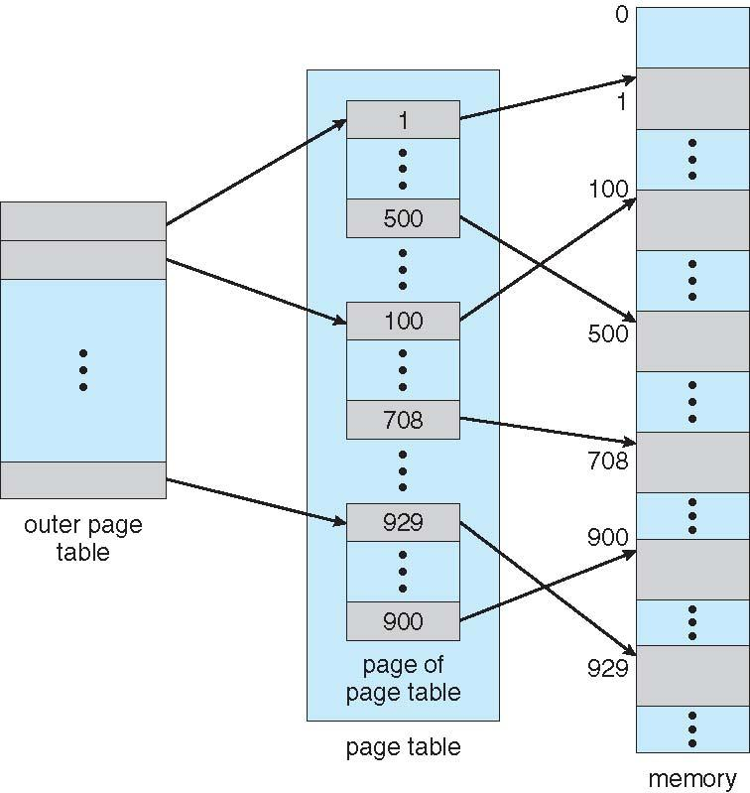
Two-Level Page-Table Scheme

Slide 46
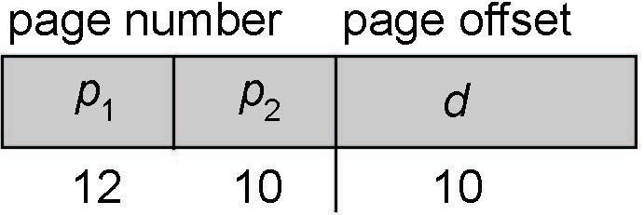
Two-Level Paging Example
A logical address (on 32-bit machine with 1K page size) is divided into:
  a page number consisting of 22 bits
  a page offset consisting of 10 bits
Since the page table is paged, the page number is further divided into:
  a 12-bit page number
  a 10-bit page offset
Thus, a logical address is as follows:
where p₁ is an index into the outer page table, and p₂ is the displacement within the page of the inner page table
Known as forward-mapped page table

Slide 47
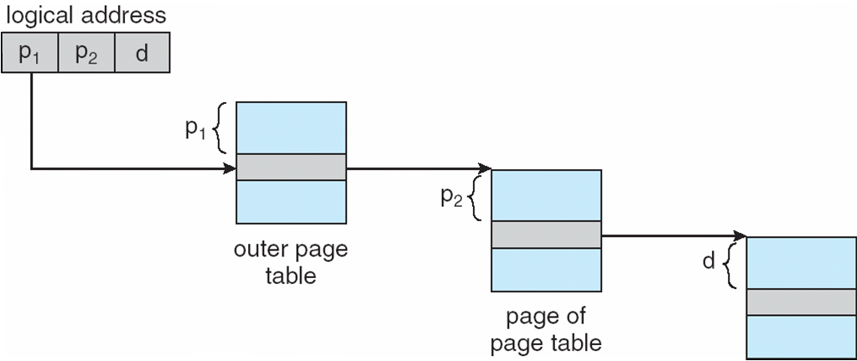
Address-Translation Scheme

Slide 48
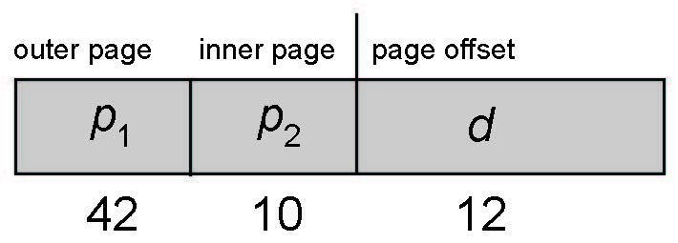
64-bit Logical Address Space
Even two-level paging scheme not sufficient
If page size is 4 KB (2¹²)
  Then page table has 2⁵² entries
  If two level scheme, inner page tables could be 2¹⁰ 4-byte entries
  Address would look like
  Outer page table has 2⁴² entries or 2⁴⁴ bytes
  One solution is to add a 2nd outer page table
  But in the following example the 2nd outer page table is still 2³⁴ bytes in size
    And possibly 4 memory access to get to one physical memory location

Slide 49
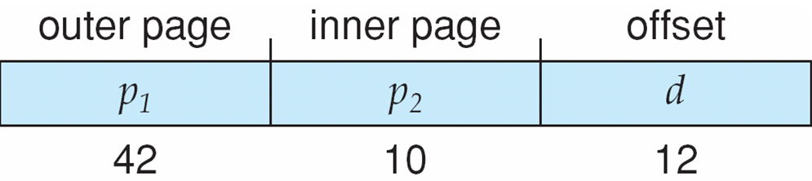
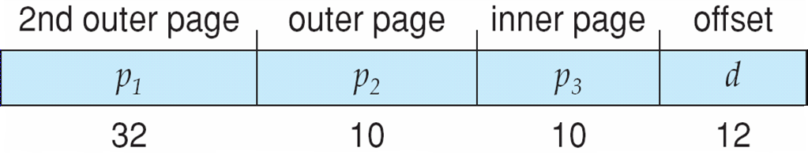
Three-level Paging Scheme

Slide 50
Hashed Page Tables
Common in address spaces > 32 bits
The virtual page number is hashed into a page table
  This page table contains a chain of elements hashing to the same location
Each element contains (1) the virtual page number (2) the value of the mapped page frame (3) a pointer to the next element
Virtual page numbers are compared in this chain searching for a match
  If a match is found, the corresponding physical frame is extracted
Variation for 64-bit addresses is clustered page tables
  Similar to hashed but each entry refers to several pages (such as 16) rather than 1
  Especially useful for sparse address spaces (where memory references are non-contiguous and scattered)

Slide 51
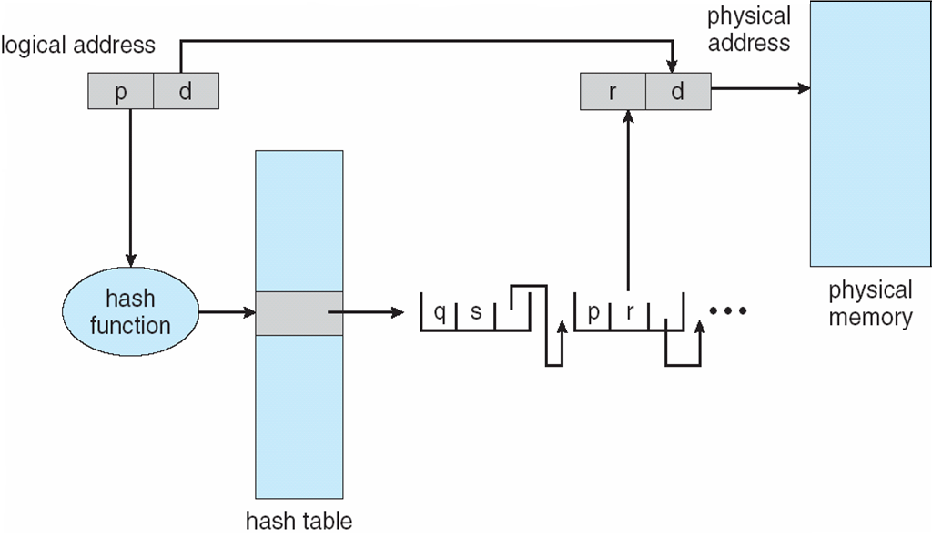
Hashed Page Table

Slide 52
Inverted Page Table
Rather than each process having a page table and keeping track of all possible logical pages, track all physical pages
One entry for each real page of memory
Entry consists of the virtual address of the page stored in that real memory location, with information about the process that owns that page
Decreases memory needed to store each page table, but increases time needed to search the table when a page reference occurs
Use hash table to limit the search to one — or at most a few — page-table entries
  TLB can accelerate access
But how to implement shared memory?
  One mapping of a virtual address to the shared physical address

Slide 53
Virtual Memory: Objectives
To describe the benefits of a virtual memory system
To explain the concepts of demand paging, page-replacement algorithms, and allocation of page frames
To discuss the principle of the working-set model
To examine the relationship between shared memory and memory-mapped files
To explore how kernel memory is managed

Slide 54
Virtual Memory: Background
Code needs to be in memory to execute.
Entire program code not needed at same time
Consider ability to execute partially-loaded program
  Program no longer constrained by limits of physical memory
  Each program takes less memory while running -> more programs run at the same time
    Increased CPU utilization and throughput with no increase in response time or turnaround time
  Less I/O needed to load or swap programs into memory -> each user program runs faster

Slide 55
Virtual Memory: Background (Cont.)
Virtual memory – separation of user logical memory from physical memory
  Only part of the program needs to be in memory for execution
  Logical address space can therefore be much larger than physical address space
  Allows address spaces to be shared by several processes
  Allows for more efficient process creation
  More programs running concurrently
  Less I/O needed to load or swap processes

Slide 56
Virtual Memory: Background (Cont.)
Virtual address space – logical view of how process is stored in memory
  Usually start at address 0, contiguous addresses until end of space
  Meanwhile, physical memory organized in page frames
  MMU must map logical to physical
Virtual memory can be implemented via:
  Demand paging
  Demand segmentation

Slide 57
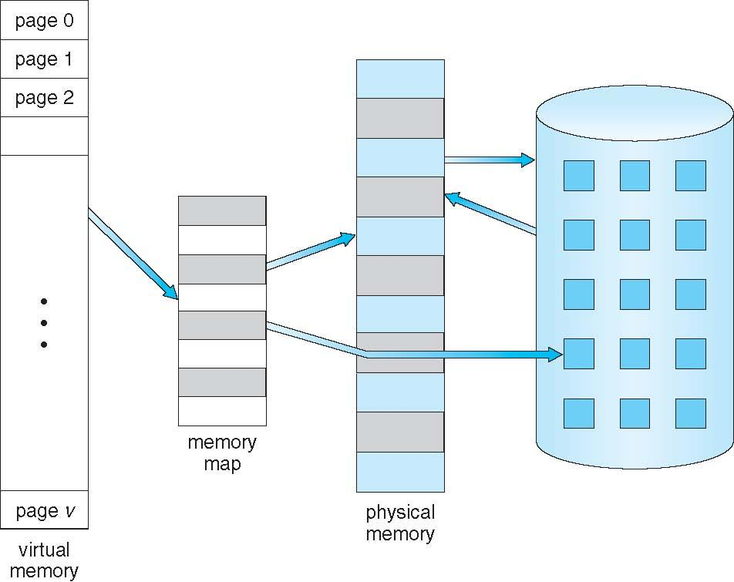
Virtual Memory That is Larger Than Physical Memory

Slide 58
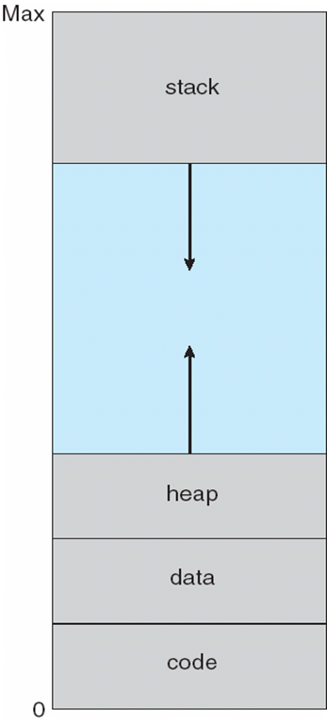
Virtual-address Space
Usually design logical address space for stack to start at Max logical address and grow “down” while heap grows “up”
  Maximizes address space use
  Unused address space between the two is hole
    No physical memory needed until heap or stack grows to a given new page
Enables sparse address spaces with holes left for growth, dynamically linked libraries, etc
System libraries shared via mapping into virtual address space
Shared memory by mapping pages read-write into virtual address space
Pages can be shared during fork(), speeding process creation

Slide 59
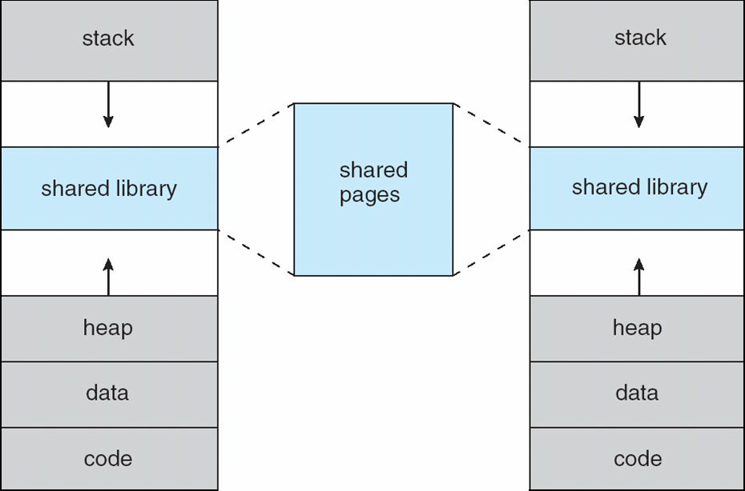
Shared Library Using Virtual Memory

Slide 60
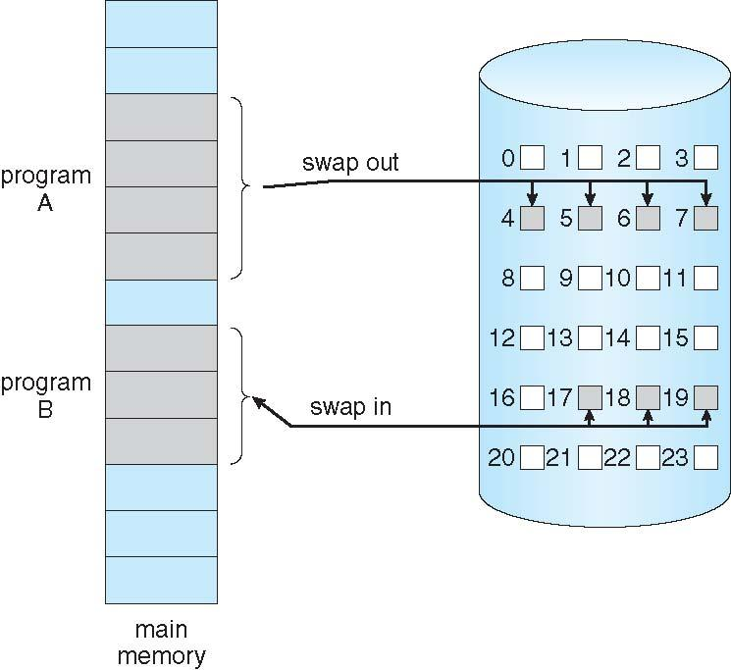
Demand Paging
Could bring entire process into memory at load time
Or bring a page into memory only when it is needed
  Less I/O needed, no unnecessary I/O
  Less memory needed
  Faster response
  More users
Similar to paging system with swapping (diagram on right)
Page is needed ⇒ reference to it
  invalid reference ⇒ abort
  not-in-memory ⇒ bring to memory
Lazy swapper – never swaps a page into memory unless page will be needed
  Swapper that deals with pages is a pager

Slide 61
Basic Concepts
With swapping, pager guesses which pages will be used before swapping out again
Instead, pager brings in only those pages into memory
How to determine that set of pages?
  Need new MMU functionality to implement demand paging
If pages needed are already memory resident
  No difference from non demand-paging
If page needed and not memory resident
  Need to detect and load the page into memory from storage
    Without changing program behavior
    Without programmer needing to change code

Slide 62
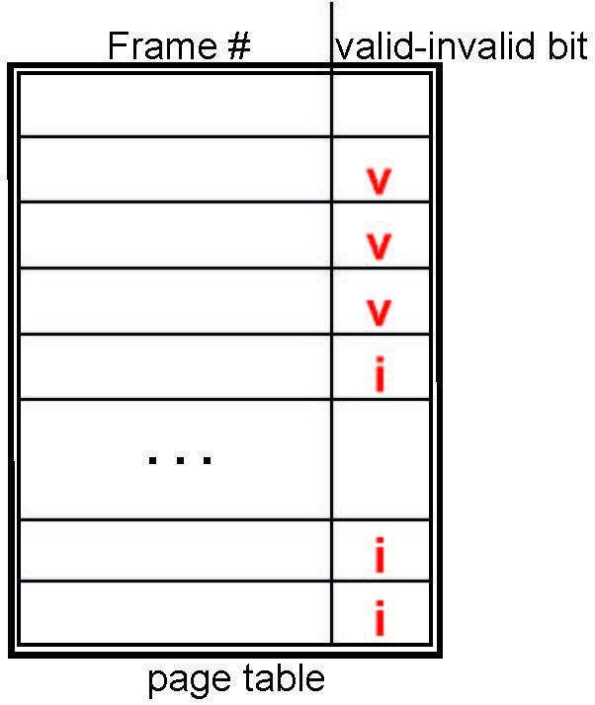
Valid-Invalid Bit
With each page table entry a valid–invalid bit is associated
(v ⇒ in-memory – memory resident, i ⇒ not-in-memory)
Initially valid–invalid bit is set to i on all entries
Example of a page table snapshot:
During MMU address translation, if valid–invalid bit in page table entry is i ⇒ page fault

Slide 63
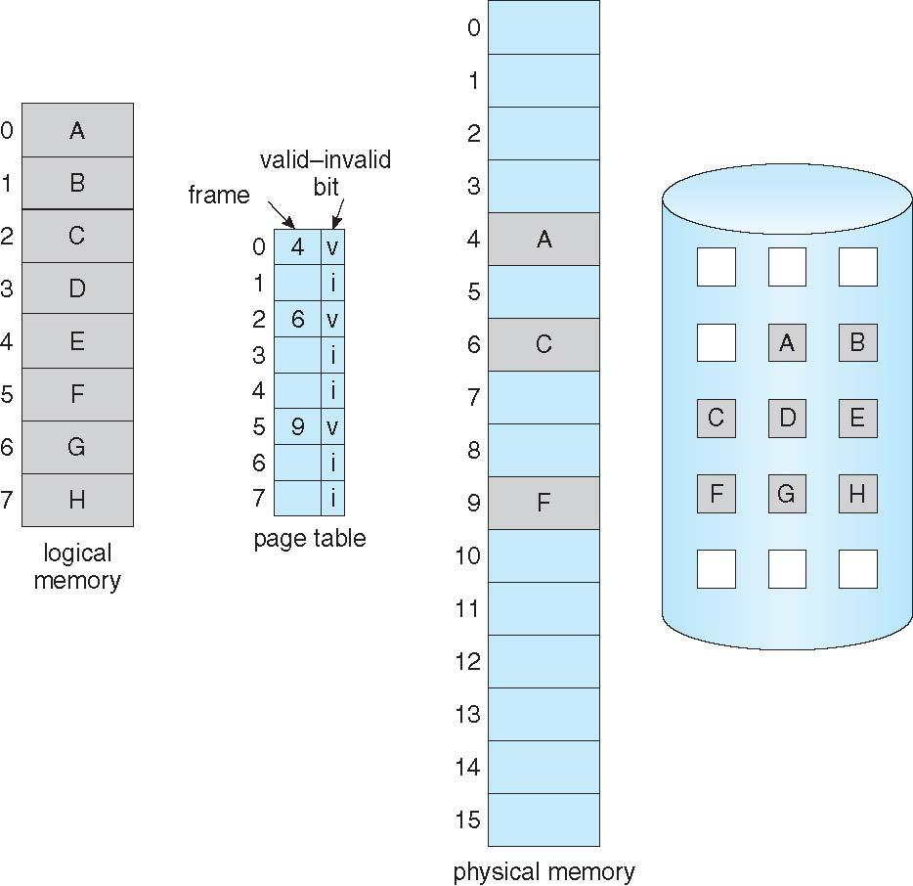
Page Table When Some Pages Are Not in Main Memory

Slide 64
Page Fault
If there is a reference to a page, first reference to that page will trap to operating system:
page fault
Operating system looks at another table to decide:
  Invalid reference ⇒ abort
  Just not in memory
Find free frame
Swap page into frame via scheduled disk operation
Reset tables to indicate page now in memory
Set validation bit = v
Restart the instruction that caused the page fault

Slide 65
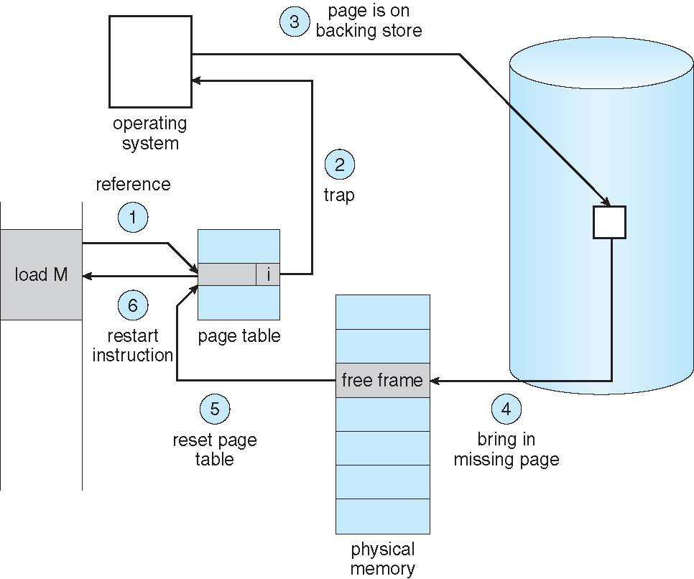
Steps in Handling a Page Fault

Slide 66
Aspects of Demand Paging
Extreme case – start process with no pages in memory
  OS sets instruction pointer to first instruction of process, non-memory-resident -> page fault
  And for every other process pages on first access
  Pure demand paging
Actually, a given instruction could access multiple pages -> multiple page faults
  Consider fetch and decode of instruction which adds 2 numbers from memory and stores result back to memory
  Pain decreased because of locality of reference
Hardware support needed for demand paging
  Page table with valid / invalid bit
  Secondary memory (swap device with swap space)
  Instruction restart

Slide 67
Performance of Demand Paging
Stages in Demand Paging (worse case)
Trap to the operating system
Save the user registers and process state
Determine that the interrupt was a page fault
Check that the page reference was legal and determine the location of the page on the disk
Issue a read from the disk to a free frame:
  Wait in a queue for this device until the read request is serviced
  Wait for the device seek and/or latency time
  Begin the transfer of the page to a free frame
While waiting, allocate the CPU to some other user
Receive an interrupt from the disk I/O subsystem (I/O completed)
Save the registers and process state for the other user
Determine that the interrupt was from the disk
Correct the page table and other tables to show page is now in memory
Wait for the CPU to be allocated to this process again
Restore the user registers, process state, and new page table, and then resume the interrupted instruction

Slide 68
Performance of Demand Paging (Cont.)
Three major activities
  Service the interrupt – careful coding means just several hundred instructions needed
  Read the page – lots of time
  Restart the process – again just a small amount of time
Page Fault Rate 0 ≤ p ≤ 1
  if p = 0 no page faults
  if p = 1, every reference is a fault
Effective Access Time (EAT)
EAT = (1 – p) x memory access
+ p (page fault overhead
+ swap page out
+ swap page in )

Slide 69
Demand Paging Example
Memory access time = 200 nanoseconds
Average page-fault service time = 8 milliseconds
EAT = (1 – p) x 200 + p (8 milliseconds)
= (1 – p x 200 + p x 8,000,000
= 200 + p x 7,999,800
If one access out of 1,000 causes a page fault, then
EAT = 8.2 microseconds.
This is a slowdown by a factor of 40!!
If want performance degradation < 10 percent
  220 > 200 + 7,999,800 x p
  20 > 7,999,800 x p
  p < .0000025
  < one page fault in every 400,000 memory accesses

Slide 70
Copy-on-Write
Copy-on-Write (COW) allows both parent and child processes to initially share the same pages in memory
  If either process modifies a shared page, only then is the page copied
COW allows more efficient process creation as only modified pages are copied
In general, free pages are allocated from a pool of zero-fill-on-demand pages
  Pool should always have free frames for fast demand page execution
    Don’t want to have to free a frame as well as other processing on page fault
  Why zero-out a page before allocating it ?
vfork() variation on fork() system call has parent suspend and child using copy-on-write address space of parent
  Designed to have child call exec()
  Very efficient

Slide 71
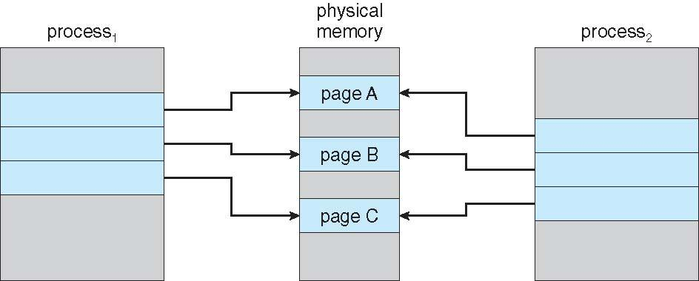
Before Process 1 Modifies Page C

Slide 72
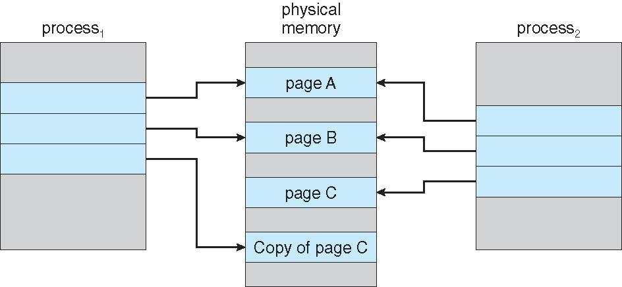
After Process 1 Modifies Page C

Slide 73
What Happens if There is no Free Frame?
Used up by process pages
Also in demand from the kernel, I/O buffers, etc
How much to allocate to each ?
Page replacement – find some page in memory, but not really in use, page it out
  Algorithm – terminate ? swap out ? replace the page ?
  Performance – want an algorithm which will result in minimum number of page faults
Same page may be brought into memory several times

Slide 74
Page Replacement
Prevent over-allocation of memory by modifying page-fault service routine to include page replacement
Use modify (dirty) bit to reduce overhead of page transfers – only modified pages are written to disk
Page replacement completes separation between logical memory and physical memory – large virtual memory can be provided on a smaller physical memory

Slide 75
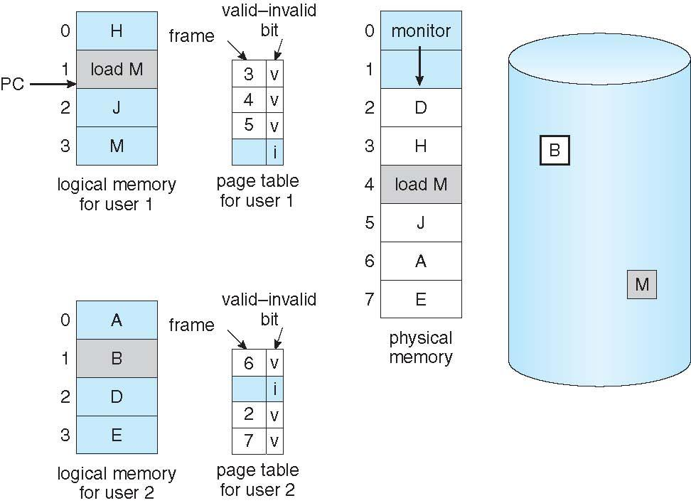
Need For Page Replacement

Slide 76
Basic Page Replacement
Find the location of the desired page on disk
Find a free frame:
- If there is a free frame, use it
- If there is no free frame, use a page replacement algorithm to select a victim frame
- Write victim frame to disk if dirty
Bring the desired page into the (newly) free frame; update the page and frame tables
Continue the process by restarting the instruction that caused the trap
Note now potentially 2 page transfers for page fault – increasing EAT

Slide 77
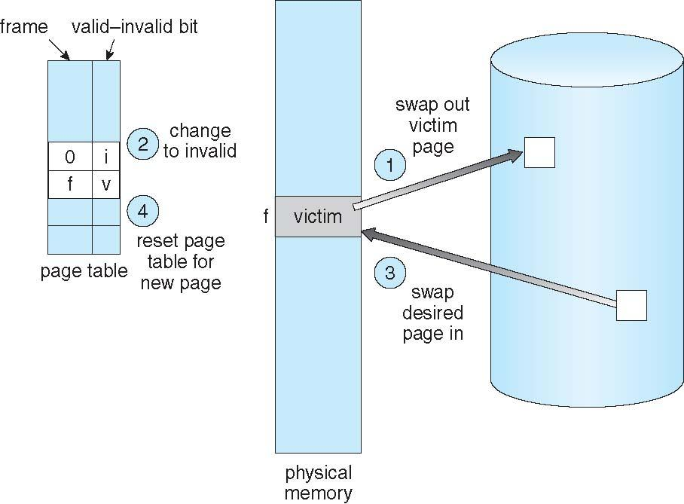
Page Replacement

Slide 78
Page and Frame Replacement Algorithms
Frame-allocation algorithm determines
  How many frames to give each process
  Which frames to replace
Page-replacement algorithm
  Want lowest page-fault rate on both first access and re-access
Evaluate algorithm by running it on a particular string of memory references (reference string) and computing the number of page faults on that string
  String is just page numbers, not full addresses
  Repeated access to the same page does not cause a page fault
  Results depend on number of frames available
In all our examples, the reference string of referenced page numbers is
reference string: 7,0,1,2,0,3,0,4,2,3,0,3,0,3,2,1,2,0,1,7,0,1

Slide 79
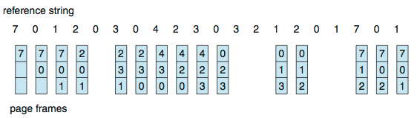
First-In-First-Out (FIFO) Algorithm
Reference string: 7,0,1,2,0,3,0,4,2,3,0,3,2,1,2,0,1,7,0,1
3 frames (3 pages can be in memory at a time per process)
Can vary by reference string: consider 1,2,3,4,1,2,5,1,2,3,4,5
  Adding more frames can cause more page faults!
    Belady’s Anomaly
How to track ages of pages? Just use a FIFO queue
15 page faults
7 | 7 | 7 | 7 |  | 3 |  | 3 |  |  | 3 |  |  | 3 | 2 |  |  | 2
 | 0 | 0 | 0 |  | 0 |  | 4 |  |  | 4 |  |  | 4 | 4 |  |  | 7
 |  | 1 | 1 |  | 1 |  | 1 |  |  | 0 |  |  | 0 | 0 |  |  | 0
 |  |  | 2 |  | 2 |  | 2 |  |  | 2 |  |  | 1 | 1 |  |  | 1
10 page faults

Slide 80
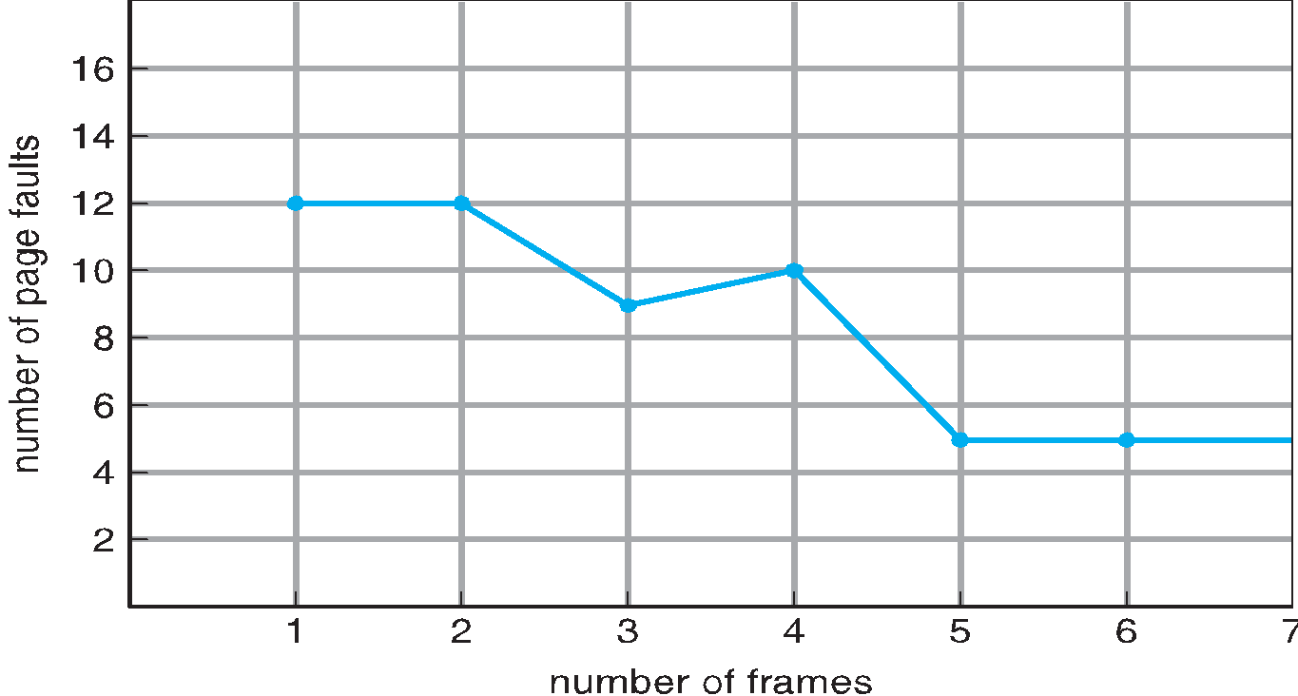
FIFO Illustrating Belady’s Anomaly

Slide 81
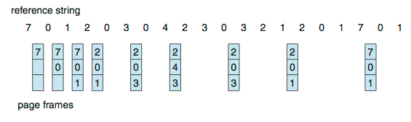
Optimal Algorithm
Replace page that will not be used for longest period of time
  9 is optimal for the example
How do you know this?
  Can’t read the future
Used for measuring how well your algorithm performs

Slide 82
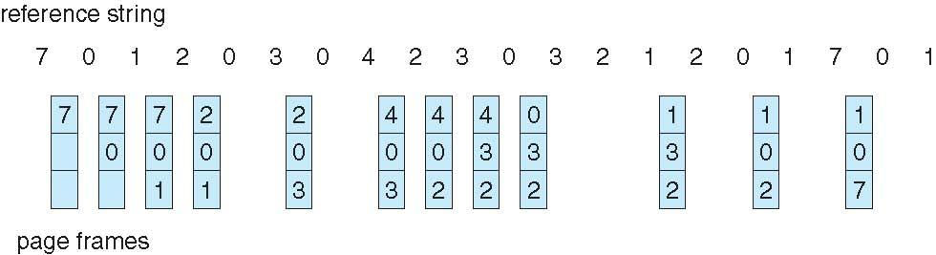
Least Recently Used (LRU) Algorithm
Use past knowledge rather than future
Replace page that has not been used in the most amount of time
Associate time of last use with each page
12 faults – better than FIFO but worse than OPT
Generally good algorithm and frequently used
But how to implement?

Slide 83
LRU Algorithm (Cont.)
Counter implementation
  Every page entry has a counter; every time page is referenced through this entry, copy the clock into the counter
  When a page needs to be changed, look at the counters to find smallest value
    Search through table needed
Stack implementation
  Keep a stack of page numbers in a double link form:
  Page referenced:
    move it to the top
    requires 6 pointers to be changed
  But each update more expensive
  No search for replacement
LRU and OPT are cases of stack algorithms that don’t have Belady’s Anomaly

Slide 84
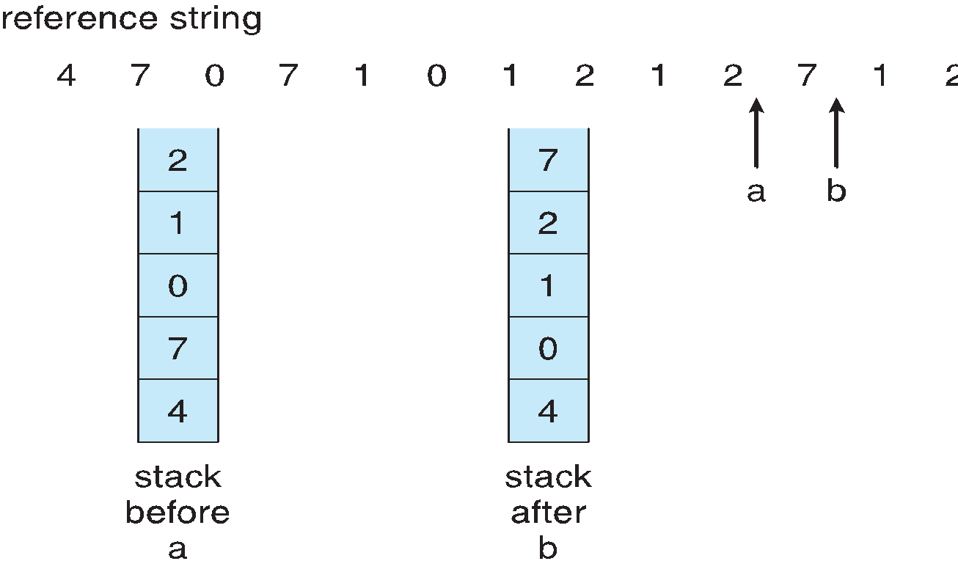
Use Of A Stack to Record Most Recent Page References

Slide 85
Additional-Reference-Bits Algorithm
We can gain additional ordering information by recording the reference bits at regular intervals.
We can keep an 8-bit byte for each page in a table in memory.
The operating system shifts the reference bit for each page into the high-order bit of its 8-bit byte, shifting the other bits right by 1 bit and discarding the low-order bit.
These 8-bit shift registers contain the history of page use for the last eight time periods.
If the shift register contains 00000000, for example, then the page has not been used for eight time periods.
A page that is used at least once in each period has a shift register value of 11111111.
A page with a history register value of 11000100 has been used more recently than one with a value of 01110111.

Slide 86
LRU Approximation Algorithms
LRU needs special hardware and still slow
Reference bit
  With each page associate a bit, initially = 0
  When page is referenced bit set to 1
  Replace any with reference bit = 0 (if one exists)
    We do not know the order, however
Second-chance algorithm
  Generally FIFO, plus hardware-provided reference bit
  Clock replacement
  If page to be replaced has
    Reference bit = 0 -> replace it
    reference bit = 1 then:
      set reference bit 0, leave page in memory
      replace next page, subject to same rules

Slide 87
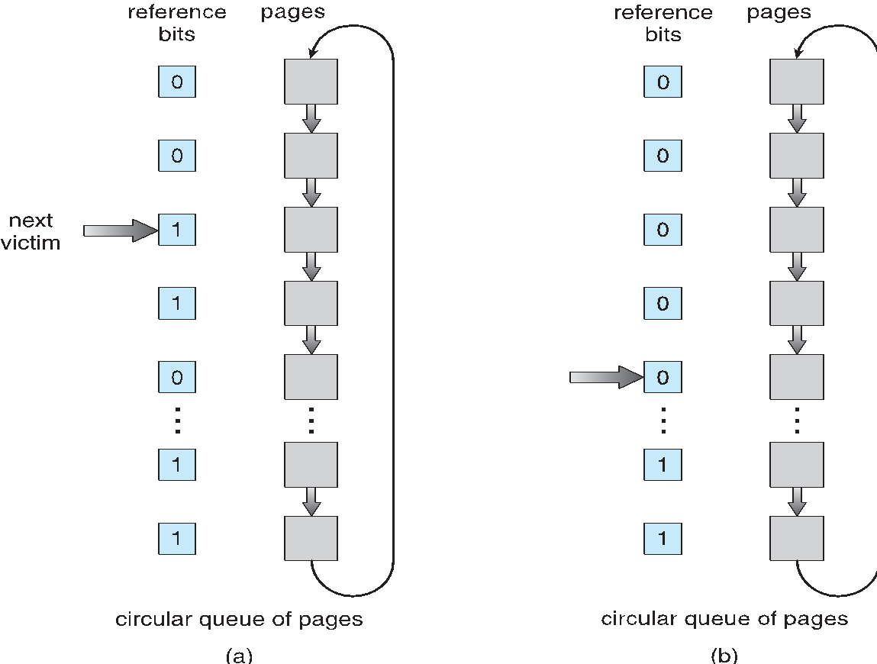
Second-Chance (clock) Page-Replacement Algorithm

Slide 88
Enhanced Second-Chance Algorithm
Improve algorithm by using reference bit and modify bit (if available) in concert
Take ordered pair (reference, modify)
(0, 0) neither recently used not modified – best page to replace
(0, 1) not recently used but modified – not quite as good, must write out before replacement
(1, 0) recently used but clean – probably will be used again soon
(1, 1) recently used and modified – probably will be used again soon and need to write out before replacement
When page replacement called for, use the clock scheme but use the four classes replace page in lowest non-empty class
  Might need to search circular queue several times

Slide 89
Counting Algorithms
Keep a counter of the number of references that have been made to each page
  Not common
Lease Frequently Used (LFU) Algorithm: replaces page with smallest count
Most Frequently Used (MFU) Algorithm: based on the argument that the page with the smallest count was probably just brought in and has yet to be used

Slide 90
Page-Buffering Algorithms
Keep a pool of free frames, always
  Then frame available when needed, not found at fault time
  Read page into free frame and select victim to evict and add to free pool
  When convenient, evict victim
Possibly, keep list of modified pages
  When backing store otherwise idle, write pages there and set to non-dirty
Possibly, keep free frame contents intact and note what is in them
  If referenced again before reused, no need to load contents again from disk
  Generally useful to reduce penalty if wrong victim frame selected

Slide 91
Allocation of Frames
Each process needs minimum number of frames
Example: IBM 370 – 6 pages to handle SS MOVE instruction:
  instruction is 6 bytes, might span 2 pages
  2 pages to handle from
  2 pages to handle to
Maximum of course is total frames in the system
Two major allocation schemes
  fixed allocation
  priority allocation

Slide 92
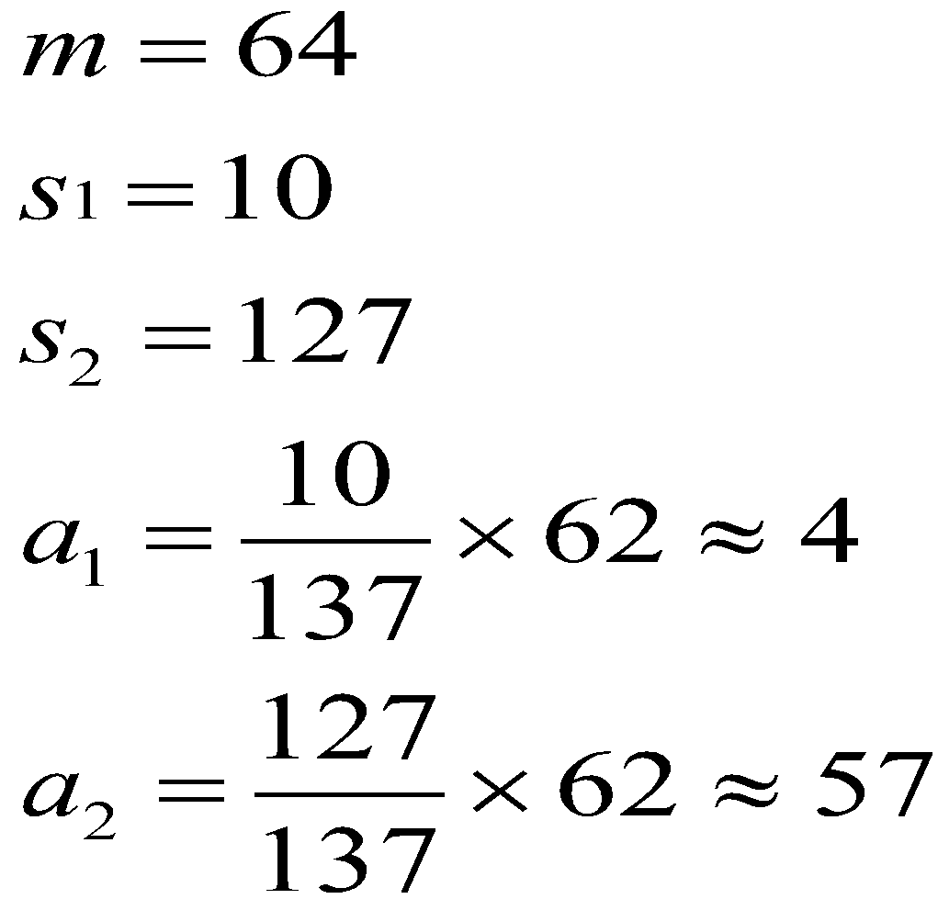
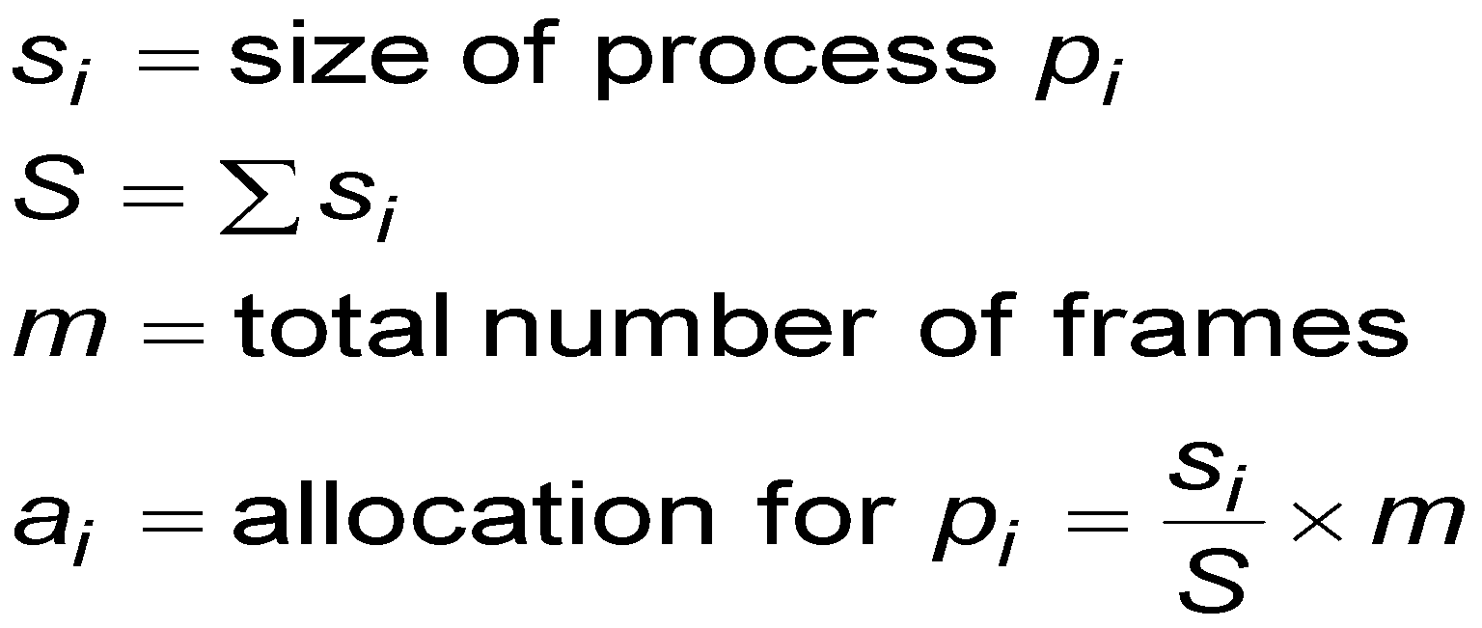
Fixed Allocation
Equal allocation – For example, if there are 100 frames (after allocating frames for the OS) and 5 processes, give each process 20 frames
  Keep some as free frame buffer pool
Proportional allocation – Allocate according to the size of process
  Dynamic as degree of multiprogramming, process sizes change

Slide 93
Priority Allocation
Use a proportional allocation scheme using priorities rather than size
If process P_{i} generates a page fault,
  select for replacement one of its frames
  select for replacement a frame from a process with lower priority number

Slide 94
Global vs. Local Allocation
Global replacement – process selects a replacement frame from the set of all frames; one process can take a frame from another
  But then process execution time can vary greatly
  But greater throughput so more common
Local replacement – each process selects from only its own set of allocated frames
  More consistent per-process performance
  But possibly underutilized memory

Slide 95
Thrashing
If a process does not have “enough” pages, the page-fault rate is very high
  Page fault to get page
  Replace existing frame
  But quickly need replaced frame back
  This leads to:
    Low CPU utilization
    Operating system thinking that it needs to increase the degree of multiprogramming
    Another process added to the system
Thrashing ≡ a process is busy swapping pages in and out

Slide 96
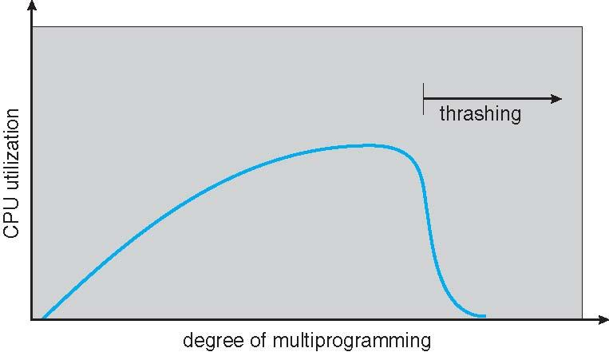
Thrashing (Cont.)

Slide 97
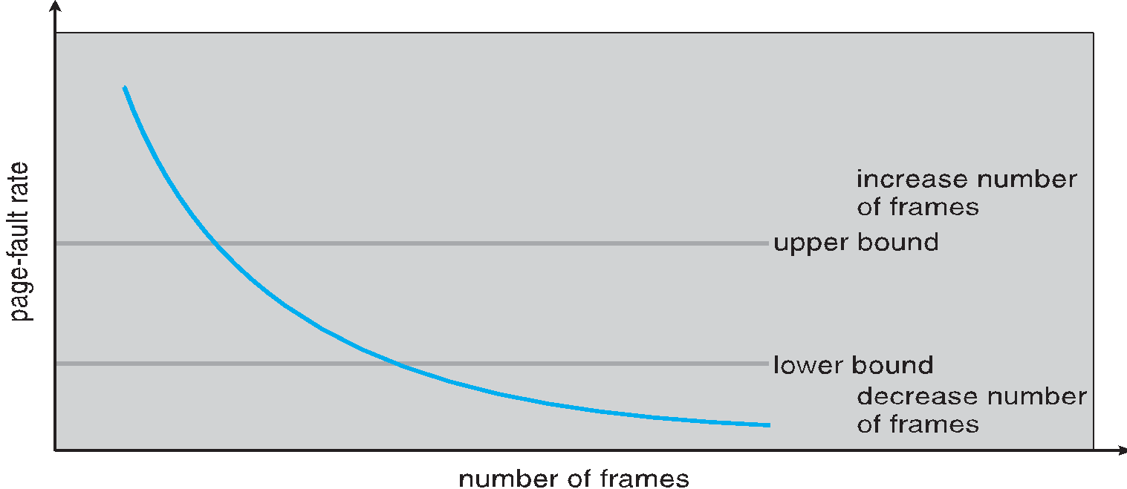
Page-Fault Frequency
More direct approach than WSS
Establish “acceptable” page-fault frequency (PFF) rate and use local replacement policy
  If actual rate too low, process loses frame
  If actual rate too high, process gains frame

Slide 98
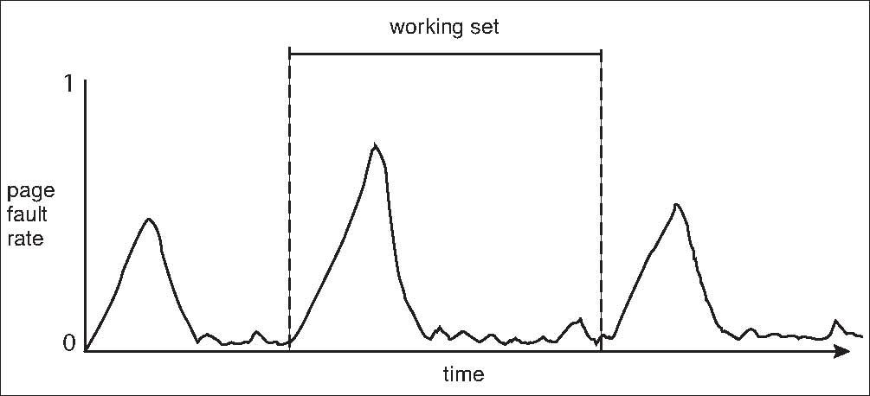
Working Sets and Page Fault Rates
Direct relationship between working set of a process and its page-fault rate
Working set changes over time
Peaks and valleys over time

Slide 99
Windows
Uses demand paging with clustering. Clustering brings in pages surrounding the faulting page
Processes are assigned working set minimum and working set maximum
Working set minimum is the minimum number of pages the process is guaranteed to have in memory
A process may be assigned as many pages up to its working set maximum
When the amount of free memory in the system falls below a threshold, automatic working set trimming is performed to restore the amount of free memory
Working set trimming removes pages from processes that have pages in excess of their working set minimum

Slide 100
Solaris
Maintains a list of free pages to assign faulting processes
Lotsfree – threshold parameter (amount of free memory) to begin paging
Desfree – threshold parameter to increasing paging
Minfree – threshold parameter to being swapping
Paging is performed by pageout process
Pageout scans pages using modified clock algorithm
Scanrate is the rate at which pages are scanned. This ranges from slowscan to fastscan
Pageout is called more frequently depending upon the amount of free memory available
Priority paging gives priority to process code pages

