Slide 1
Unit: 5 (I/0 Systems)

Slide 2
Topics
Mass Storage Structures- Overview
Disk Scheduling and Management;
File System Storage-File Concepts,
Directory and Disk Structure,
Sharing and Protection;
File System Implementation- File System Structure,
Directory Structure
Allocation Methods
Free Space Management

Slide 3
Mass Storage Structures- Overview
Magnetic Disks
Traditional magnetic disks have the following basic structure:
  One or more platters in the form of disks covered with magnetic media.
  Hard disk platters are made of rigid metal, while "floppy" disks are made of more flexible plastic.
  Each platter has two working surfaces. Older hard disk drives would sometimes not use the very top or bottom surface of a stack of platters, as these surfaces were more susceptible to potential damage.
  Each working surface is divided into a number of concentric rings called tracks.
  The collection of all tracks that are the same distance from the edge of the platter, ( i.e. all tracks immediately above one another in the following diagram ) is called a cylinder.
  Each track is further divided into sectors, traditionally containing 512 bytes of data each, although some modern disks occasionally use larger sector sizes.
  The data on a hard drive is read by read-write heads.
  The storage capacity of a traditional disk drive is equal to the number of heads ( i.e. the number of working surfaces ), times the number of tracks per surface, times the number of sectors per track, times the number of bytes per sector.
  A particular physical block of data is specified by providing the head-sector-cylinder number at which it is located.

Slide 4
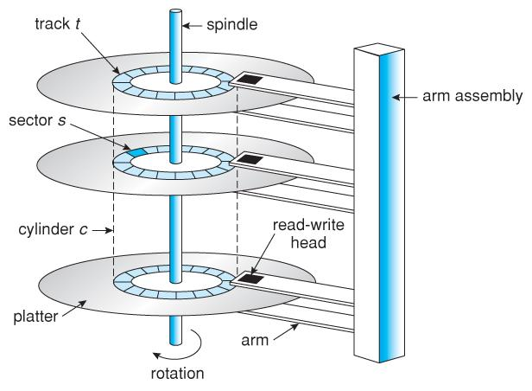
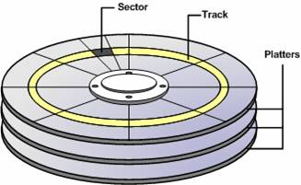
Secondary Storage
Disc Structure
Header | Data | CRC
Sector

Slide 5
Mass Storage Structures- Overview
Magnetic Disks
Disk heads "fly" over the surface on a very thin cushion of air. If they should accidentally contact the disk, then a head crash occurs, which may or may not permanently damage the disk or even destroy it completely. For this reason it is normal to park the disk heads when turning a computer off, which means to move the heads off the disk or to an area of the disk where there is no data stored.
Floppy disks are normally removable. Hard drives can also be removable, and some are even hot-swappable, meaning they can be removed while the computer is running, and a new hard drive inserted in their place.
Disk drives are connected to the computer via a cable known as the I/O Bus. Some of the common interface formats include Enhanced Integrated Drive Electronics, EIDE; Advanced Technology Attachment, ATA; Serial ATA, SATA, Universal Serial Bus, USB; Fiber Channel, FC, and Small Computer Systems Interface, SCSI.
The host controller is at the computer end of the I/O bus, and the disk controller is built into the disk itself. The CPU issues commands to the host controller via I/O ports. Data is transferred between the magnetic surface and onboard cache by the disk controller, and then the data is transferred from that cache to the host controller and the motherboard memory at electronic speeds.

Slide 6
Mass Storage Structures- Overview
Magnetic Tape
Magnetic tapes were once used for common secondary storage before the days of hard disk drives, but today are used primarily for backups.
Accessing a particular spot on a magnetic tape can be slow, but once reading or writing commences, access speeds are comparable to disk drives.
Capacities of tape drives can range from 20 to 200 GB, and compression can double that capacity.

Slide 7
Mass Storage Structures- Overview
Solid State Disc
As technologies improve and economics change, old technologies are often used in different ways. One example of this is the increasing used of solid state disks, or SSDs.
SSDs use memory technology as a small fast hard disk. Specific implementations may use either flash memory or DRAM chips protected by a battery to sustain the information through power cycles.
Because SSDs have no moving parts they are much faster than traditional hard drives, and certain problems such as the scheduling of disk accesses simply do not apply.
However SSDs also have their weaknesses: They are more expensive than hard drives, generally not as large, and may have shorter life spans.
SSDs are especially useful as a high-speed cache of hard-disk information that must be accessed quickly. One example is to store filesystem meta-data, e.g. directory and inode information, that must be accessed quickly and often. Another variation is a boot disk containing the OS and some application executables, but no vital user data. SSDs are also used in laptops to make them smaller, faster, and lighter.
Because SSDs are so much faster than traditional hard disks, the throughput of the bus can become a limiting factor, causing some SSDs to be connected directly to the system PCI bus for example.

Slide 8
Secondary Storage
Disc Structure
Q. Consider a System which has 16 plotters. Each plotter is divided into 2-Surfaces. Each Surface has 1K tracks. Each track has 512 sectors. Each Sector can store 2 KB of data.
Find the capacity of disc in bytes.
How many bits are required to identify no of sectors.
Capacity of Disk = 16*2*1*2^10*512*2*2^10 Bytes
= 2^4 * 2^11*2^9*2^11
= 2^35
= 2^5 GB
= 32 GB
ii) No of Sectors = 16 *2*2^10*2^9
= 2^4*2^11*2^9
= 2^24
24 bits requires to represent no of Sectors.

Slide 9
Secondary Storage
Disc I/O
Seek Time
Rotational Time
Transfer Time
Transfer Rate
Seek Time: Amount of Time taken to move Read/Write header from it’s current position to desire track
Rotational Time: Amount of Time taken to rotate the track when Read/Write header comes to exact position(i.e. sector). Rotational time is generally taken as ‘half Rotation time’ i.e. (1/2 Rotation)
Transfer Time: The amount of time taken to transfer the required data. Transfer time depends on the rotation rate of the disc.
Transfer Rate: The No of Bytes transferred for unit time is known as Transfer Rate.

Slide 10
Secondary Storage
Disc Structure
Q. Consider a System where average seek time is 60ns and rotation rate of the disc is 3600rpm. Each track of the disc has 1K sectors. Each sector is having the size of 512 bytes. What is the time taken to read two random sectors over the disc?
Total Seek time = 60ns+60ns = 120ns. Rotation Rate = 3600 rpm.
Rotation Time
3600 rotation 🡪 60 sec
So, 1 rotation 🡪 60/3600 sec = 1/120sec
R.T = 2*1/120 = 1/60 Sec
Now, 2^10*512 🡪 1/60 sec
1 🡪 (1/60)*(1/ 2^10*512)
2*512 🡪 1/(30*2^10) sec
Time to read 2 Random Sector = 120ns+ 1/60s + 1/(30*2^10) s
Transfer Rate
RT=1/60 s
1/60 s 🡪 512*2^10B
So, 1s 🡪 512*2^10*60B
= 2^9*2^10*2*30B
= 2^20*30B
= 30MB

Slide 11
Mass Storage Structures- Overview
Disc Scheduling
As mentioned earlier, disk transfer speeds are limited primarily by seek times and rotational latency. When multiple requests are to be processed there is also some inherent delay in waiting for other requests to be processed.
Bandwidth is measured by the amount of data transferred divided by the total amount of time from the first request being made to the last transfer being completed, ( for a series of disk requests. )
Both bandwidth and access time can be improved by processing requests in a good order.
Disk requests include the disk address, memory address, number of sectors to transfer, and whether the request is for reading or writing.

Slide 12
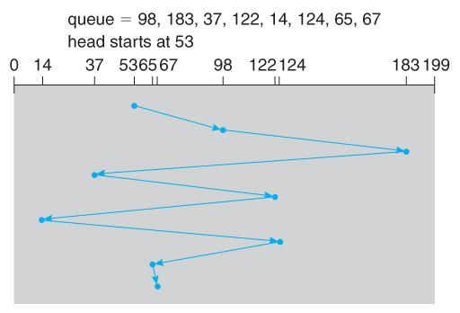
Mass Storage Structures- Overview
FCFS Scheduling
First-Come First-Serve is simple and intrinsically fair, but not very efficient. Consider in the following sequence the wild swing from cylinder 122 to 14 and then back to 124:
FCFS disk scheduling.
No of Movement made by R/W head
=(98-53)+(183-98)+(183-37)+(122-37)+(124-14)+(129-65)+(67-65) = 640

Slide 13
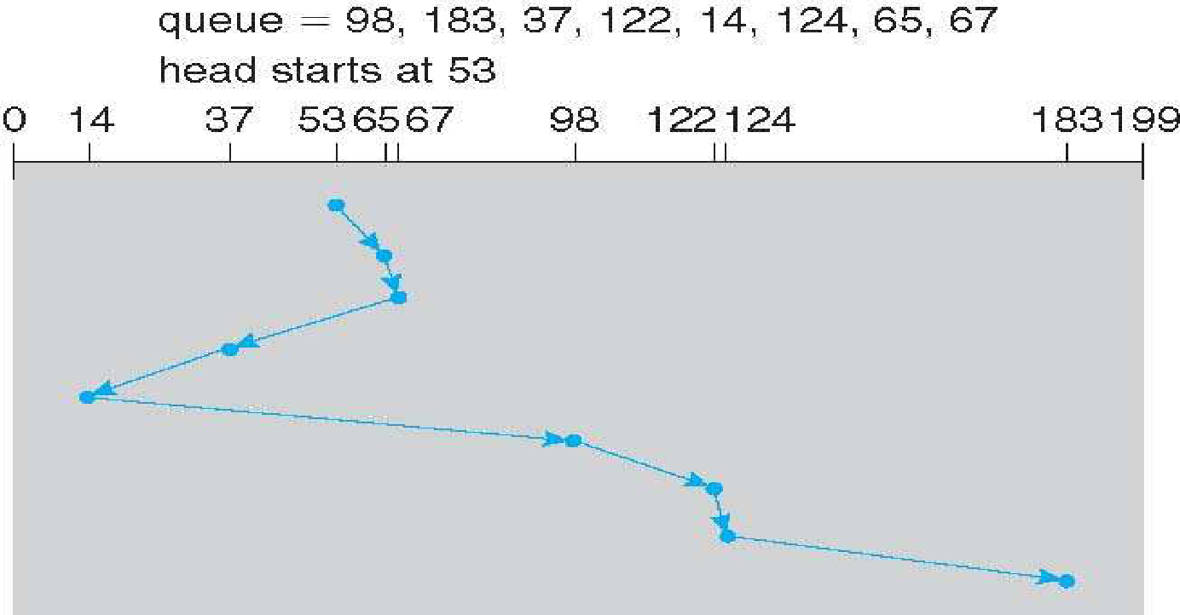
Mass Storage Structures- Overview
SSTF Scheduling
Shortest Seek Time First scheduling is more efficient, but may lead to starvation if a constant stream of requests arrives for the same general area of the disk.
SSTF reduces the total head movement to 236 cylinders, down from 640 required for the same set of requests under FCFS. Note, however that the distance could be reduced still further to 208 by starting with 37 and then 14 first before processing the rest of the requests
SSTF disk scheduling.
No of Movement made by R/W head
=(65-53)+2+(67-37)+(37-14)+(98-14)+(122-98)+(124-122)+(184-124) = 236

Slide 14
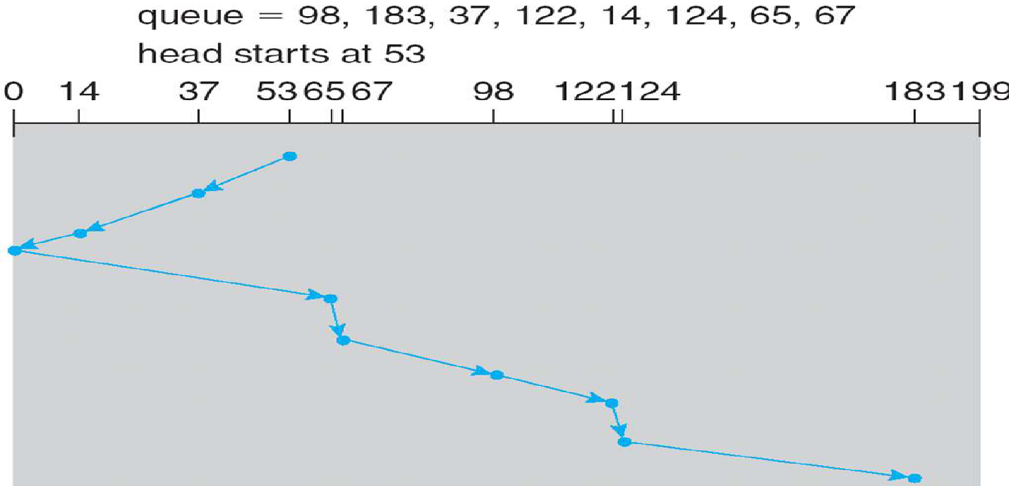
Mass Storage Structures- Overview
SCAN Scheduling
SCAN Scheduling: The disk arm starts at one end of the disk, and moves toward the other end, servicing requests until it gets to the other end of the disk, where the head movement is reversed and servicing continues.
SCAN algorithm Sometimes called the elevator algorithm
Illustration shows total head movement of 208 cylinders
But note that if requests are uniformly dense, largest density at other end of disk and those wait the longest
No of Movement made by R/W head = 208

Slide 15
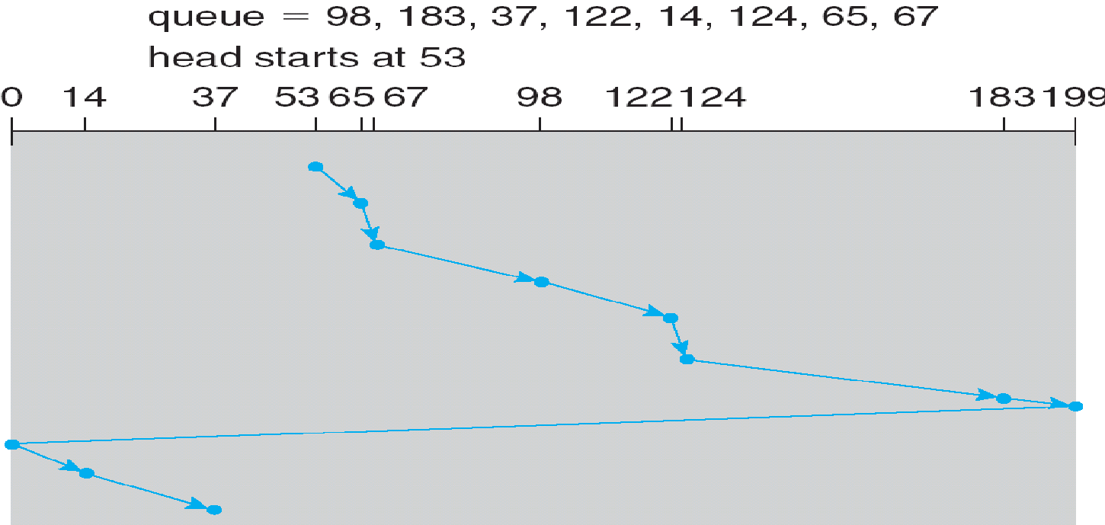
Mass Storage Structures- Overview
C-SCAN Scheduling
Provides a more uniform wait time than SCAN
The head moves from one end of the disk to the other, servicing requests as it goes
When it reaches the other end, however, it immediately returns to the beginning of the disk, without servicing any requests on the return trip
Treats the cylinders as a circular list that wraps around from the last cylinder to the first one
No of Movement made by R/W head = ?

Slide 16
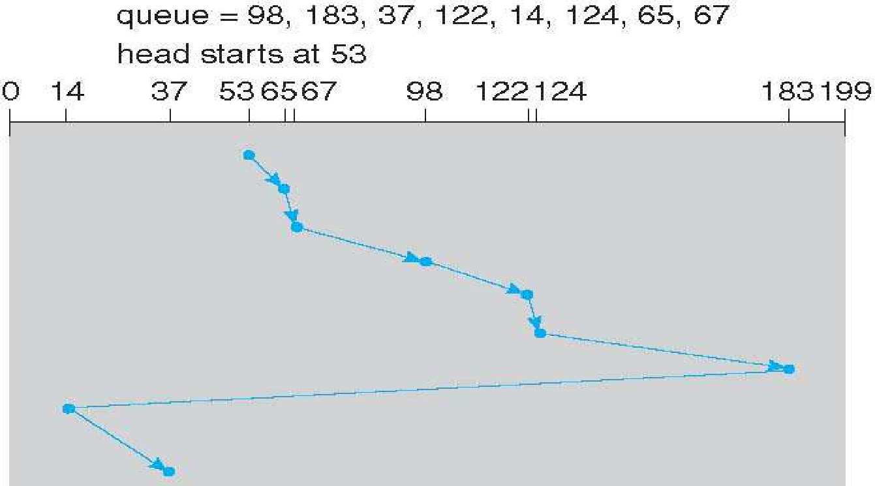
Mass Storage Structures- Overview
C-LOOK Scheduling
C-LOOK a version of C-SCAN
Arm only goes as far as the last request in each direction, then reverses direction immediately, without first going all the way to the end of the disk
No of Movement made by R/W head = 153

Slide 17
File System Concept
Objective
To explain the function of file systems
To describe the interfaces to file systems
To discuss file-system design tradeoffs, including access methods, file sharing, file locking, and directory structures
To explore file-system protection
Contiguous logical address space
Types:
Data
-numeric
-character
-binary
Program
Contents defined by file’s creator
Many types
->Consider text file, source file, executable file

Slide 18
File System Concept
Attributes
Name – only information kept in human-readable form
Identifier – unique tag (number) identifies file within file system
Type – needed for systems that support different types
Location – pointer to file location on device
Size – current file size
Protection – controls who can do reading, writing, executing
Time, date, and user identification – data for protection, security, and usage monitoring
Information about files are kept in the directory structure, which is maintained on the disk
Many variations, including extended file attributes such as file checksum
Information kept in the directory structure

Slide 19
File System Concept
File Operations
File is an abstract data type
Create
Write – at write pointer location
Read – at read pointer location
Reposition within file - seek
Delete
Truncate
Open(Fi) – search the directory structure on disk for entry Fi, and move the content of entry to memory
Close (Fi) – move the content of entry Fi in memory to directory structure on disk

Slide 20
File System Concept
Open Files
Several pieces of data are needed to manage open files: Open-file table: tracks open files
File pointer: pointer to last read/write location, per process that has the file open
File-open count: counter of number of times a file is open – to allow removal of data from open-file table when last processes closes it
Disk location of the file: cache of data access information
Access rights: per-process access mode information

Slide 21
File System Concept
Open File Locking
Provided by some operating systems and file systems Similar to reader-writer locks
Shared lock similar to reader lock – several processes can acquire concurrently
Exclusive lock similar to writer lock
Mediates access to a file
Mandatory or advisory: Mandatory – access is denied depending on locks held and requested
Advisory – processes can find status of locks and decide what to do

Slide 22
File System Concept
Open File Locking
import java.io.*;
import java.nio.channels.*;
public class LockingExample {
public static final boolean EXCLUSIVE = false;
public static final boolean SHARED = true;
public static void main(String arsg[]) throws IOException {
FileLock sharedLock = null;
FileLock exclusiveLock = null;
try {
RandomAccessFile raf = new RandomAccessFile("file.txt", "rw");
// get the channel for the file
FileChannel ch = raf.getChannel();
// this locks the first half of the file - exclusive
exclusiveLock = ch.lock(0, raf.length()/2, EXCLUSIVE);
/** Now modify the data . . . */
// release the lock
exclusiveLock.release();
// this locks the second half of the file - shared
sharedLock = ch.lock(raf.length()/2+1, raf.length(), SHARED);
/** Now read the data . . . */
// release the lock
sharedLock.release();
} catch (java.io.IOException ioe) {
System.err.println(ioe);
}finally {
if (exclusiveLock != null)
exclusiveLock.release();
if (sharedLock != null)
sharedLock.release();
}
}
}

Slide 23
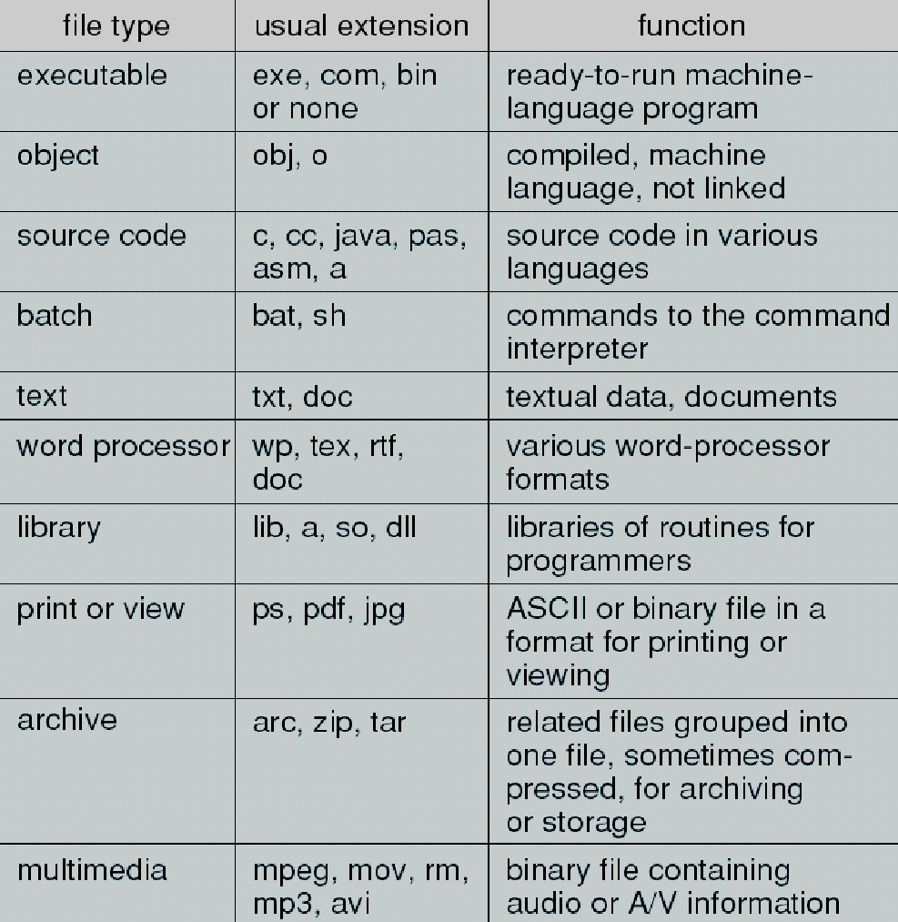
File System Concept

Slide 24
File System Concept
Open File Locking
None - sequence of words, bytes
Simple record structure
🡪Lines
🡪Fixed length
🡪Variable length
Complex Structures
🡪Formatted document
🡪Relocatable load file

Slide 25
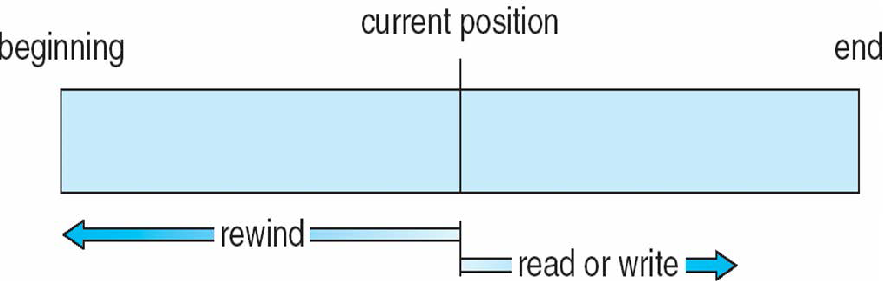
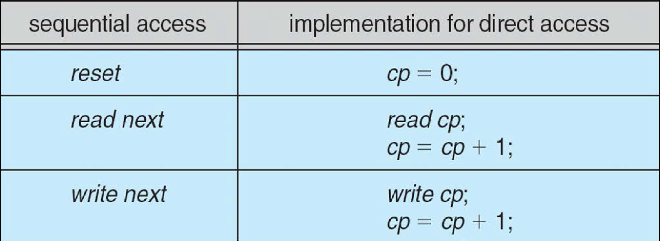
File System Concept
Sequential Access
read next
write next
reset
no read after last write
(rewrite)
Direct Access – file is fixed length logical records
read n
write n
position to n
read next
write next
rewrite n
Where n = relative block number
Relative block numbers allow OS to decide where file should be
Sequential Access File

Slide 26
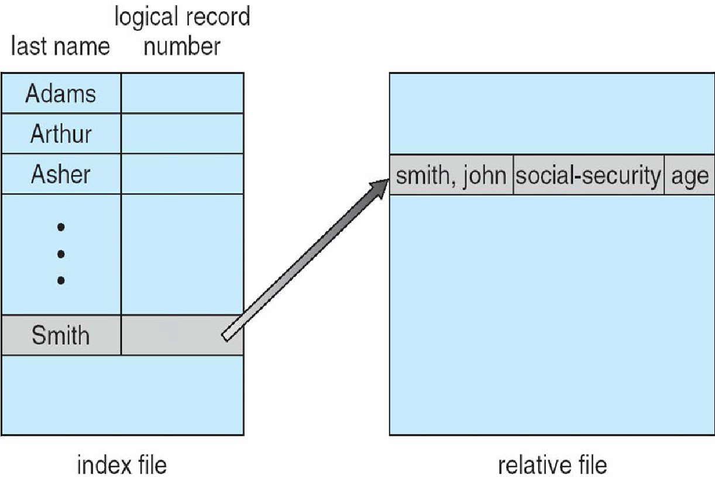
File System Concept
Can be built on top of base methods
General involve creation of an index for the file
Keep index in memory for fast determination of location of data to be operated on (consider UPC code plus record of data about that item)
If too large, index (in memory) of the index (on disk)
IBM indexed sequential-access method (ISAM) Small master index, points to disk blocks of secondary index
File kept sorted on a defined key
All done by the OS
VMS operating system provides index and relative files as another example (see next slide)
Other Access Methods
Example of Index and Relative Files

Slide 27
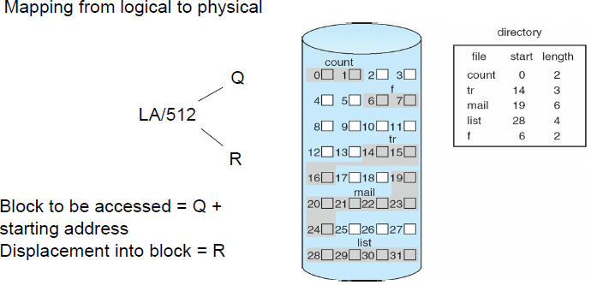
File System Implementation
Allocation Methods - Contiguous
An allocation method refers to how disk blocks are allocated for files:
Contiguous allocation – each file occupies set of contiguous blocks
Best performance in most cases
Simple – only starting location (block #) and length (number of blocks) are required
Problems include finding space for file, knowing file size, external fragmentation, need for compaction off-line (downtime) or on-line

Slide 28
File System Implementation
Allocation Methods - Extent-Based Systems (modified contiguous allocation )
Many newer file systems (i.e., Veritas File System) use a modified contiguous allocation scheme
Extent-based file systems allocate disk blocks in extents
An extent is a contiguous block of disks
🡪Extents are allocated for file allocation
🡪A file consists of one or more extents
Extents can be added to an existing file that needs space to grow. A block can be found given by the location of the first block in the file and the block count, plus a link to the first exten

Slide 29
File System Implementation
Allocation Methods - Linked allocation
Linked allocation – each file a linked list of blocks
File ends at nil pointer
No external fragmentation
Each block contains pointer to next block
No compaction, external fragmentation
Free space management system called when new block needed
Improve efficiency by clustering blocks into groups but increases internal fragmentation
Reliability can be a problem
Locating a block can take many I/Os and disk seeks
FAT (File Allocation Table) variation
Beginning of volume has table, indexed by block number
Much like a linked list, but faster on disk and cacheable
New block allocation simple

Slide 30
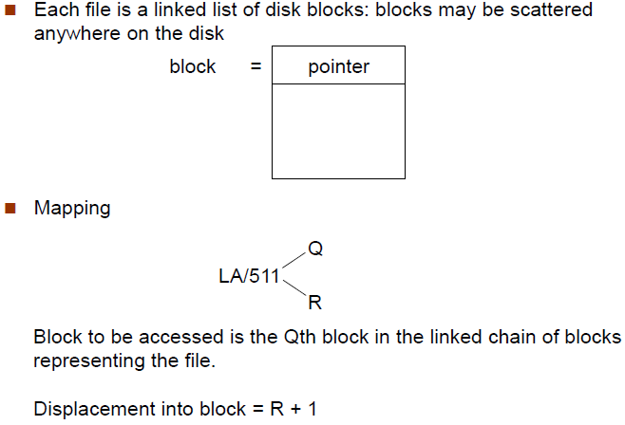
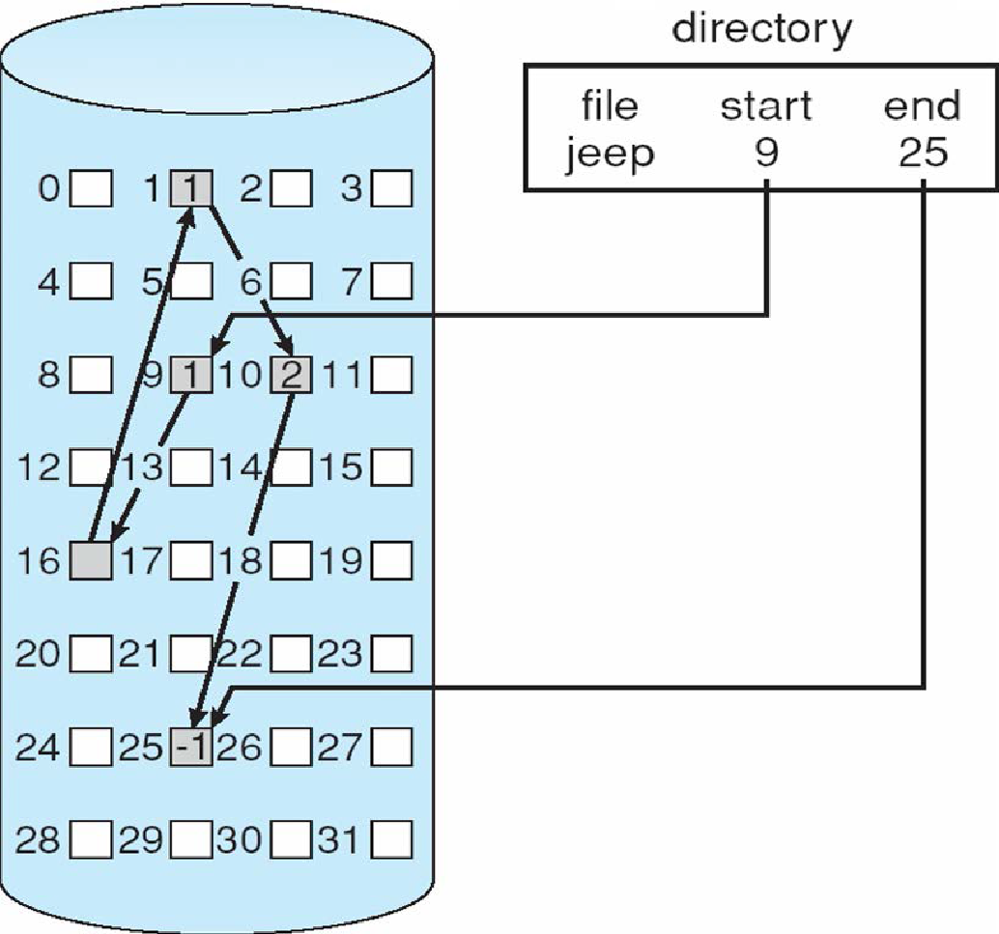
File System Implementation
Allocation Methods - Linked allocation

Slide 31
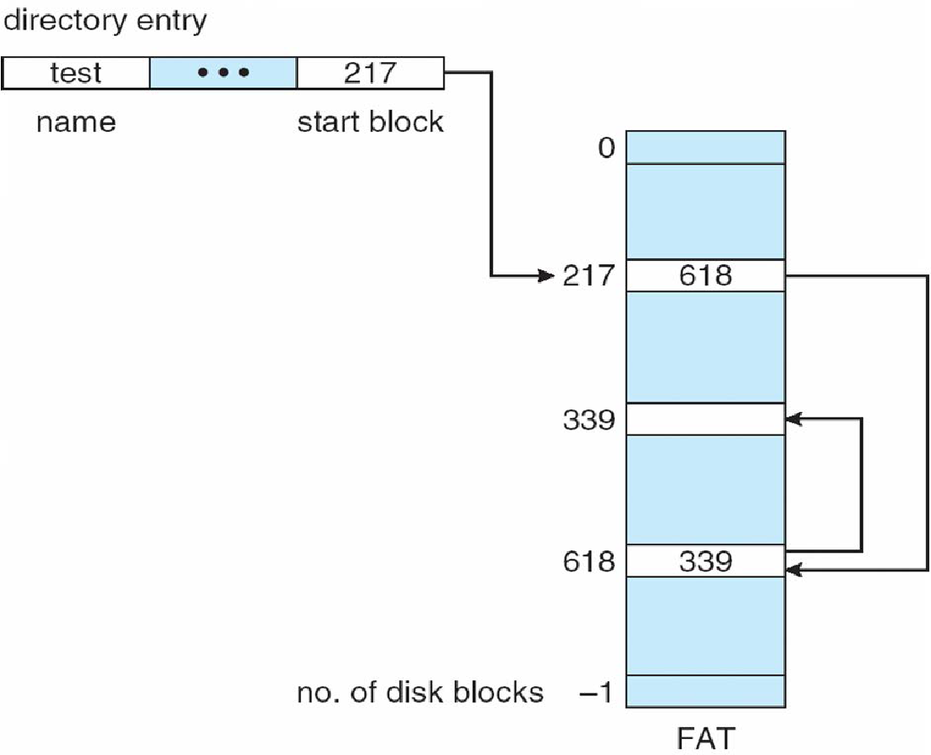
File System Implementation
File Allocation Table

Slide 32
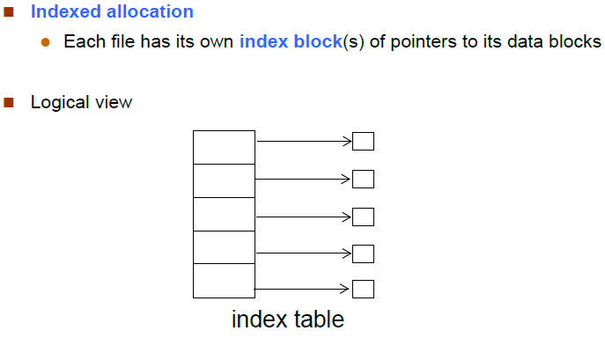
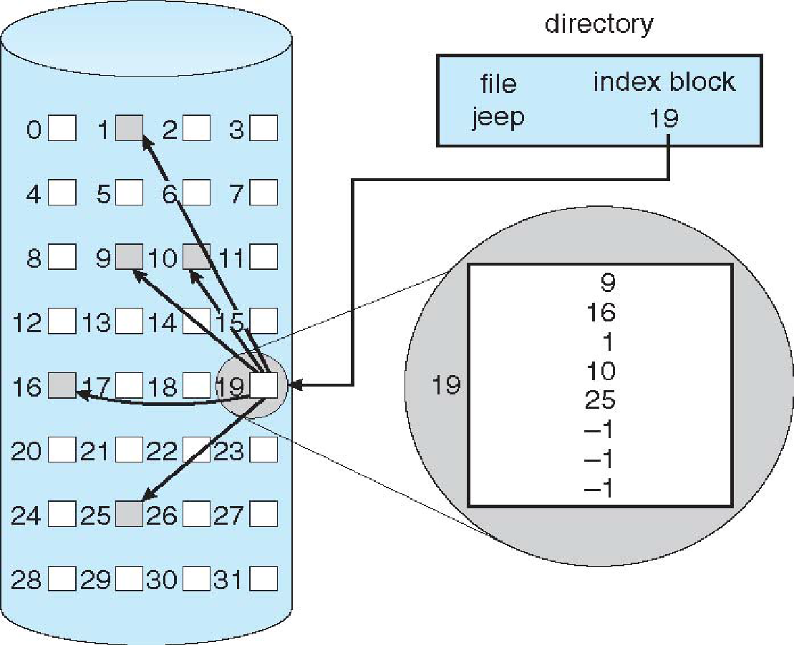
File System Implementation
Allocation Methods - Indexed

Slide 33


File System Implementation
Allocation Methods - Indexed Allocation
Need index table
Random access
Dynamic access without external fragmentation, but have overhead of index block
Mapping from logical to physical in a file of maximum size of 256K bytes and block size of 512 bytes. We need only 1 block for index table
QR Q = displacement into index table
R = displacement into block
Mapping from logical to physical in a file of unbounded length (block size of 512 words)
Linked scheme – Link blocks of index table (no limit on size)

Slide 34
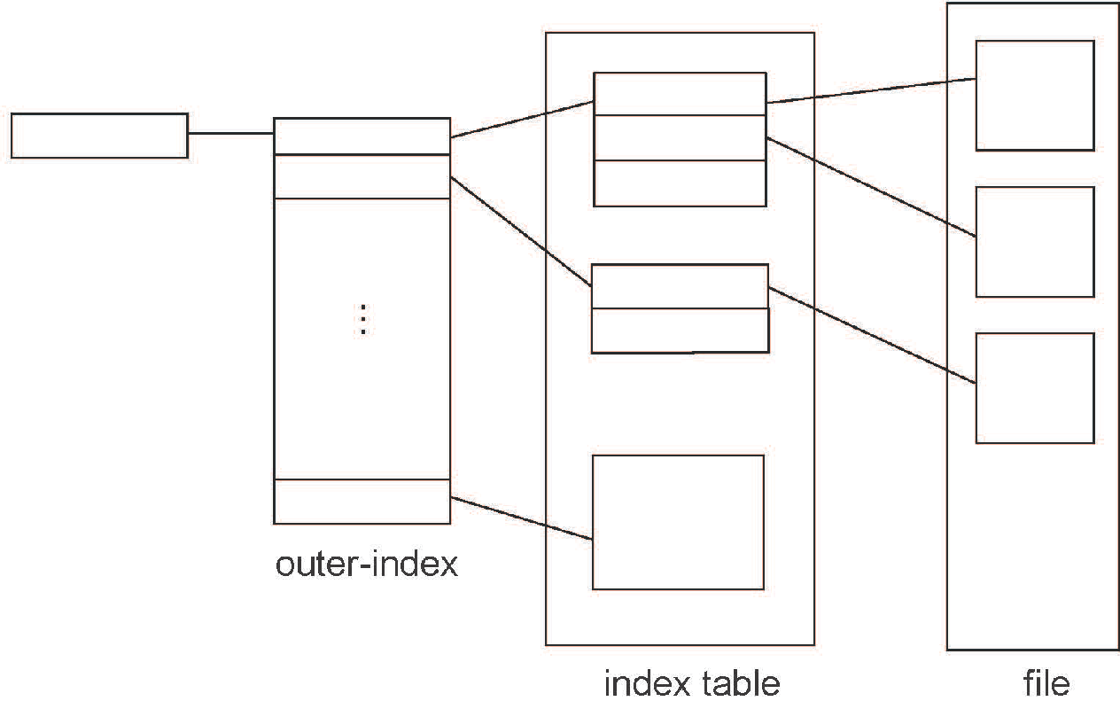

File System Implementation
Allocation Methods - Indexed Allocation
Q1 = block of index table
R1 is used as follows:
Q2 = displacement into block of index table
R2 displacement into block of file:
Indexed Allocation Mapping

Slide 35
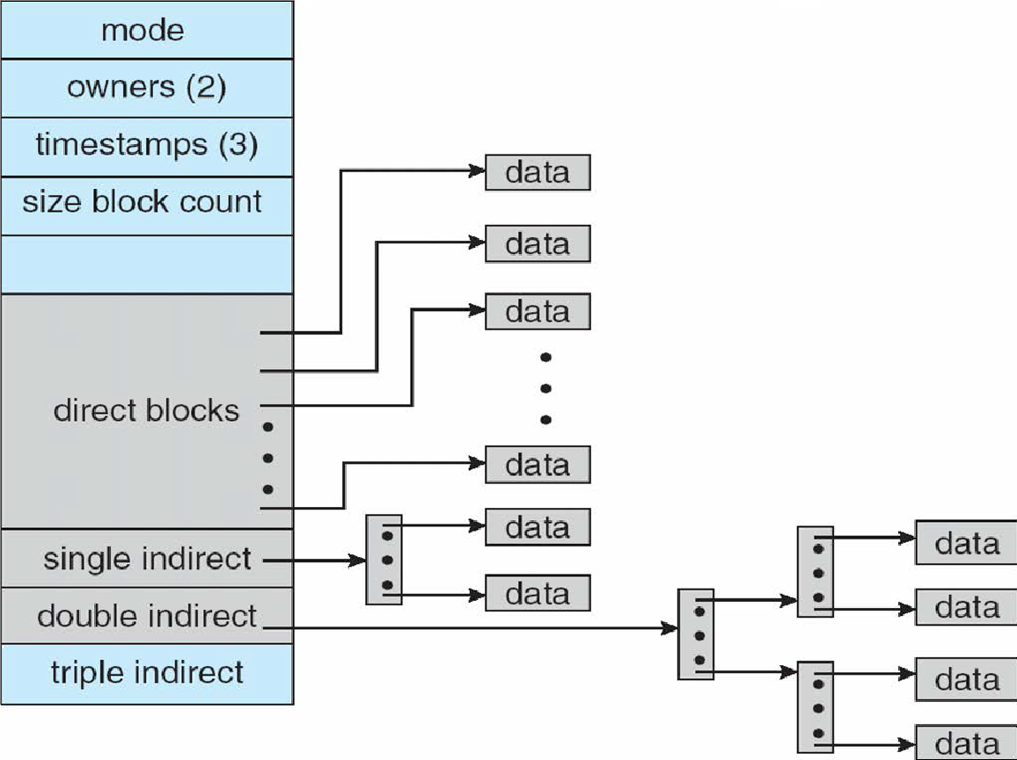
File System Implementation
Allocation Methods – Combined Scheme
4K bytes per block, 32-bit addresses
If file is small enough, use only direct blocks pointers.
If number of blocks in file is greater than the number of direct block pointers, use single, double, or triple indirect. A
Additional levels of indirection increase the number of blocks that can be associated with a file.
More index blocks than can be addressed with 32-bit file pointer

Slide 36
File System Implementation
Performance
Best method depends on file access type Contiguous great for sequential and random
Linked good for sequential, not random
Declare access type at creation -> select either contiguous or linked
Indexed more complex Single block access could require 2 index block reads then data block read
Clustering can help improve throughput, reduce CPU overhead
Adding instructions to the execution path to save one disk I/O is reasonable
🡪Intel Core i7 Extreme Edition 990x (2011) at 3.46Ghz = 159,000 MIPS http://en.wikipedia.org/wiki/Instructions_per_second
  🡪Typical disk drive at 250 I/O s per second 159,000 MIPS / 250 = 630 million instructions during one disk I/O
  🡪Fast SSD drives provide 60,000 IOPS 159,000 MIPS / 60,000 = 2.65 millions instructions during one disk I/O

Slide 37
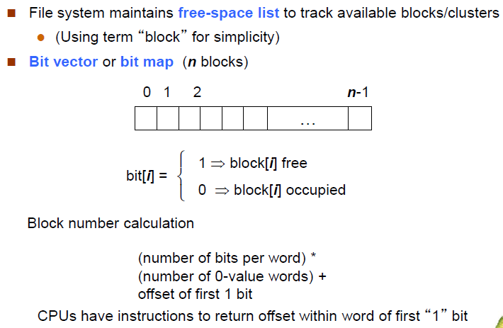
File System Implementation
Free Space Management
Bit map requires extra space
Example:
block size = 4KB = 212 bytes
disk size = 240 bytes (1 terabyte)
n = 240/212 = 228 bits (or 32MB)
if clusters of 4 blocks -> 8MB of memory
Easy to get contiguous files

Slide 38
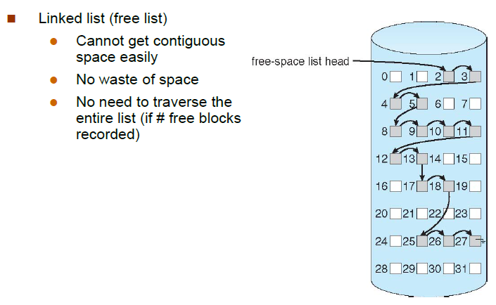
File System Implementation
Free Space Management:
Linked Free Space List on Disk

Slide 39
File System Implementation
Free Space Management:
Grouping Modify linked list to store address of next n-1 free blocks in first free block, plus a pointer to next block that contains free-block-pointers (like this one)
Counting Because space is frequently contiguously used and freed, with contiguous-allocation allocation, extents, or clustering Keep address of first free block and count of following free blocks
Free space list then has entries containing addresses and counts
Space Maps Used in ZFS
  Consider meta-data I/O on very large file systems Full data structures like bit maps couldn’t fit in memory -> thousands of I/Os
  Divides device space into metaslab units and manages metaslabs Given volume can contain hundreds of metaslabs
  Each metaslab has associated space map Uses counting algorithm
  But records to log file rather than file system Log of all block activity, in time order, in counting format
  Metaslab activity -> load space map into memory in balanced-tree structure, indexed by offset Replay log into that structure
  Combine contiguous free blocks into single entry

Slide 40
File System Implementation
Efficiency and Performance:
Efficiency dependent on: Disk allocation and directory algorithms
Types of data kept in file’s directory entry
Pre-allocation or as-needed allocation of metadata structures
Fixed-size or varying-size data structures
Performance Keeping data and metadata close together
Buffer cache – separate section of main memory for frequently used blocks
  Synchronous writes sometimes requested by apps or needed by OS No buffering / caching – writes must hit disk before acknowledgement
  Asynchronous writes more common, buffer-able, faster
Free-behind and read-ahead – techniques to optimize sequential access
Reads frequently slower than writes

Slide 41
Buffer cache : where blocks are kept under the assumption that they will be used again shortly.
page cache : cache ﬁle data using a page cache
The page cache uses virtual memory techniques to cache ﬁle data as pages rather than as ﬁle-system-oriented blocks. as accesses interface with virtual memory rather than the ﬁle system.
Several systems—including Solaris, Linux, and Windows —use page caching to cache both process pages and ﬁle data. This is known as uniﬁed virtual memory.

Slide 42
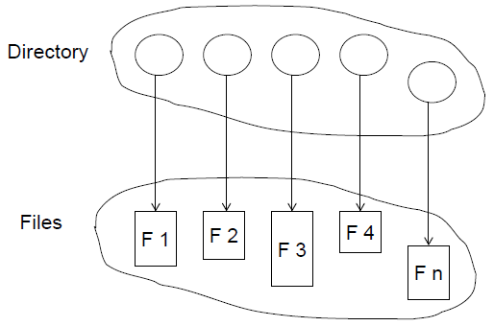
File System Concept
Directory Structure
A collection of nodes containing information about all files
Both the directory structure and the files reside on disk

Slide 43
File System Concept
Disk Structure
Disk can be subdivided into partitions
Disks or partitions can be RAID protected against failure
Disk or partition can be used raw – without a file system, or formatted with a file system
Partitions also known as minidisks, slices
Entity containing file system known as a volume
Each volume containing file system also tracks that file system’s info in device directory or volume table of contents
As well as general-purpose file systems there are many special-purpose file systems, frequently all within the same operating system or computer

Slide 44
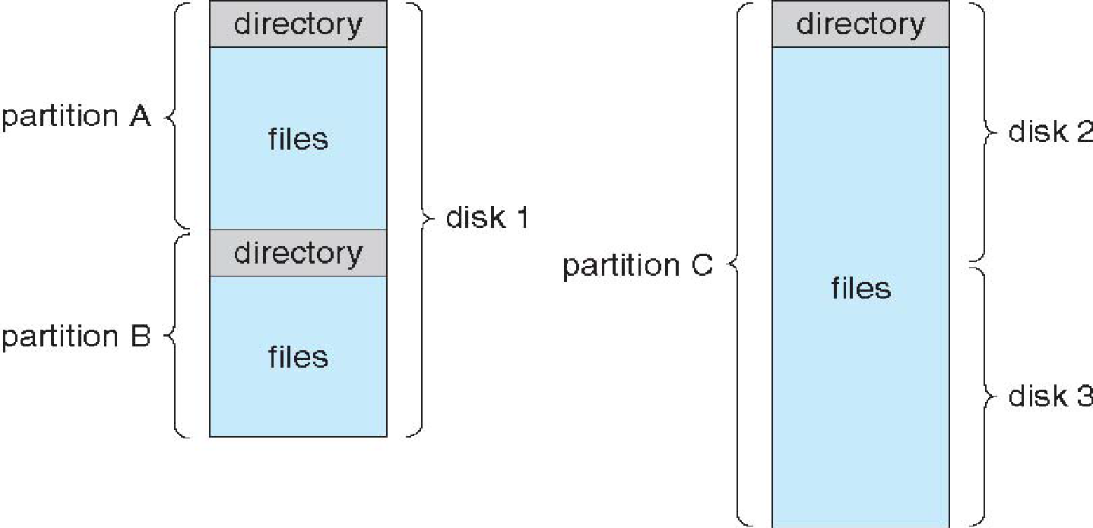
File System Concept
A Typical File-system Organization
Operation Perform on Files
Search for a file
Create a file
Delete a file
List a directory
Rename a file
Traverse the file system

Slide 45
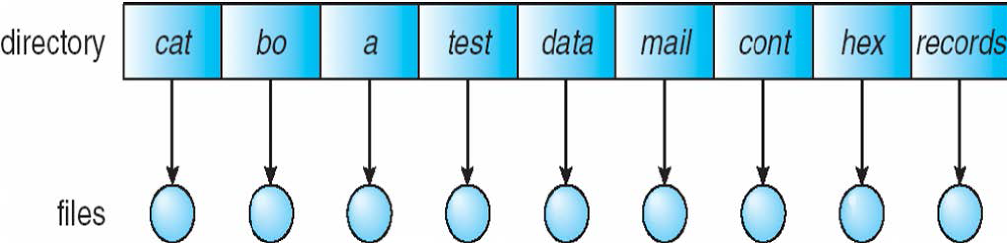
File System Concept
Directory Organization
The Directory is organized logically to obtained
Efficiency – locating a file quickly
Naming – convenient to users Two users can have same name for different files
The same file can have several different names
Grouping – logical grouping of files by properties, (e.g., all Java programs, all games, …)
A single directory for all users
Naming problem
Grouping problem

Slide 46
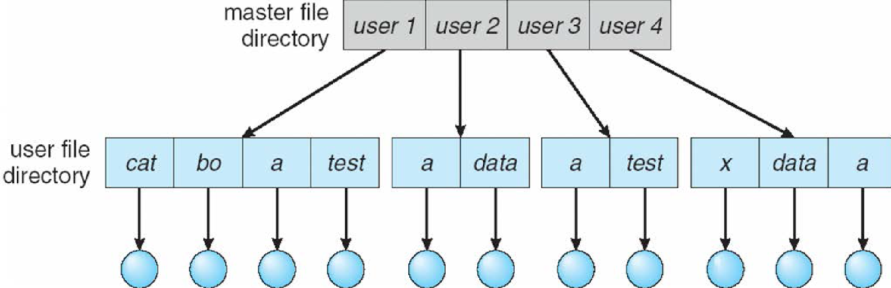
File System Concept
Directory Organization
Two Level Directory
Separate directory for each user
Path name
Can have the same file name for different user
Efficient searching
No grouping capability
when the users want to cooperate on some task and to access one another’s ﬁles ?
a user name and a ﬁle name deﬁne a path name.
Additional syntax is needed to specify the volume of a ﬁle

Slide 47
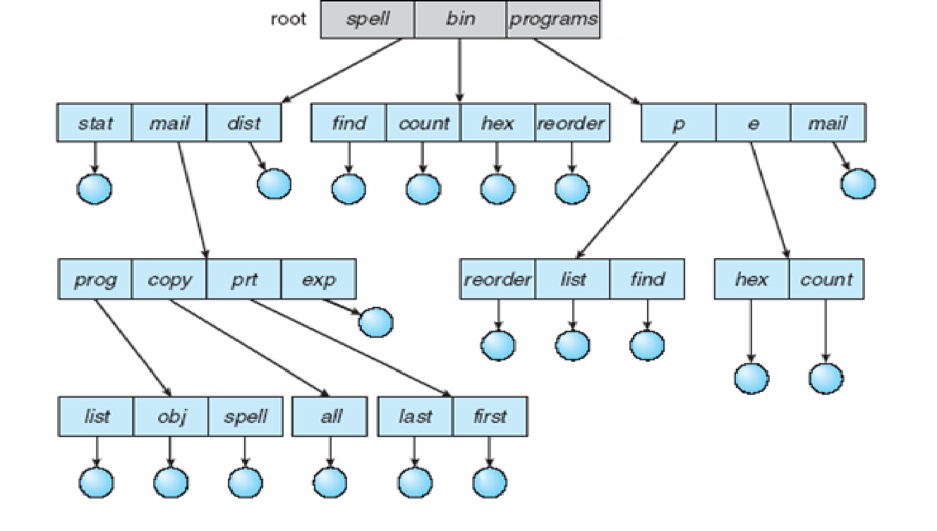
File System Concept
Directory Organization
Tree Structured Directory
  generalization is to extend the directory structure
  A directory is simply another ﬁle (One bit in each directory entry deﬁnes the entry as a ﬁle (0) or as a subdirectory (1).
  An absolute path name begins at the root and follows a path down to the speciﬁed ﬁle
  A relative path name deﬁnes a
  path from the current directory.
Allowing a user to deﬁne her own subdirectories
Efficient searching
Grouping Capability
deletion of a directory?
users can be allowed to access, in addition to
their ﬁles, the ﬁles of other users.

Slide 48
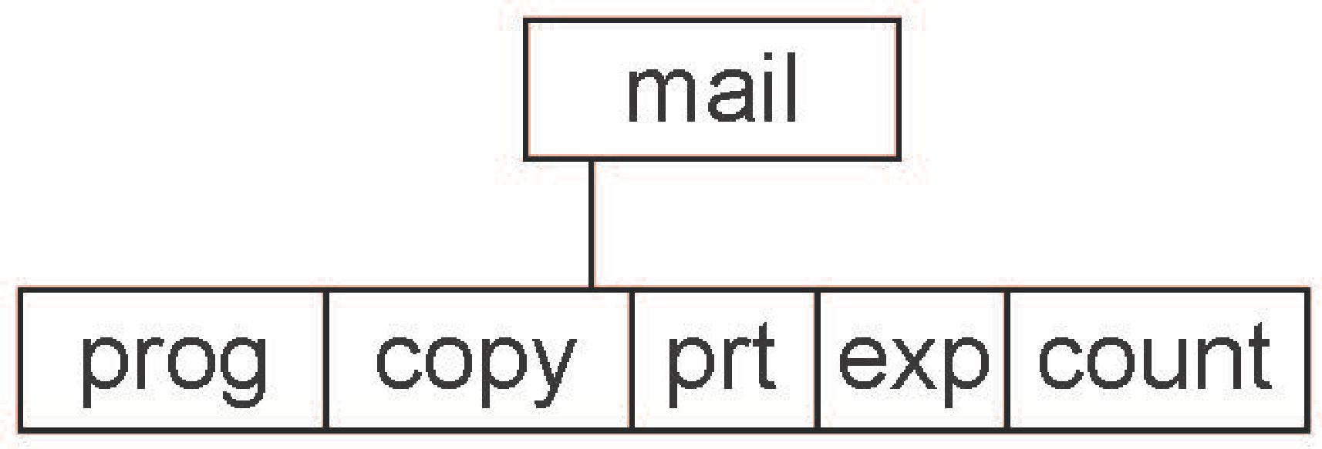
File System Concept
Directory Organization
Absolute or relative path name
Creating a new file is done in current directory
Delete a file
rm <file-name>
Creating a new subdirectory is done in current directory
mkdir <dir-name>
Example: if in current directory /mail
mkdir count
Deleting “mail” ⇒ deleting the entire subtree rooted by “mail”

Slide 49
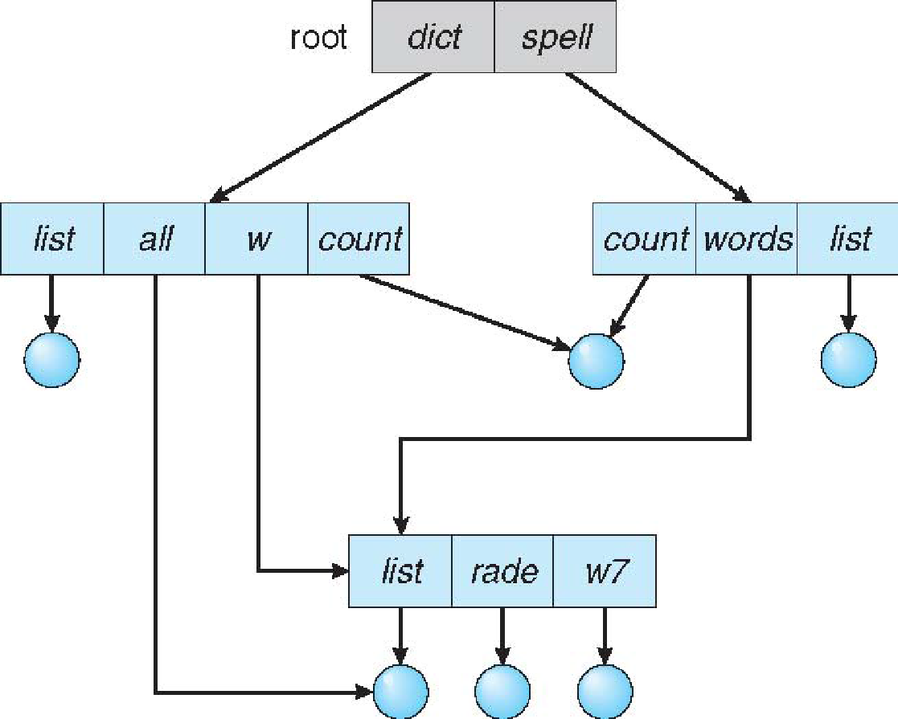
File System Concept
Directory Organization
Acyclic-Graph Directories
A shared directory or ﬁle exists in the ﬁle system in two (or more) places at once.
With a shared ﬁle, only one actual ﬁle exists, so any changes made by one person are immediately visible to the other
  Link
  duplicate all information about them in both sharing directories
A ﬁle may now have multiple absolute path names
shared ﬁle be deallocated and reused?
If dict deletes list ⇒ dangling pointer
Solutions:
  Backpointers, so we can delete all pointers
  Variable size records a problem
  Backpointers using a daisy chain organization
  Entry-hold-count solution
  New directory entry type Link –
  another name (pointer) to an existing file
  Resolve the link – follow pointer to locate the file

Slide 50
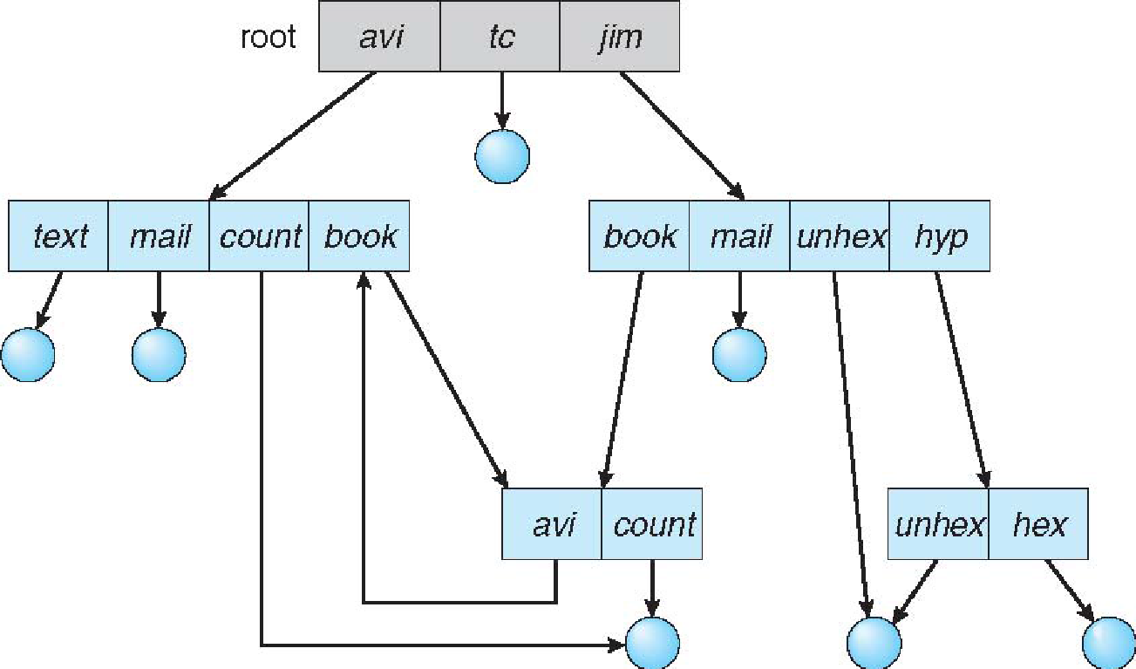
File System Concept
Directory Organization
General Graph Directories
How do we guarantee no cycles?
Allow only links to file not subdirectories
Garbage collection
Every time a new link is added use a cycle detection algorithm to determine whether it is OK

Slide 51
File System Concept
File Sharing
Sharing of files on multi-user systems is desirable
Sharing may be done through a protection scheme
On distributed systems, files may be shared across a network
Network File System (NFS) is a common distributed file-sharing method
If multi-user system User IDs identify users, allowing permissions and protections to be per-user Group IDs allow users to be in groups, permitting group access rights
Owner of a file / directory
Group of a file / directory

Slide 52
File System Concept
File Sharing
Uses networking to allow file system access between systems Manually via programs like FTP
🡪Automatically, seamlessly using distributed file systems
🡪Semi automatically via the world wide web
Client-server model allows clients to mount remote file systems from servers
🡪Client and user-on-client identification is insecure or complicated
🡪NFS is standard UNIX client-server file sharing protocol
🡪Server can serve multiple clients
CIFS is standard Windows protocol
Standard operating system file calls are translated into remote calls
Distributed Information Systems (distributed naming services) such as LDAP, DNS, NIS, Active Directory implement unified access to information needed for remote computing

Slide 53
File System Concept
File Sharing-Failure Mode
All file systems have failure modes; For example corruption of directory structures or other non-user data, called metadata
Remote file systems add new failure modes, due to network failure, server failure
Recovery from failure can involve state information about status of each remote request
Stateless protocols such as NFS v3 include all information in each request, allowing easy recovery but less security

Slide 54
File System Concept
File Sharing-Failure Mode
  Specify how multiple users are to access a shared file simultaneously
  Similar to process synchronization algorithms
  Tend to be less complex due to disk I/O and network latency (for remote file systems
Andrew File System (AFS) implemented complex remote file sharing semantics
Unix file system (UFS) implements:
  Writes to an open file visible immediately to other users of the same open file
  Sharing file pointer to allow multiple users to read and write concurrently
  AFS has session semantics
  ->Writes only visible to sessions starting after the file is closed

Slide 55
File System Concept
Protection
File owner/creator should be able to control:
->what can be done
->by whom
Types of access
Read
Write
Execute
Append
Delete
List

Slide 56
File System Implementation
File-System Structure
File-System Implementation
Directory Implementation
Allocation Methods
Free-Space Management

Slide 57
File System Implementation
Objective
To describe the details of implementing local file systems and directory structures
To describe the implementation of remote file systems
To discuss block allocation and free-block algorithms and trade-offs

Slide 58
File System Implementation
Objective
File structure
🡪Logical storage unit
🡪Collection of related information
File system resides on secondary storage (disks)
🡪Provided user interface to storage, mapping logical to physical
🡪Provides efficient and convenient access to disk by allowing data to be stored, located retrieved easily
Disk provides in-place rewrite and random access
🡪 I/O transfers performed in blocks of sectors (usually 512 bytes)
File control block – storage structure consisting of information about a file
Device driver controls the physical device
File system organized into layers

Slide 59
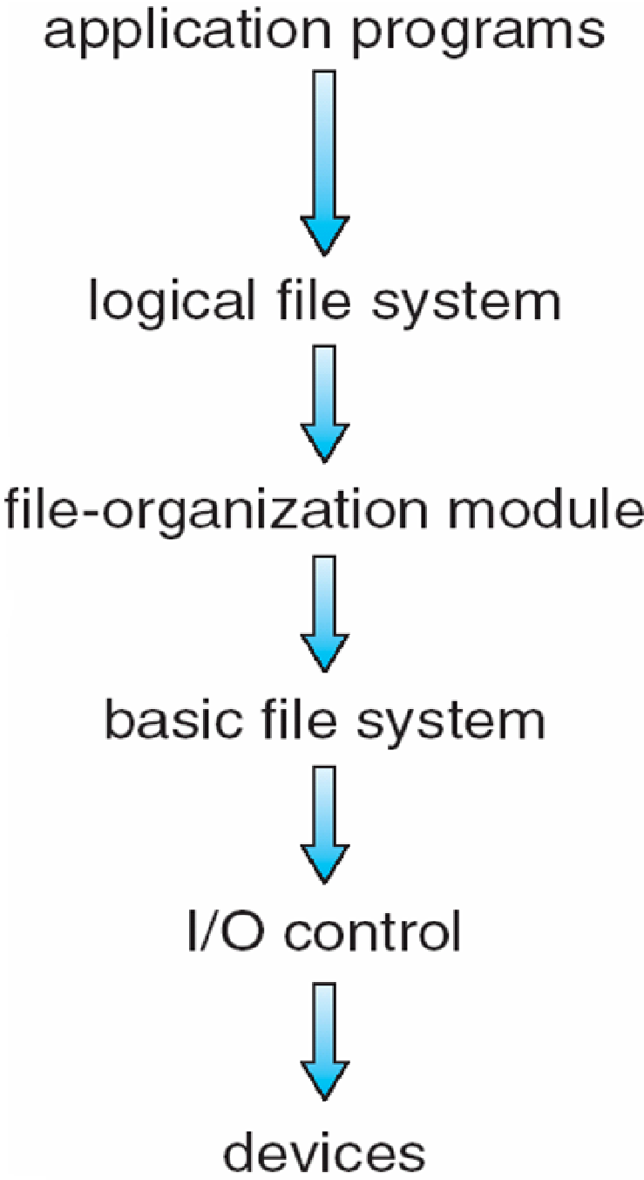
File System Implementation
Device drivers manage I/O devices at the I/O control layer 🡪Given commands like “read drive1, cylinder 72, track 2, sector 10, into memory location 1060” outputs low-level hardware specific commands to hardware controller
Basic file system given command like “retrieve block 123” translates to device driver
Also manages memory buffers and caches (allocation, freeing, replacement)
🡪Buffers hold data in transit
🡪Caches hold frequently used data
File organization module understands files, logical address, and physical blocks
🡪Translates logical block # to physical block #
🡪Manages free space, disk allocation
Layered File System

Slide 60
File System Implementation
Logical file system manages metadata information
🡪Translates file name into file number, file handle, location by maintaining file control blocks (inodes in UNIX)
🡪Directory management
🡪Protection
Layering useful for reducing complexity and redundancy, but adds overhead and can decrease performance Translates file name into file number, file handle, location by maintaining file control blocks (inodes in UNIX)
🡪Logical layers can be implemented by any coding method according to OS designer.
Many file systems, sometimes many within an operating system
Each with its own format (CD-ROM is ISO 9660; Unix has UFS, FFS; Windows has FAT, FAT32, NTFS as well as floppy, CD, DVD Blu-ray, Linux has more than 40 types, with extended file system ext2 and ext3 leading; plus distributed file systems, etc.)
New ones still arriving – ZFS, GoogleFS, Oracle ASM, FUSE
File System Layers

Slide 61
File System Implementation
We have system calls at the API level, but how do we implement their functions?
🡪On-disk and in-memory structures
Boot control block contains info needed by system to boot OS from that volume.
🡪 Needed if volume contains OS, usually first block of volume
Volume control block (superblock, master file table) contains volume details –
🡪Total # of blocks, # of free blocks, block size, free block pointers or array
Directory structure organizes the files
🡪Names and inode numbers, master file table

Slide 62
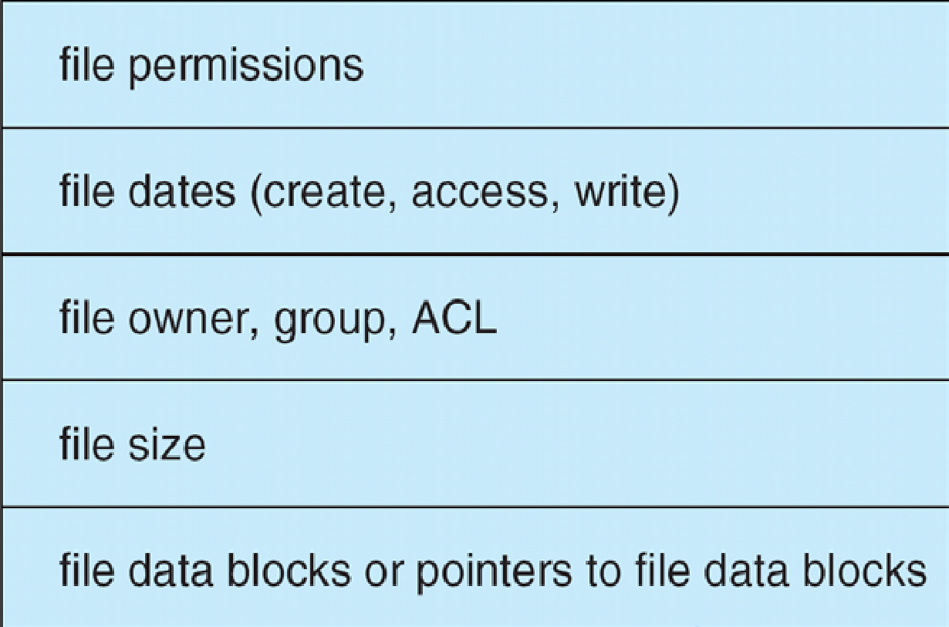
File System Implementation
Per-file File Control Block (FCB) contains many details about the file 🡪inode number, permissions, size, dates
🡪NFTS stores into in master file table using relational DB structures

Slide 63
File System Implementation
In-Memory File System Structures
Mount table storing file system mounts, mount points, file system types
The following figure illustrates the necessary file system structures provided by the operating systems
Figure 12-3(a) refers to opening a file
Figure 12-3(b) refers to reading a file
Plus buffers hold data blocks from secondary storage
Open returns a file handle for subsequent use
Data from read eventually copied to specified user process memory address

Slide 64
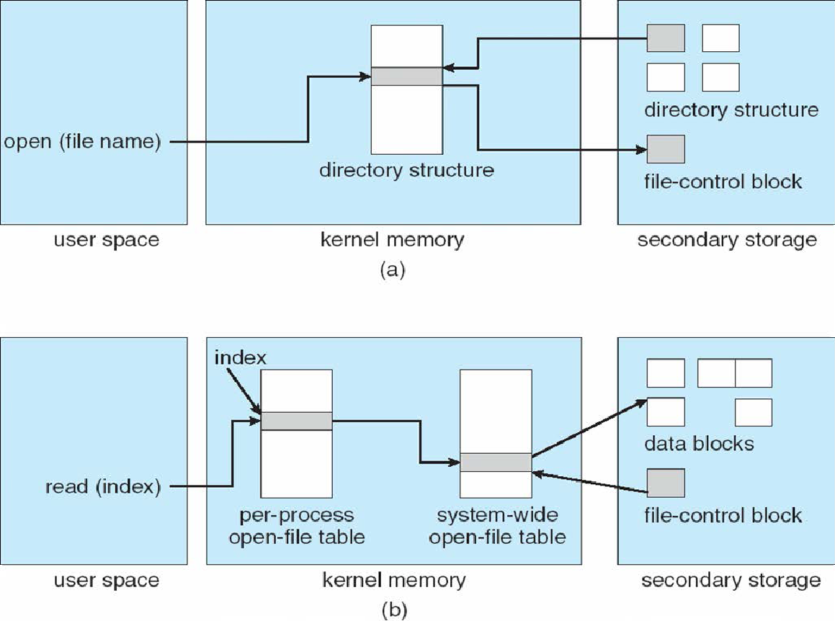
File System Implementation
In-Memory File System Structures

Slide 65
File System Implementation
Partitions and Mounting
Partition can be a volume containing a file system (“cooked”) or raw – just a sequence of blocks with no file system
Boot block can point to boot volume or boot loader set of blocks that contain enough code to know how to load the kernel from the file system Or a boot management program for multi-os booting
Root partition contains the OS, other partitions can hold other Oses, other file systems, or be raw Mounted at boot time
Other partitions can mount automatically or manually
  At mount time, file system consistency checked Is all metadata correct? If not, fix it, try again
  If yes, add to mount table, allow access

Slide 66
File System Implementation
Virtual File Systems
Virtual File Systems (VFS) on Unix provide an object-oriented way of implementing file systems
VFS allows the same system call interface (the API) to be used for different types of file systems
Separates file-system generic operations from implementation details
  Implementation can be one of many file systems types, or network file system
  Implements vnodes which hold inodes or network file details
Then dispatches operation to appropriate file system implementation routines

Slide 67
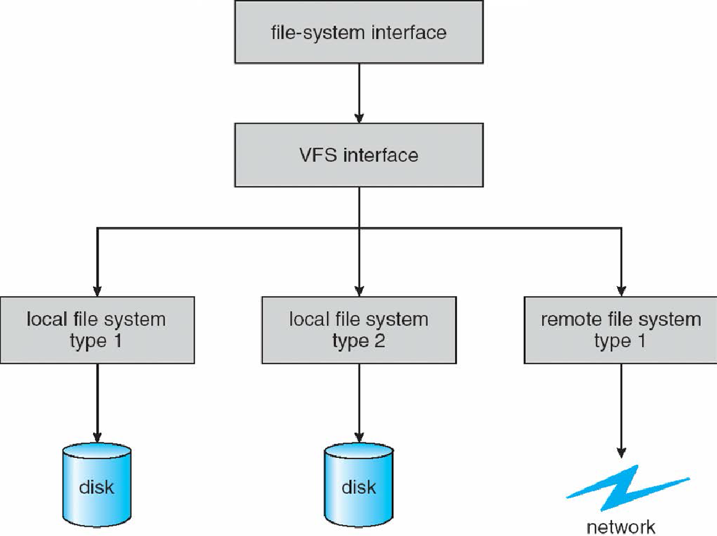
File System Implementation
Virtual File Systems
The API is to the VFS interface, rather than any specific type of file system

Slide 68
File System Implementation
Virtual File Systems
For example, Linux has four object types: inode, file, superblock, dentry
  VFS defines set of operations on the objects that must be implemented Every object has a pointer to a function table Function table has addresses of routines to implement that function on that object
  For example:
  • int open(. . .)—Open a file
  • int close(. . .)—Close an already-open file
  • ssize t read(. . .)—Read from a file
  • ssize t write(. . .)—Write to a file
  • int mmap(. . .)—Memory-map a file

Slide 69
File System Implementation
Directory Implementation
Linear list of file names with pointer to the data blocks
Simple to program
  Time-consuming to execute
  ->Linear search time
  ->Could keep ordered alphabetically via linked list or use B+ tree
Hash Table – linear list with hash data structure
Decreases directory search time
Collisions – situations where two file names hash to the same location
Only good if entries are fixed size, or use chained-overflow method

Slide 70
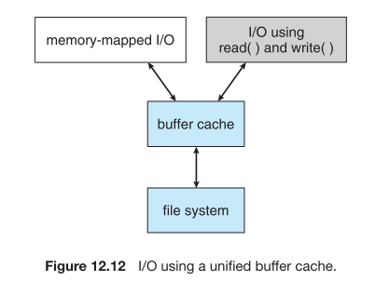
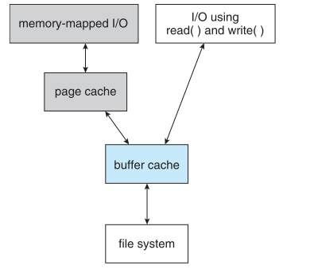
Uniﬁed buffer cache.
Opening and accessing a ﬁle : One approach is to use memory mapping; the second is to use the standard system calls read () and write ().
2) double caching, requires caching ﬁle-system data twice. Not only does it waste memory but it also wastes signiﬁcant CPU and I/O cycles due to the extra data movement within system memory. In addition, inconsistencies between the two caches can result in corrupt ﬁles.
I/O without a uniﬁed buffer cache.

Slide 71
Another issue that can affect the performance of I/O is whether writes to the ﬁle system occur synchronously or asynchronously.
  Synchronous writes occur in the order in which the disk subsystem receives them, and the writes are not buffered. Thus, the calling routine must wait for the data to reach the disk drive before it can proceed.
  In an asynchronous write, the data are stored in the cache, and control returns to the caller. Most writes are asynchronous.
However, metadata writes, among others, can be synchronous.
Operating systems frequently include a ﬂag in the open system call to allow a process to request that writes be performed synchronously. For example, databases use this feature for atomic transactions, to assure that data reach stable storage in the required order.

Slide 72
Any Question???

